Slide 1
A Surgical Skills Logbook for JMOs: A Quality Improvement initiative
Avinesh Chelliah BMed MD
Surgical SRMO, Prince of Wales Hospital
Eastern and Greater Southern Surgical Skills Training Network

Slide 2
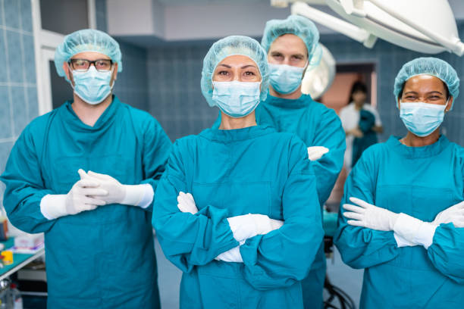
Issue: JMO education on surgical rotations is highly variable in both volume and quality.
Procedural skills require time and resources to practice
High inpatient turnover = higher administrative burden for JMOs
Operating theatre schedules for registrars and consultants
“I spent 10 weeks on surgery and only went to theatres on my last day.”

Slide 3
Intervention: A logbook of surgical skills, to help JMOs identify and attain learning goals for a surgical rotation.

Slide 4
Method:
Shortlisted skills from existing resources:
Australian Curriculum Framework for Junior Doctors, CPMEC
JDocs Framework, RACS
Essential Surgical Skills, RACS
A5 Logbook structured according to procedural and non-procedural skills
Endorsed by HETI and circulated to NSW interns via Prevocational Training Networks / JMO Managers

Slide 5
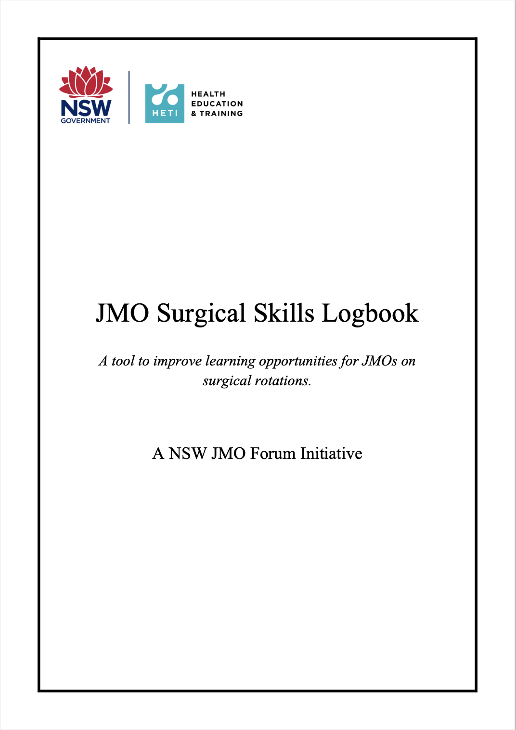
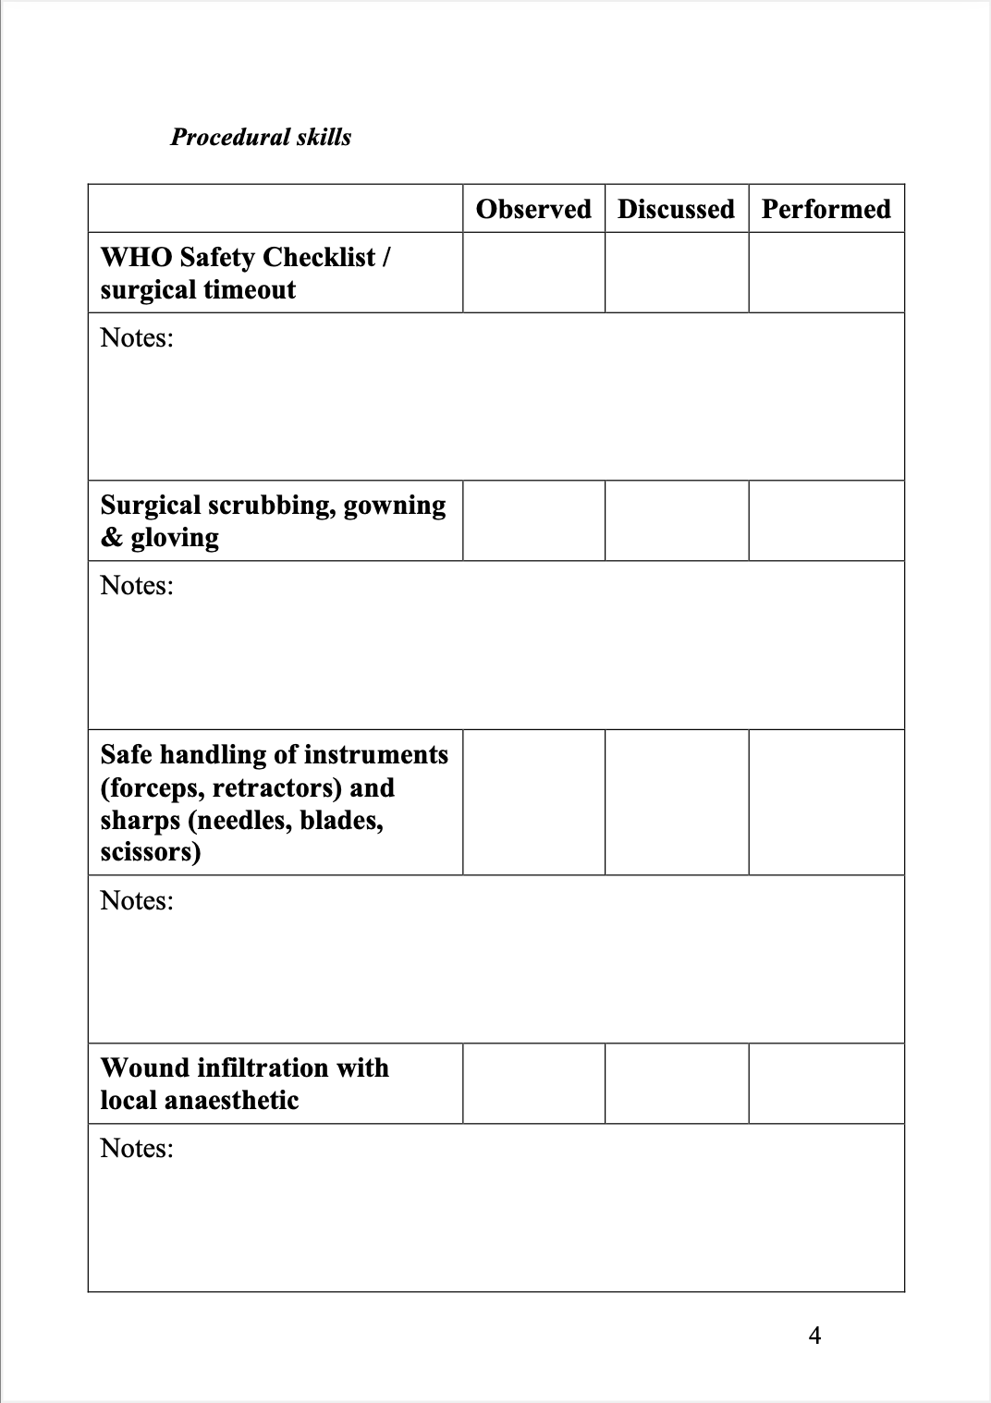
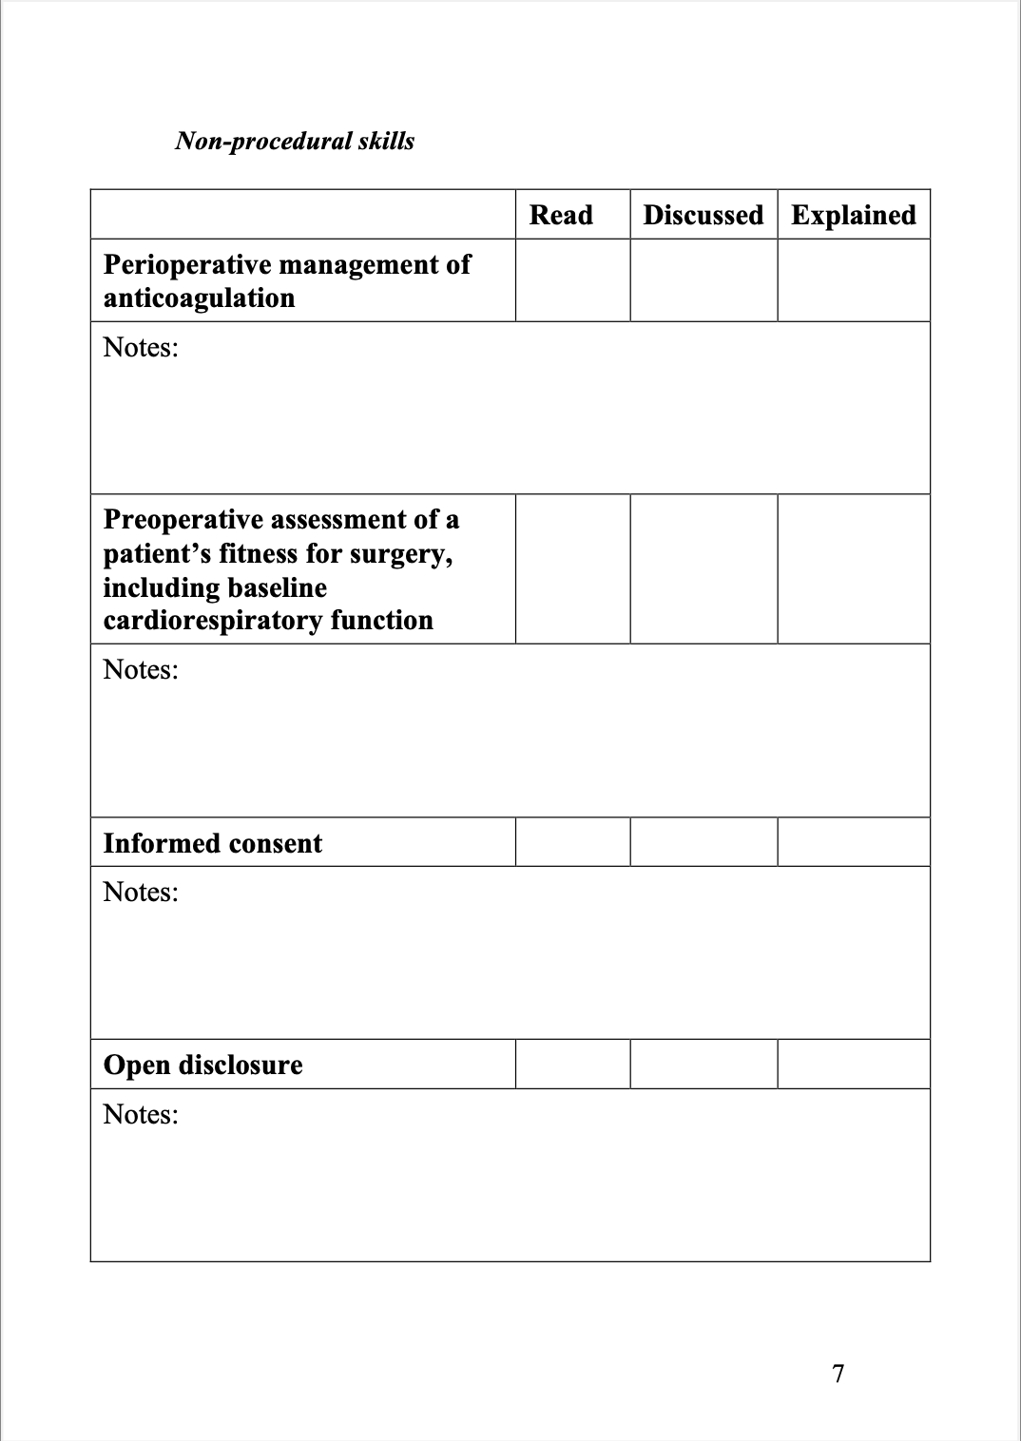

Slide 6
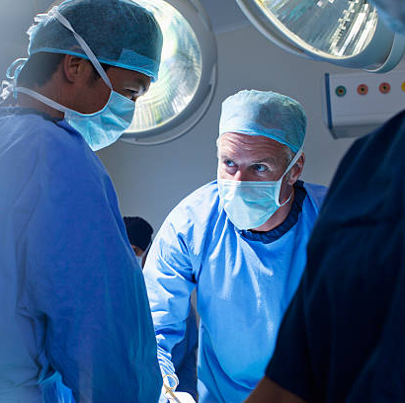
Intended Evaluation
Objective assessment of learning not feasible
Survey in Logbook linked via QR code, measuring:
Frequency of teaching
Type of teaching (level of teacher, formal vs informal)
JMO satisfaction with teaching
Confidence in surgical skills

Slide 7
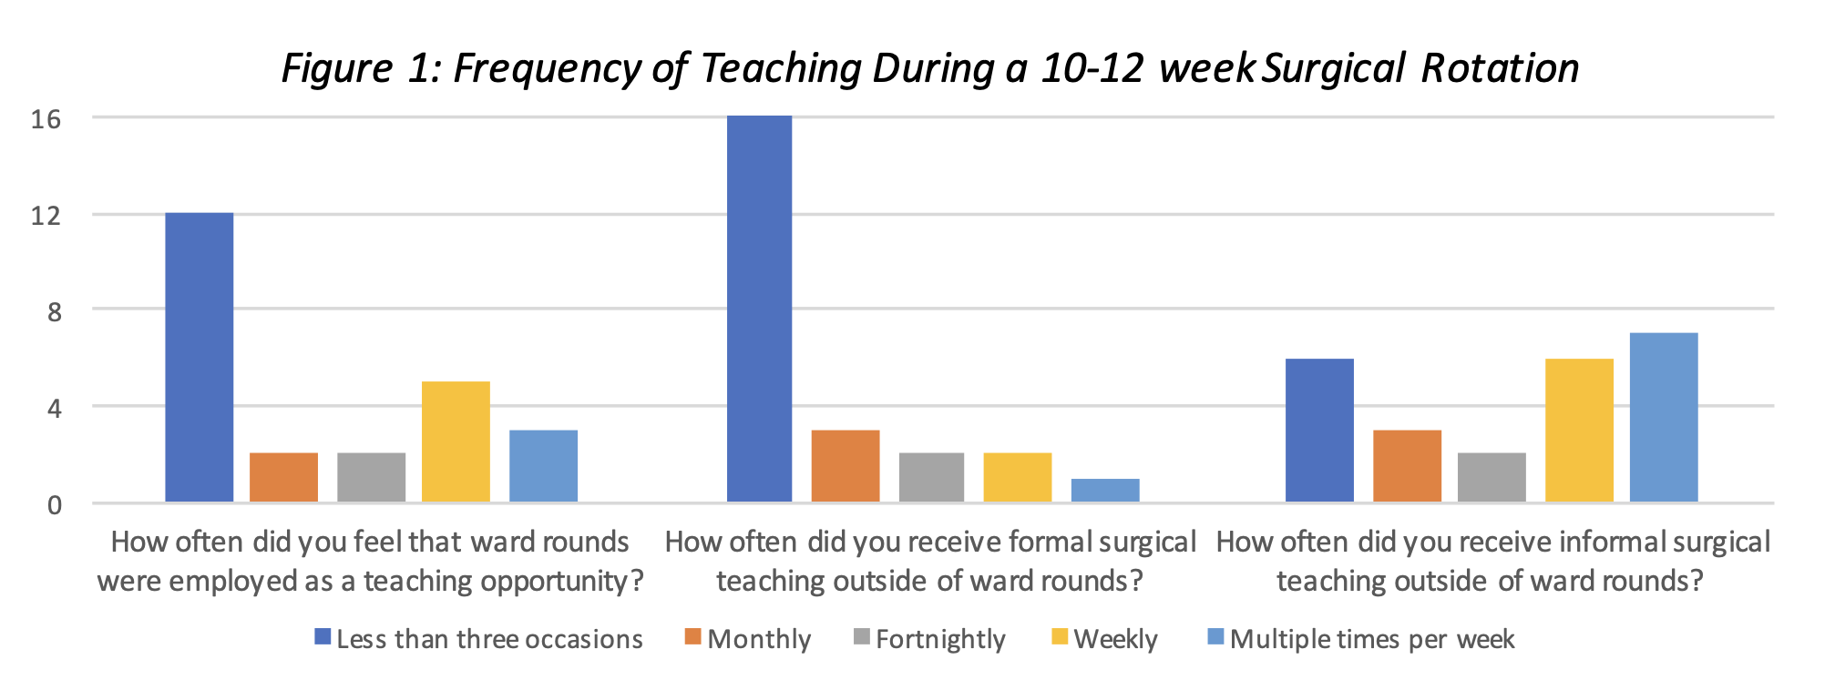

Slide 9
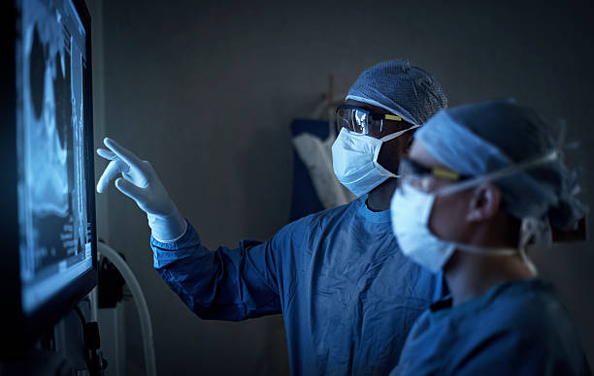
Conclusions
Survey response rates restricted the external validity and reliability of results.
Nevertheless, a logbook of learning objectives may help JMOs identify and attain learning goals during surgical rotations.
Surgical supervisors may also use the logbook to assess JMO performance and guide teaching.

