Slide 1
Sepsis
Josh Kim

Slide 2
Mrs NP
55 year old women
Background of cirrhosis from heavy alcohol use
Presented to ED with 2/52 hx of headache, vomiting
Noted to be drowsy by ambulance

Slide 3
Examination
Febrile 40.5 degrees
BP 184/102
HR 132
Sats 94% on RA
E3V2M5
Intermittently groaning and opens eyes spontaneously
Unable to verbalise or give history

Slide 4
Differentials?
Sepsis
Meningoencephalitis
Bacterial- listeria, strep pneumoniae, Neisseria meningitides
Viral- HSV1/2, VZV, enterovirus

Slide 5
Investigations
Blood cultures
Lumbar puncture- protein, glucose, bacterial MCS, Viral NAAT (enterovirus, HSV1 + 2, VZV), bacterial NAAT (listeria, neiserria meningitis, strep pnuemoniae), CSF cryptococcal antigen
CTB
Baseline bloods
EEG
Notes:
Management

Slide 6
Management
Ceftriaxone 2g BD
Benzylpenicillin 2.4g Q4hrly
Aciclovir 10mg/kg TDS
Dexamethasone 10mg IV QID for 5 days

Slide 7
Results
CSF glucose <0.1mmol/L
CSF protein 11.35 g/L
CSF
  RBC 585
  WCC 8865
  72% neutrophils
Strep pneumoniae DNA detected

Slide 8
Management
Cardiac arrest in ED
After prolonged attempt at resuscitation, decision to cease treatment

Slide 9
Mrs ML
71 year old
Presented with headache, fevers and chills
Mild dysuria
Covid-19 infection 3 weeks ago, but cleared and improved in symptoms in 1 week
BG of migraines
Otherwise well and independent

Slide 10
Examination
Alert and orientated
Febrile 39 degrees, HR 114, BP 132/74
Cardiorespiratory examination unremarkable
Abdomen soft non tender
Neuro examination- cranial nerves grossly intact
Lower + Upper limbs- power 5/5, reflexes normal
No neck stiffness/photophobia

Slide 11
Investigations
CXR- clear
eGFr>90
WCC 12
CRP 116
CT venogram- no thrombus identified. No abnormalities detected

Slide 12
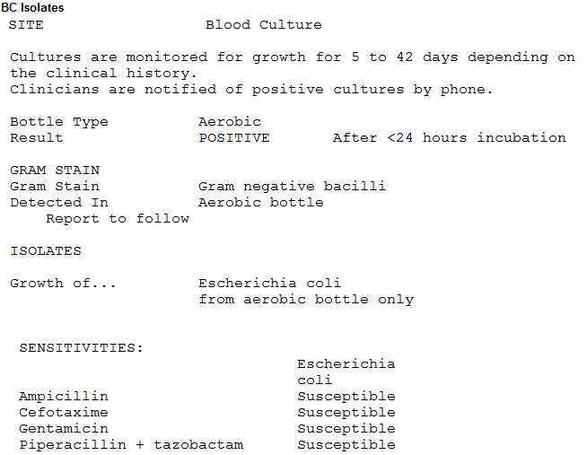
Results
Notes:
Urine MSU also confirmed same bacteria + resistance strains

Slide 13
Management
Renal US
Ampicillin + gentamicin stat dose
Treated with 72 hours IV abx and when fevers improved, discharge on additional 7 days of oral abx

Slide 14
Sepsis
Sepsis is caused when the body’s immune system becomes overactive in response to an infection, causing inflammation which can affect how well other tissues and organs work.”
Is an syndrome
  A group of body dysfunctions found together
  Dysfunctions that progress together in a predictable way
  High mortality rate, variable clinical presentations
National Institute for Health and Care Excellence Guidelines

Slide 15
SIRS
Sepsis
Severe Sepsis
Septic Shock
HR>100
RR>20
T > 38 or < 35.5 F
Abnormal WBC count
Low pCO₂
2 SIRS criteria
Infection
+
Sepsis
+
-Hypotension
-End organ damage
-Elevated lactate
Severe sepsis and persistent signs of end organ dysfunction
Mortality 50%
MORTALITY

Slide 16
Normal response to infection
Local infection
Non-specific inflammatory response
3 phases
  Vasodilation - increased blood flow to site, infusion of antibodies and cells to fight infection
  Vessel permeability - antibodies and cells exit bloodstream and enter infected tissue
  Once infection is controlled, tissue repairs itself

Slide 17
Pathophysiology of Sepsis
Uncontrolled, exaggerated immune response
Endothelium damage, cell mediator activation, disruption of coagulation system homeostasis
Vasodilation and capillary permeability
Systemic inflammatory response
End-organ damage, death
Notes:
The fundamental concept to keep in mind when discussing sepsis is that of “hemostasis,” the healthy balance of blood coagulation vs anti-coagulation. In times of normal health, our bodies produce clotting factors in the blood that are always on standby to clot whenever necessary. These factors are activated whenever the endothelium (the lining of organs and blood vessels) is disturbed or traumatized. Clotting factors are like a cache of highly unstable gun powder. Once activated, they can set off a dangerous chain-reaction of clotting everywhere. This potential is kept in check by anticoagulating factors also present in healthy blood.
In sepsis, infecting organisms cause direct trauma to endothelium, and the body also suppresses or depletes the supply of available anticoagulating fators. A perfect storm of intravascular coagulation occurs everywhere in the body, most notably in the most delicate microvascular system. This leads to hypoperfusion and clinical exam findings of “end-organ injury.” The endothelium continues to malfunction, resulting in loss of blood vessel wall motor tone, which leads to hypotension, as well as leaky blood vessels, which leads to edema in the lungs, brain, and soft tissues.

Slide 18

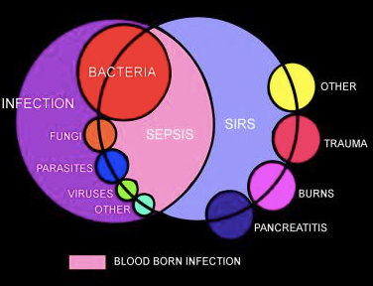
Notes:
There are multiple infectious causes of sepsis. There are multiple triggers for SIRS. Once you identify SIRS, you must look for the trigger. Infection from any type of germ (bacteria, virus, fungi, etc) is possible. As shown in the Venn diagram above, conditions other than infection can result in SIRS (trauma, burns, pancreatitis, etc.).

Slide 19
Risk Factors
Extremes of age (old and young)
  Can’t communicate, need careful assessment
  Patients with developmental delay
  Cerebral Palsy
Recent surgery, invasive procedure, illness, childbirth/pregnancy termination/miscarriage
Reduced immunity

Slide 20
Increased Risk for sepsis
Diabetes
Liver cirrhosis
Autoimmune diseases (lupus, rheumatoid arthritis)
HIV/AIDS
Sickle cell disease
Splenectomy patients
Compromised skin (chronic wounds, burns, ulcers)
Post-organ transplant (bone marrow, solid organ), chemotherapy
Chronic steroid use
Indwelling catheters of any kind (dialysis, Foley, IV, PICC, PEG tubes, etc)

Slide 21
Exposures
Travel History
Sexual History
Occupational/ Recreational activities
Close contacts
Notes:
3 most common infections to exclude from Thailand for instance- dengue, malaria, typhoid

Slide 22
Organism virulence
Encapsulated organisms
Klebsiella pneumoniae
Endotoxin
Notes:
Strep pnuemoniae, Neisseria, haemophilus influenza
Endoxtoxin- toxic shock, strep, staph, clostridium difficile

Slide 23
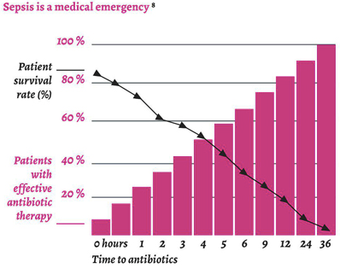
(Crit Care Med 2006;34[6]:1589.)

Slide 24
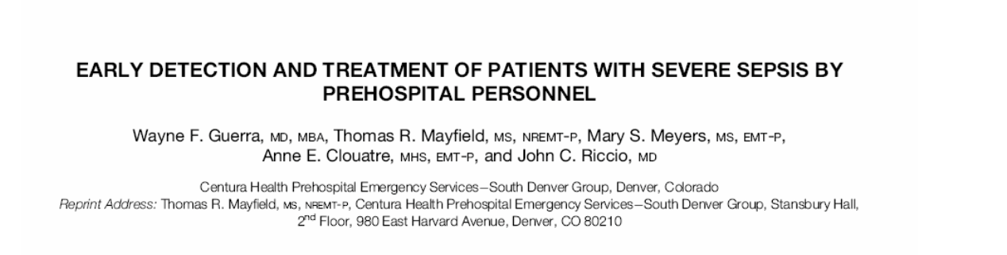
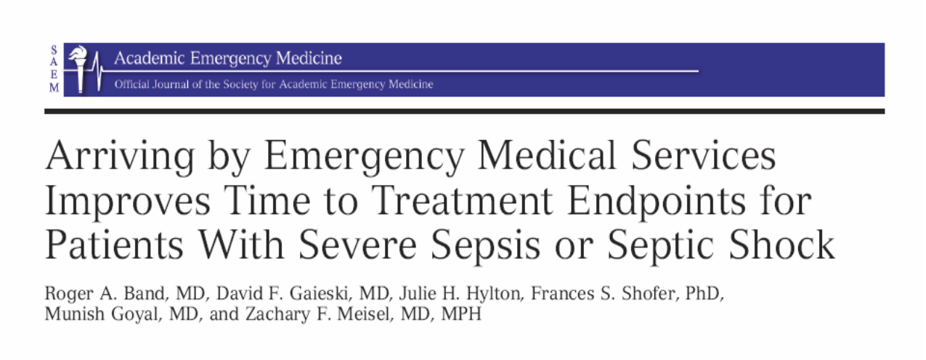

Slide 25
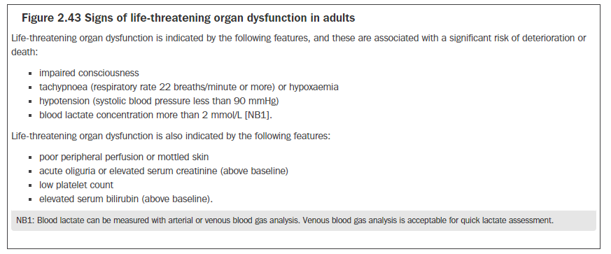

Slide 26
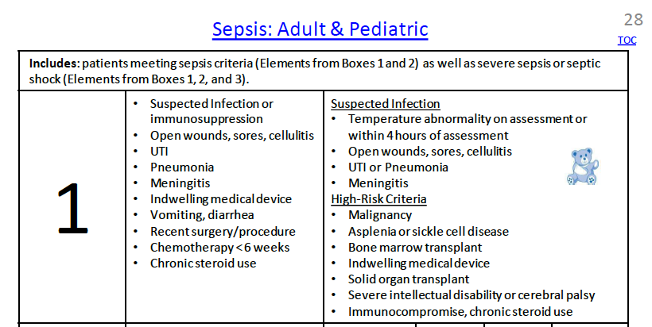

Slide 27
62 year old male in Oncology ward
Rapid response- found to be clammy, confused
Hypotensive, febrile
Mildly hypoxic but bedside CXR clear
Urine- has SPC which is cloudy
Has a port in situ as receives chemotherapy
Treatment??

Slide 28
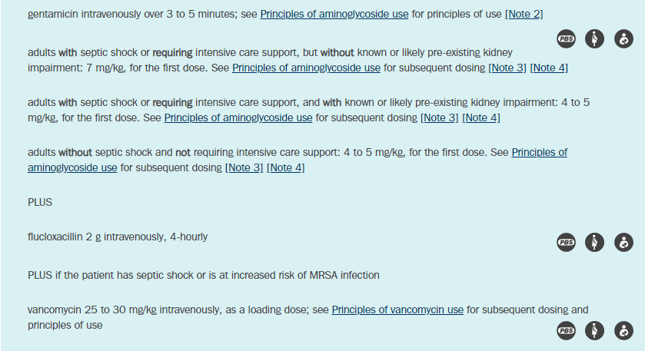

Slide 29
82 year old male
From home alone
Worsening SOB + cough
Hypoxic to 84% on RA
RR 26
Differential + Empirical treatment?

Slide 30
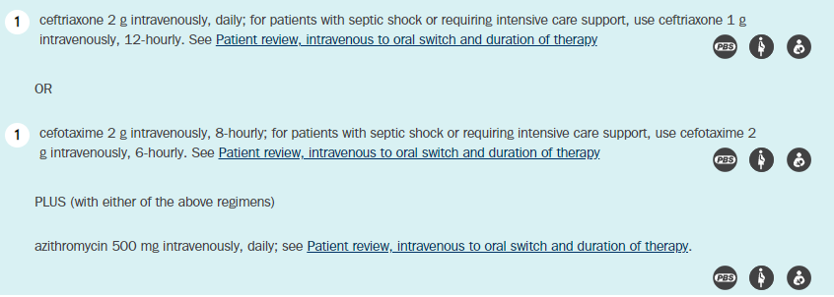
What if this person had recently come back from a holiday in Darwin??
Notes:
Instead of ceftriaxone would add Meropenem 1g daily to cover for .Bulkohlderia pseudomallei and A. baumannii are important causes of high-severity CAP.
Wet seasons

Slide 31
Mr JA
47 year old male
Advanced HIV infection- diagnosed at POWH incidental finding whilst under cardiology for AF with RVR on b/g of AVR
CD4 count 10, HIV viral load 6170000 copies/ml
Commenced on Biktarvy, PJP prophylaxis as outpatient
Admitted with AKI, and episode of melena

Slide 32
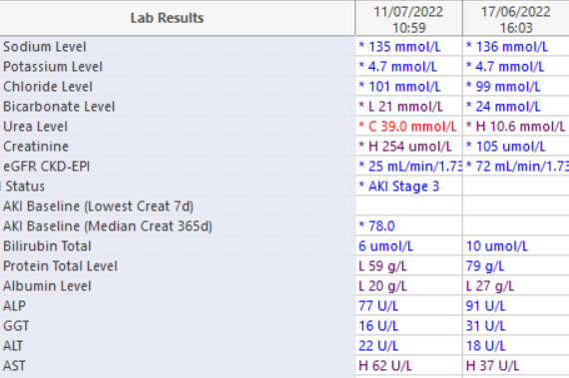
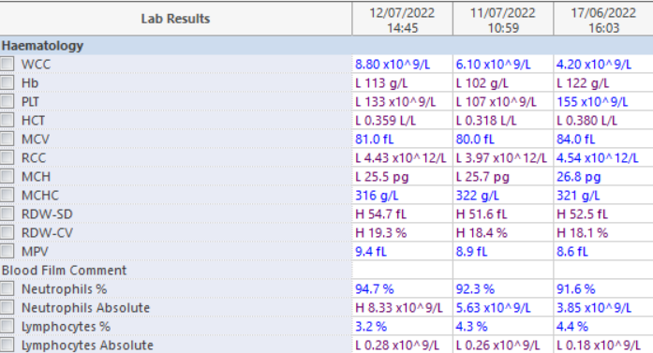


Slide 33
Overnight
CODE BLUE
Episode of malaena
Hypoxic, hypotensive
Differential diagnosis ?
Management ?

Slide 34
Progress
Vitamin K given after Haem advice
Rapid response on ward –large volume melaena with hypotension
Gastro, cardio, haematology consulted
Transferred to HDU
Noted hypoxia- on 2L oxygen at the time

Slide 35
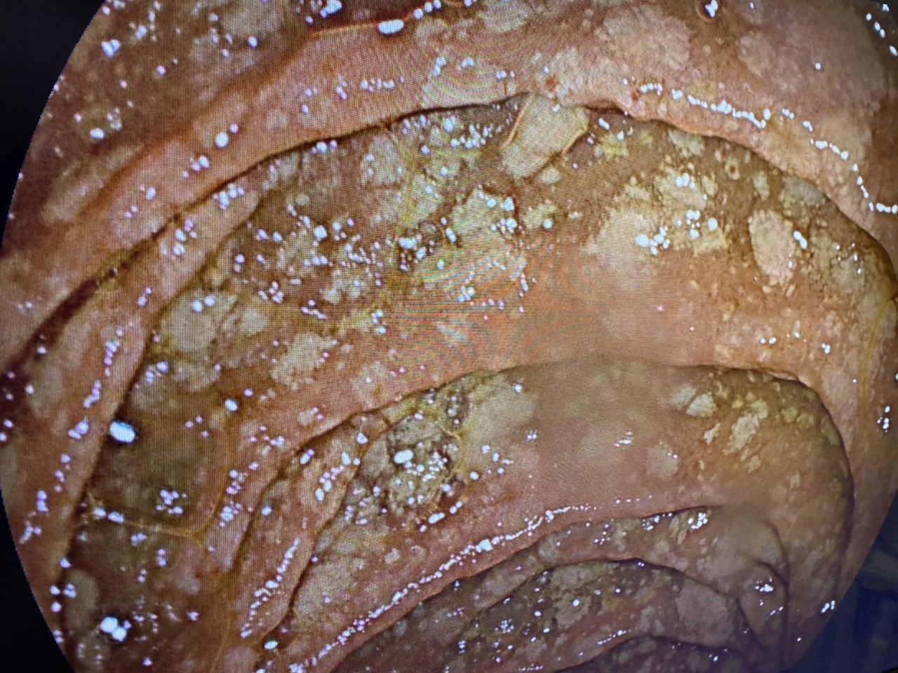

Slide 36
Impression
Advanced HIV infection - new diagnosis 2022 (CD4 10, on Biktarvy)
Dilated cardiomyopathy, metallic AVR
Acute kidney injury
  Multifactorial, improving
Severe ulcerative oesophagitis
  Evidence of candidiasis on endoscopy; co-existing pathology probable (including CMV, HSV)
Type 1 respiratory failure
  Requiring NIV
  Reported non-productive cough "for weeks", weight loss
Pancytopenia

Slide 37
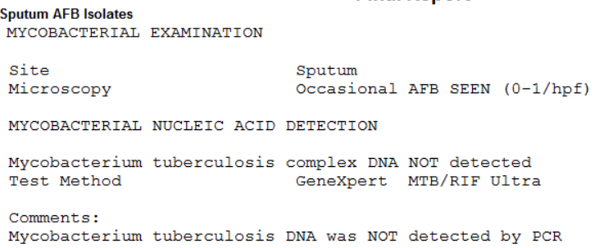
Progress

Slide 38
MAC Treatment
Hydrocortisone IV 100mg QID
Rifabutin 300mg daily
Ethambutol 15mg/kg 48hrly
Azithromycin 500mg daily
Amikacin 10mg/kg stat dose

Slide 39
Learning Points
Recognise early signs of sepsis
Blood cultures + microbiological diagnosis important
Commence empiric antibiotics asap
Remember to ask for help! If JMO, Registrar, AT, fellow… or even as a consultant

Slide 40
Questions?

Slide 41
