Slide 1
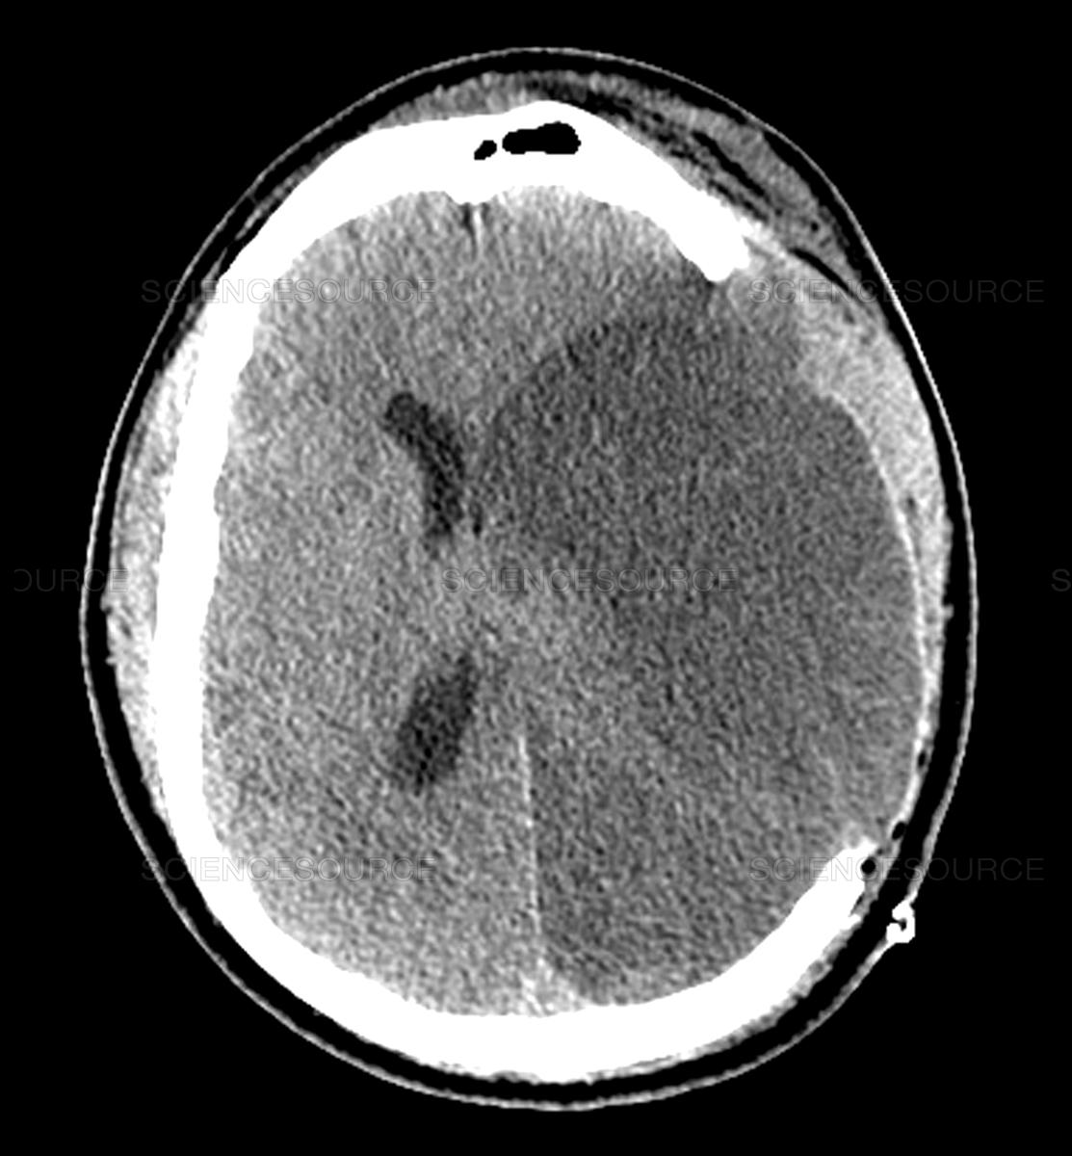
A Quick Guide to Stroke Codes
Ike Leon Chen
Stroke Advanced Trainee
Prince of Wales Hospital

Slide 2
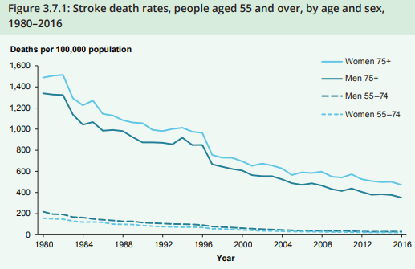
Why have stroke codes?
Prevalence: 1.7%
Incidence: 1.3 per 1000 population (2015 data)
Death rates have dropped by 74% between 1980 and 2016
Every minute a large vessel ischemic stroke is untreated, the average patient loses 1.9 million neurons, 13.8 billion synapses and 12km of axonal fibers
Every 15mins reduction in time to thrombolysis increases the odds of walking independently after leaving hospital (4%) or going home versus NH (3%) and reduces risk of inpatient death (4%) and brain haemorrhage (4%).

Slide 3
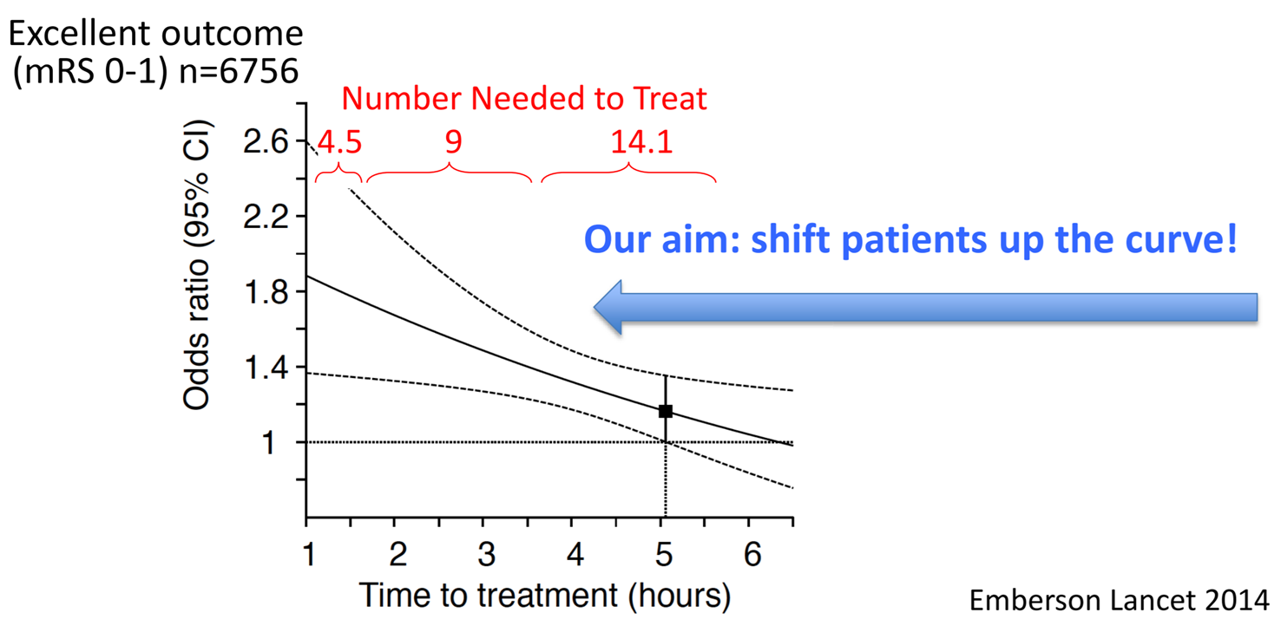
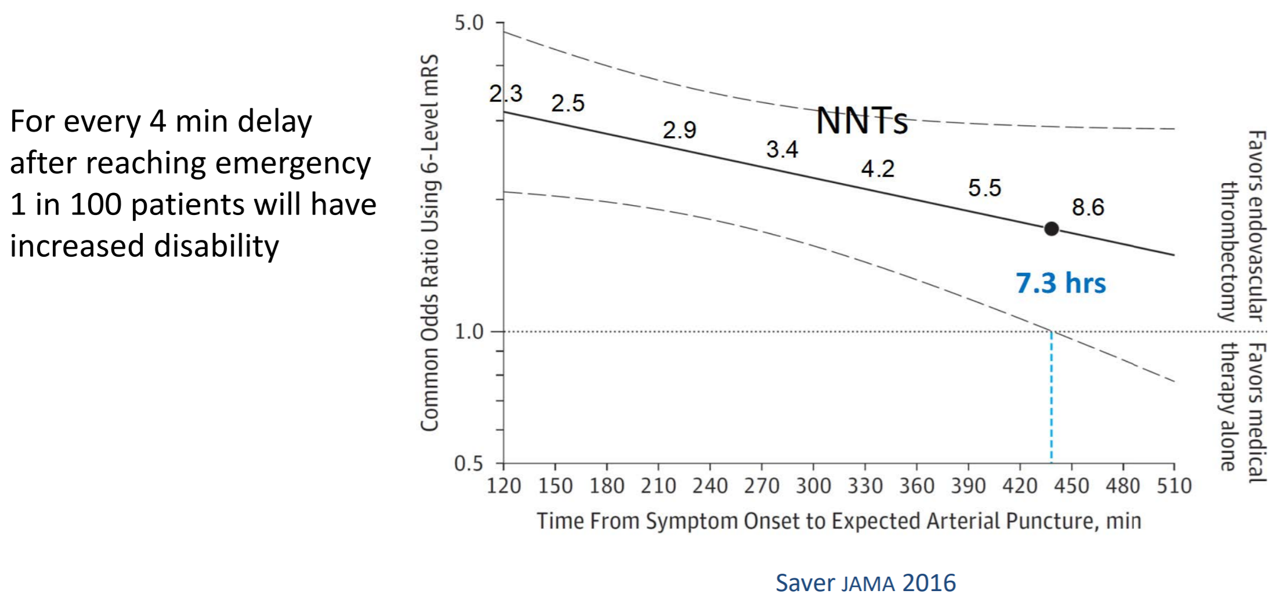

Slide 4
POW Hospital
24/7 thrombolysis service
Thrombolysis in ED resus/ ICU
24/7 Endovascular clot retrieval on site
Post-stroke reperfusion therapy care ideally in stroke unit

Slide 5
“Phases of Play”
Notes:
Access to an interdisciplinary acute care team with expert knowledge of stroke management, who are trained in delivery of thrombolysis and monitoring of patients receiving thrombolytic therapy
Streamlined acute stroke assessment workflow (including ambulance pre-notification, code stroke team response and direct transport from triage to CT scan) to minimise treatment delays, and protocols available to guide medical, nursing and allied health acute phase management
Immediate access to imaging facilities and staff trained to interpret images
Routine data collected in a central register to allow monitoring, benchmarking and improvements of patient outcomes over time for those treated with reperfusion.

Slide 6
Checkpoints
Onset to Recognition
Recognition to Door
Door to Scanner
Scanner to Needle
Scanner to Door out / Needle to Door out

Slide 9
Notes:
Diagnostic Radiologist
The diagnostic radiologist receives early alert of the estimated time and actual arrival of the patient in ED.
This allows them to prioritize review of the images and assess for intracranial LVO, intracranial hemorrhage (ICH), or perfusion abnormality.
These findings can be broadcast via Code Stroke Alert to the rest of the team and in particular, to the NI if LVO is suspected.

Slide 10
When should you call a stroke code?
If you suspect an inpatient has developed new symptoms in the last 24 hours that can be explained by a stroke
Use ASAP tool for decision to activate a hyper-acute stroke code
Notes:
ASAP tool
- NSW Telestroke Service will establish statewide referral criteria to the service (inclusions and exclusions) and provide a standard triage tool to support referral
- The current proof of concept uses an acute stroke assessment protocol that has been embedded in the triage process within the referring site's emergency department to support patient selection for telestroke involvement.
- Uses a hybrid of functional status, stroke severity and onset time
- Although this tries to be as all encompassing as possible, there may be other unusual presentations of strokes (chameleons).

Slide 11
What you need to do in a stroke code?
After activating stroke code, STAY with the patient
Ensure at least 20G IVC in cubital fossa, and bloods sent off immediately (no need to wait for Creatinine before deciding CT Angiogram Arch-CoW)
May assist in CT perfusion eMR order - please include “Stroke Code” and a brief clinical history and result
May assist in notifying CT radiographer to hold/ prepare scanner. Get patient to scanner ASAP – wheel them yourselves if you must
Ensuring Stroke Kit and Resus Bay
Be ready to assist in organizing retrieval for transfer if ECR.
Notes:
Delegation is key
Ongoing liaison with stroke MO

Slide 12
Other Uncommon Scenarios for Pathway Entry
Deterioration in neurological status
Minor deficits, but unexpected imaging findings of LVO
Notes:
Where and how else can the pathway be entered? Permutations.
- Clinical syndrome
- Patient background and risk factors profile (e.g., AF)
- Chronicity of vascular finding (old or new)
- Appearance of tissue on imaging
- Variation in vascular supply anatomy
- Ultimately, stroke team decision

Slide 13
What goes through my mind?
Identifier
Onset time
Severity and type of deficits/ symptoms
mRS
Hand dominance
Other info that affects inclusion/ exclusion criteria for thrombolysis
Anti coagulation
Other bleeding diathesis and predisposition
Recent procedure in a non-compressible site
Possibility of mimics
Patient’s weight
IV Access

Slide 14
Thrombolysis
If Neurologist decides that patient should have thrombolysis
Obtain consent from patient or NOK - Verbal consent sufficient as this is a recognised emergency treatment; but make sure to document later.
Make sure no contraindication to thrombolysis
Ascertain patient’s weight and calculate 0.9mg/kg dose of Alteplase (max dose 90mg). 10% of dose given as bolus over 1min, with the remainder infused over 60mins
Post-thrombolysis monitoring

Slide 15
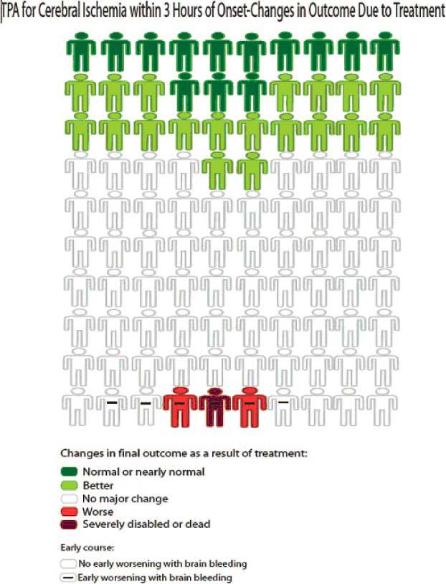
→ LSW–NEEDLE TIME <3 HRS
Better off ~ 1/3
No change ~ 2/3
Worse off ~ 3/100
NNT for MRS 0-1 is
3 if treated <90mins
8 if treated <180mins
14 if treated <279mins
Thrombolysis does NOT affect candidacy for ECR (Endovascular Clot Retrieval). Not mutually exclusive.
Notes:
All-comers
*Requires other inclusion criteria

Slide 16
Thrombolysis

Slide 17
Thrombolysis

Slide 18
Thrombolysis

Slide 19
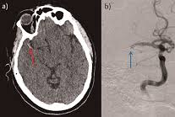
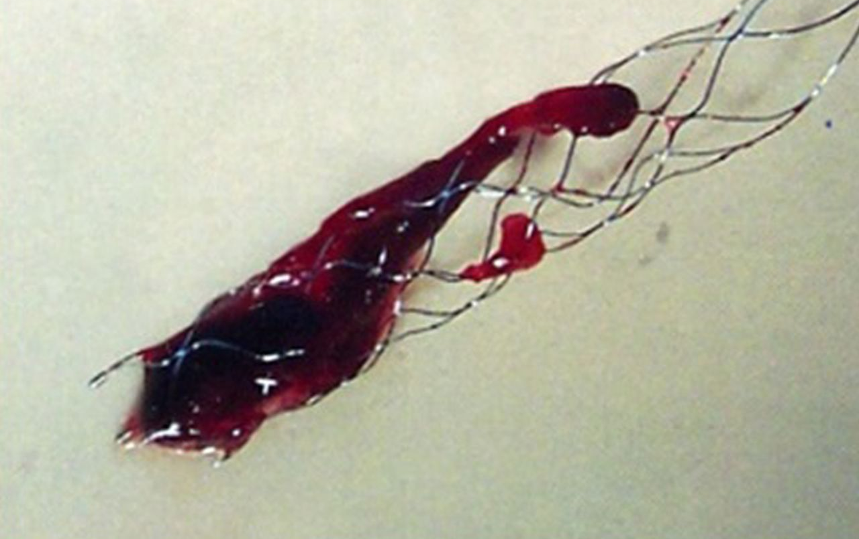
Endovascular Clot Retrieval
Endovascular clot retrieval for stroke have been demonstrated to be effective even up to 24 hours
Therefore, stroke presentations with onset time/ last seen well time up to 24 hours, are still potentially treatable, AND are still emergencies
Clot can be retrieved from ICA, M1, M2 and Basilar

Slide 20
ECR

Slide 21
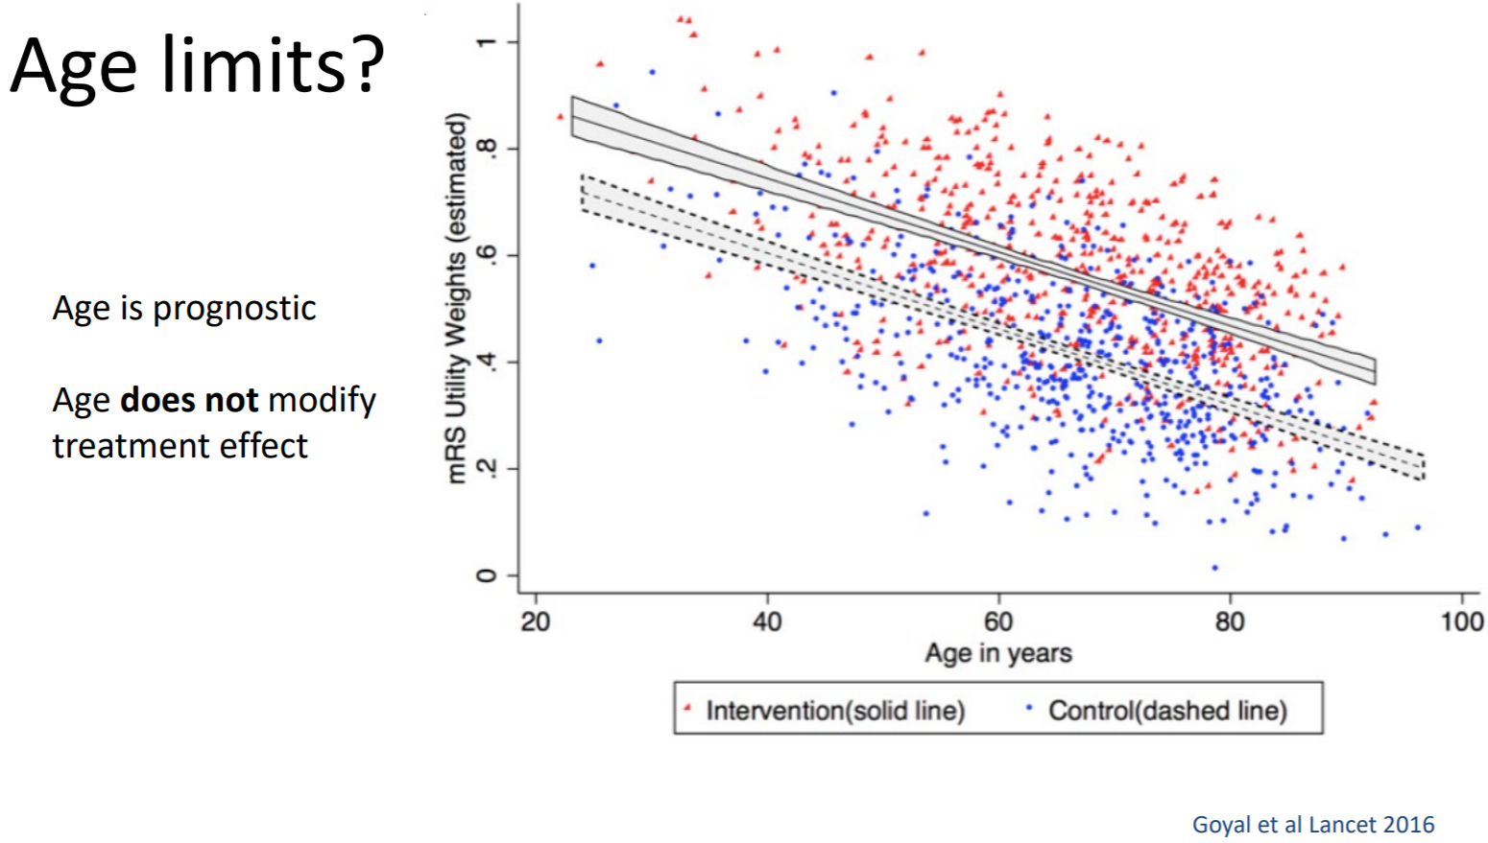
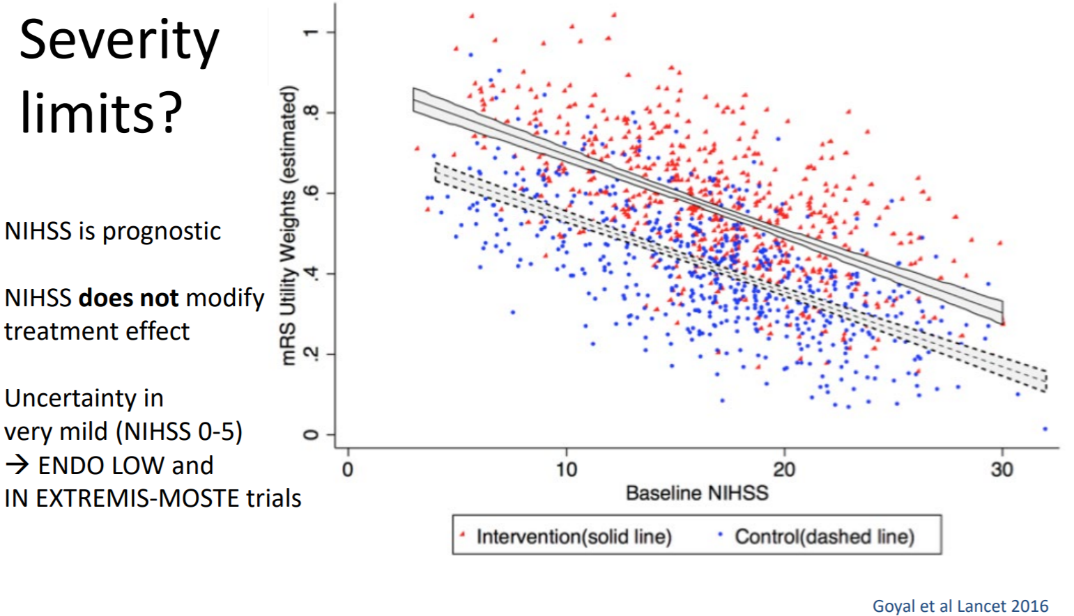

Slide 22
ECR

Slide 23
ECR

Slide 27
Anyone up for more simulation?

Slide 28
How can I help?

