Slide 1
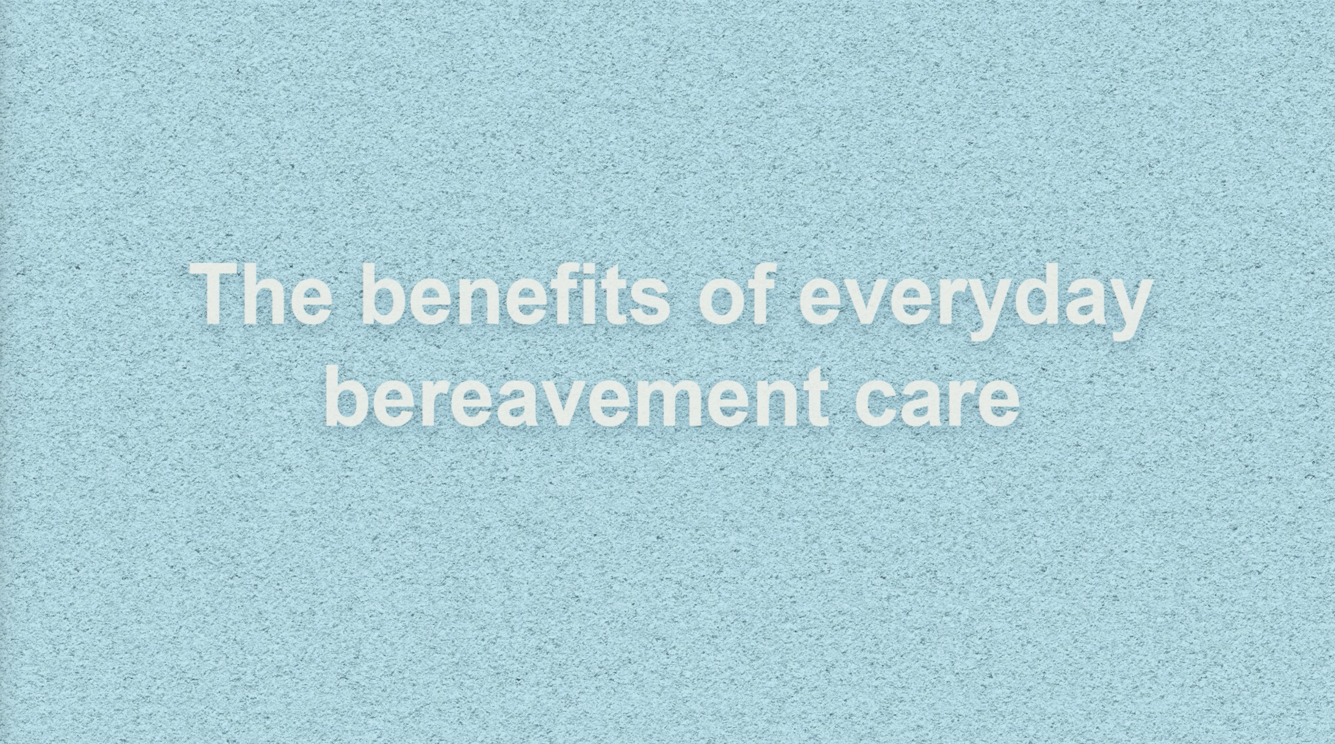

Slide 2
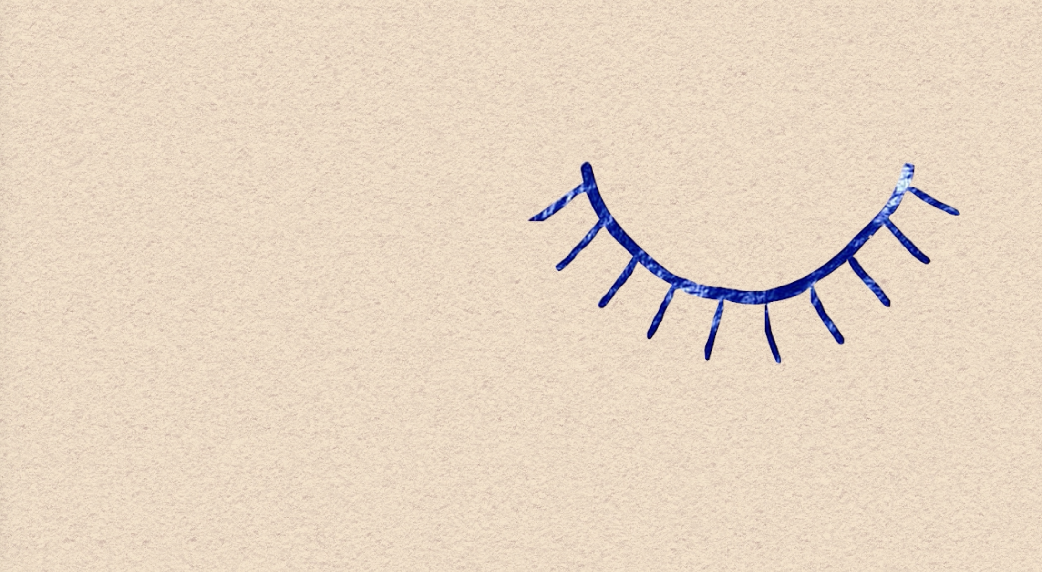
Grief is a normal and natural response to loss
There are many hidden losses for people receiving healthcare. Can you think of some?
Notes:
Grief is a normal and natural response to loss.
There are many hidden losses for people receiving healthcare.
Can you think of some?
Loss of health and wellbeing
Amputation
Loss of safety
Loss of privacy
Loss of independence
Death or anticipated death
Miscarriage/pregnancy loss / adoption
Deaths that are stigmatized – certain cancers, suicide, homicide

Slide 3
Grief is a normal and natural response to loss
There are many hidden losses for people receiving healthcare. Can you think of some?
Loss of health and wellbeing
Amputation
Loss of safety
Loss of privacy
Loss of independence
Death or anticipated death
Miscarriage/pregnancy loss / adoption
Deaths that are stigmatized – certain cancers, suicide, homicide
Notes:
Grief is a normal and natural response to loss.
There are many hidden losses for people receiving healthcare.
Can you think of some?
Loss of health and wellbeing
Amputation
Loss of safety
Loss of privacy
Loss of independence
Death or anticipated death
Miscarriage/pregnancy loss / adoption
Deaths that are stigmatized – certain cancers, suicide, homicide

Slide 4
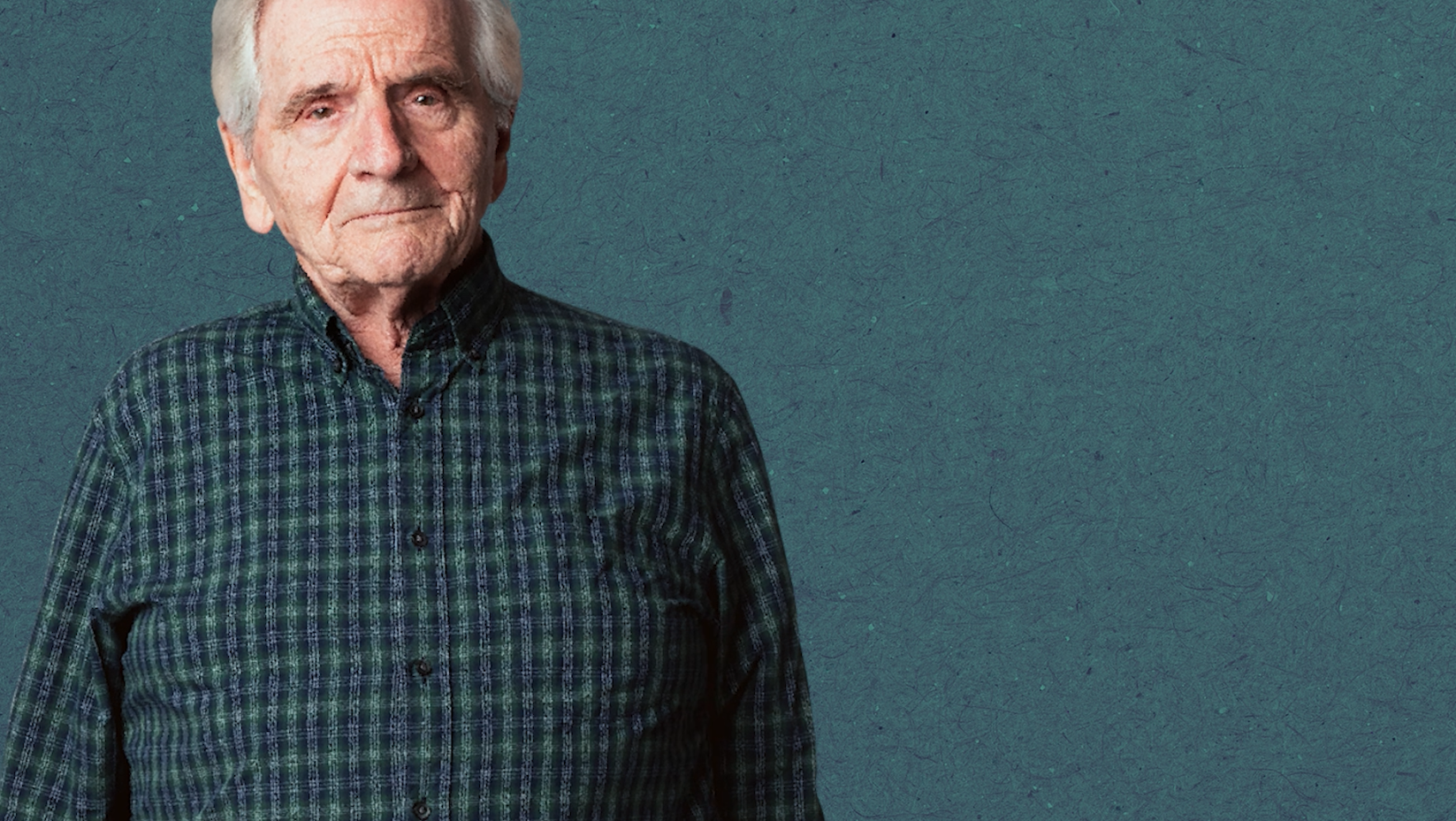
“Grief is not a problem to be solved: it’s an experience to be carried”*
What are the negative impacts for people if grief isn’t recognized?
*Megan Devine (it’s Ok that you’re not OK: Meeting Grief and Loss in a Culture That Doesn’t Understand).
Notes:
Start a discussion about the impact of unrecognised grief.
You can also have a discussion about what happens when grief is acknowledged – the difference it makes for patients and staff

Slide 5
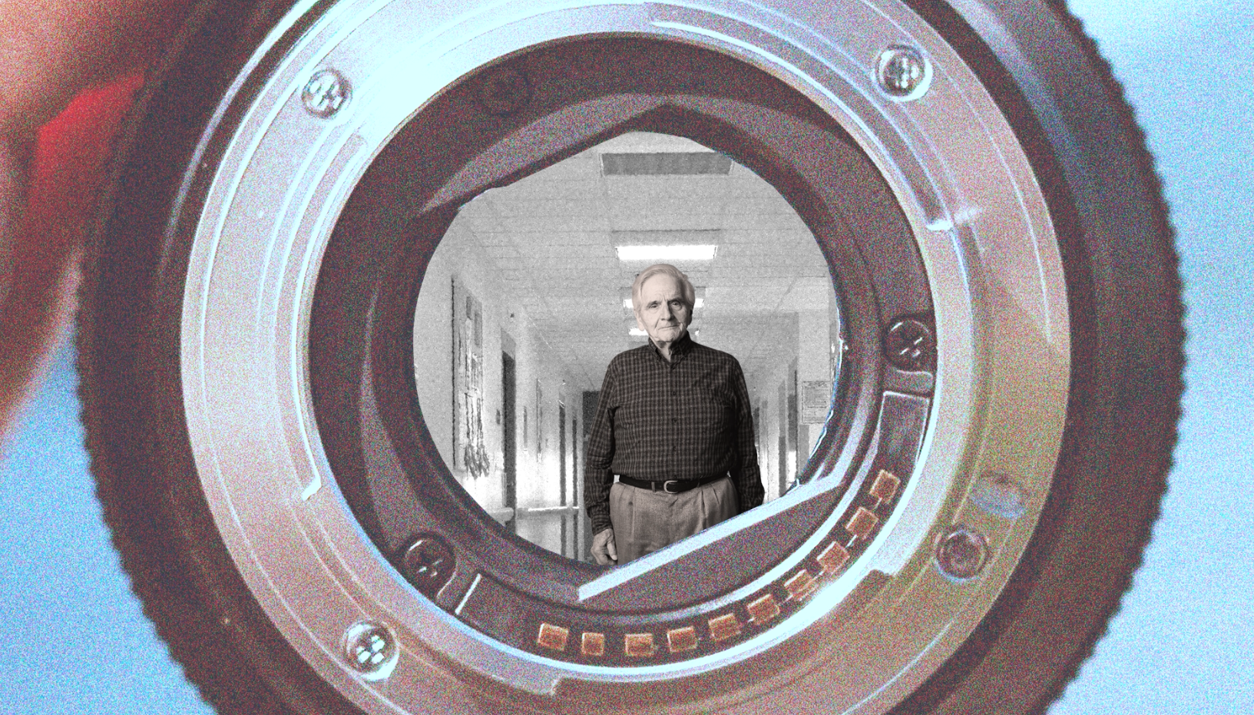
What does having a bereavement lens mean?
We all have a role in supporting someone who is grieving.
What are 3 common ways bereaved people present in your workplace?
Notes:
What does having a bereavement lens mean?
We all have a role in supporting someone who is grieving.
What are 3 common ways people who are bereaved may show up in your workplace?

Slide 6

Things we can do:
Acknowledge loss/bereavement:
“I noticed you looked sad when we asked about your support at home”
Listening and asking questions:
“Can you tell me more about …?”
Compassionate responding:
“It’s ok to have a cry, please take your time”
Discussion: What else?
Notes:
Things we can do:
Acknowledge loss/bereavement “I’ve noticed you seemed upset when we asked about your supports at home”
Listening and asking questions “Can you tell me more about …?”
Compassionate responding “It’s ok to have a cry, please take your time”
Discussion point: What else?

Slide 7

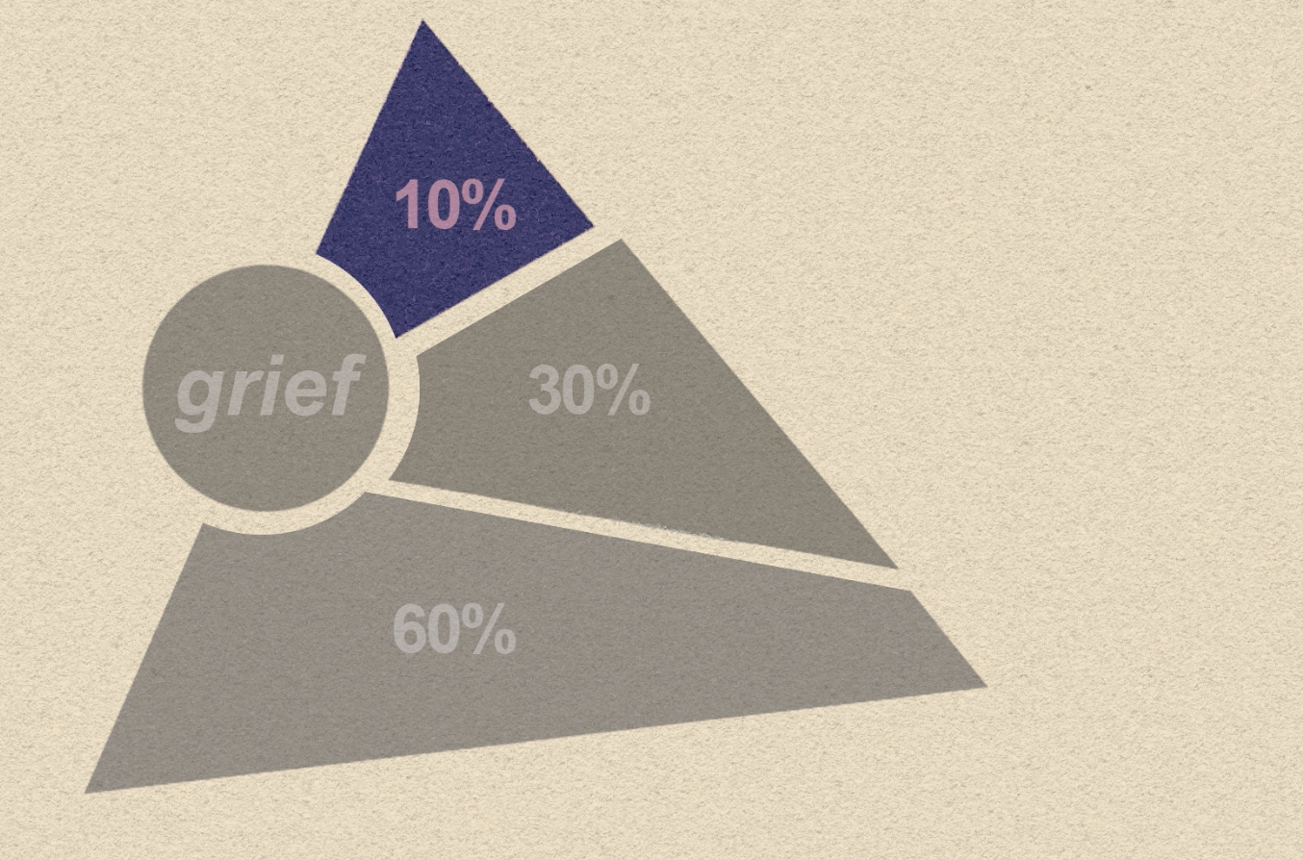
The public health model of bereavement provides a reminder to all of us in healthcare that we all have a role to play in the compassionate and everyday care of people who are experiencing loss.
Discussion: What are 3 ways you can have a ‘bereavement lens’ in your workplace?
Notes:
The public Health model of bereavement provides a reminder to all of us in healthcare that we all have a role to play in the compassionate and everyday care of people who are experiencing loss.
Discussion: What are 3 ways you can have a ‘bereavement lens’ in your workplace?

