Slide 1
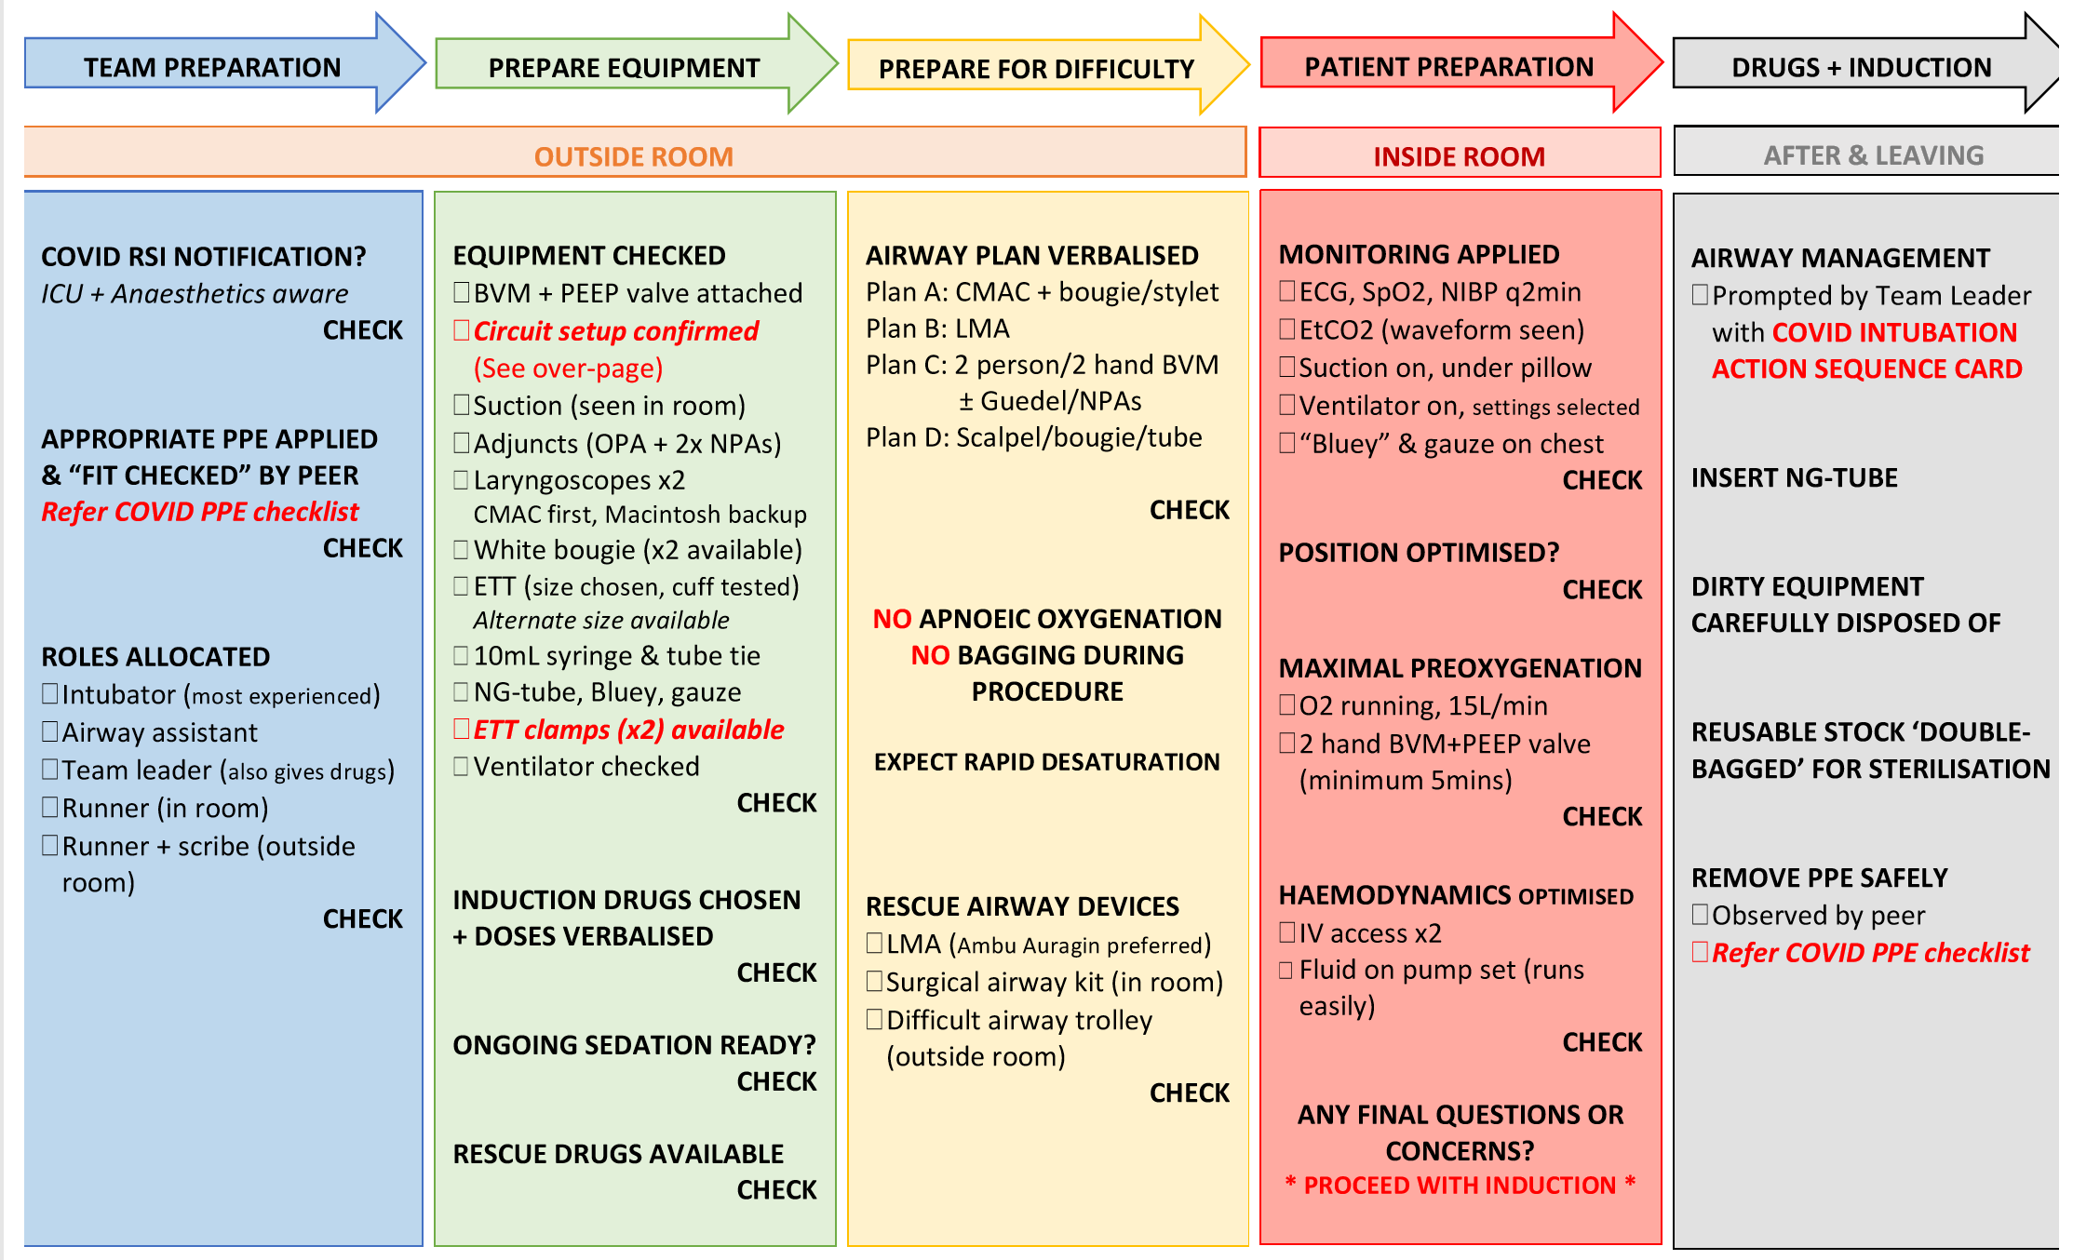
PRINCE OF WALES HOSPITAL COVID-19 INTUBATION CHECKLIST
OUTSIDE + INSIDE ROOM
AFTER + LEAVING
COVID RSI NOTIFICATION
ICU + Anaesthetics aware
CHECK
APPROPRIATE PPE APPLIED & “FIT CHECKED” BY BUDDY
Refer COVID PPE checklist
CHECK
ROLES ALLOCATED
Intubator (most experienced)
Airway assistant
Team leader (+ gives drugs)
Hander (outside room in PPE)
Runner (outside room)
CHECK
COMMUNICATION
Radios turned on and checked (Channel 20)
- Med TL (inside room)
- Runner RN (outside room)
CHECK
EQUIPMENT CHECKED
BVM + PEEP+ viral filter
Circuit setup with EtCO2 + viral filter + inline suction
Suction
Adjuncts (OPA), LMA
VLs (Cmac 1st +Macintosh)
Bougie x 2 or stylet
ETT x2 (size chosen, cuff tested, alternate size ready)
10ml syringe, tube tie
NGT, bluey, gauze
Ventilator settings chosen
Oxygen cylinder + spare
CHECK
INDUCTION DRUGS
Ketamine 1-2 mg/kg
Propofol 1-2mg/kg
Rocuronium 1.5mg/kg
Suxamethonium 200mg
*Dose adjust if shocked*
CHECK
POST INTUBATION SEDATION
CHECK
RESCUE DRUGS
Metaraminol 0.5mg/ml
Adrenaline 10mcg/ml
CHECK
AIRWAY PLAN VERBALISED
Plan A: CMAC + bougie/ stylet
Plan B: LMA
Plan C: 2 person/ 2 hand BVM
+/- OPA
Plan D: Scalpel/ bougie/ ETT
CHECK
NO APNOEIC OXYGENATION
NO BAGGING DURING PROCEDURE
EXPECT RAPID DESATURATION
RESCUE AIRWAY DEVICES
LMA (Auragain preferred)
Surgical airway kit
(in room)
Difficult intubation trolley (outside room)
CHECK
*DISCUSS PLAN IN
HYPOXIC ARREST*
MONITORING APPLIED
ECG, SpO2, NIBP q2min
EtCO2 (waveform)
Suction on, under pillow
Ventilator started+ silenced
Bluey + gauze on chest
CHECK
POSITION OPTIMISED?
RAMP 30°
Extra towels/ pillows
CHECK
MAXIMAL PREOXYGENATION
O2 running, 15L/min NRB
2 hand BVM + PEEP valve
(good seal, min 5 min if able)
CHECK
HAEMODYNAMICS OPTIMISED
IV access x 2
Fluid on pump set
Consider early pressors
CHECK
ANY FINAL QUESTIONS OR CONCERNS?
* PROCEED WITH INDUCTION*
AIRWAY MANAGEMENT
Prompted by Team Leader with COVID INTUBATION SEQUENCE CARD
INSERT NG-TUBE
DIRTY EQUIPMEN T CAREFULLY DISPOSED OF
REUSABLE STOCK DOUBLE BAGGED FOR STERILISATION
REMOVE PPE SAFELY
Facing door
Observed by buddy
Refer to doffing checklist
(RAMP 30°, extra
pillows and towels)
OR
OR
*DICSUSS PLAN IN
HYPOXIC ARREST*
Courtesy of Liverpool Hospital ED, anaesthetics and ICU

Slide 2
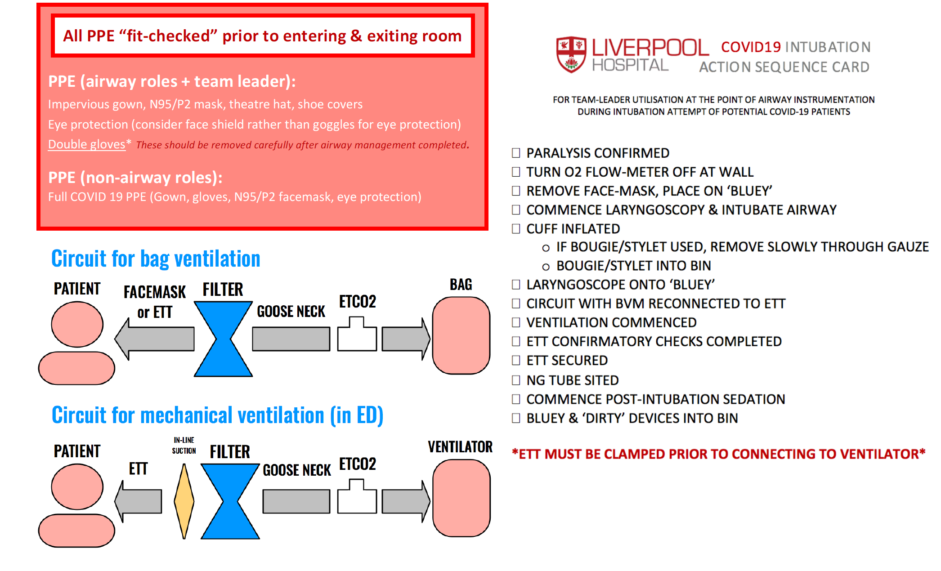
COVID-19 INTUBATION ACTION SEQUENCE CARD
1) SEDATION GIVEN, PARALYSIS CONFIRMED
2) TURN O2 FLOW- METER OFF AT WALL
3) REMOVE FACE-MASK, PLACE ON BLUEY
4) COMMENCE LARYNGOSCOPY -> BOUGIE -> ETT
5) BOUGIE REMOVED BY ASSISTANT (2 HANDS)
- REMOVE BOUGIE SLOWLY THROUGH GAUZE
- BOUGIE STRAIGHT INTO BIN
6) LARYNGOSCOPE ONTO BLUEY
7) CUFF INFLATED
8) ATTACH CIRCUIT WITH VIRAL FILTER + EtCO2 ATTACHED
9) VENTILATION COMMENCED
10) ETT CONFIRMATORY CHECKS COMPLETED
11) ETT SECURED
12) NGT SITED
13) DIRTY GLOVES REMOVED, CLEAN GLOVES DONNED
14) COMMENCED POST-INTUBATION SEDATION
15) BLUEY AND “DIRTY DEVICES” INTO BUCKET
Courtesy of Liverpool Hospital ED, anaesthetics and ICU

Slide 3
Wall O2
Monitor
PRE-DEPARTURE TO ICU:
ICU ready?
Monitor at end of bed
IV lines attached to bed frame drip stand
ABCDE checklist completed:
A: ETT secure
B: EtCO2 trace, SpO2 optimised
C: haemodynamics optimised
D: sedation + muscle relaxant adequate?
E: check power for monitor + ventilator
DEPARTURE TO ICU:
Clean runner clears corridors
Medical team leader doffs and dons clean PPE outside room facing closed door
Sheet and drape pt
Intubator and airway nurse pass pt over to medical team leader and hander nurse
Transport to ICU
Airway trolley
A Dr
Bin
A RN
Med TL
C-mac
Dripstand
O2 cylinder
Ventilator
D O O R
Runner RN
Airway trolley
Hander RN

