Slide 1
Dermatology essentials for THE Emergency Department
Dr Emily Forward
Dermatology Registrar
2020

Slide 2
Learning objectives
Describe morphology of cutaneous lesions and rashes
An approach to drug rashes and some interesting cases
Understand the role of investigations in dermatological conditions

Slide 3
Recommended texts
Dermnet NZ
Dermatology Essentials – Jean Bolognia et al
Dermatology Made Easy – Amanda Oakley

Slide 4
How to consult
Ideally before 1pm
Take a history
Examine and describe the rash
Think of some differentials and consider investigations

Slide 5
Describing rashes
Single lesion or rash
Distribution
Unilateral, symmetrical, dermatomal, extensor, photosensitive
Configuration
Linear, annular, target, discoid
Colour
Morphology
Scale

Slide 6
Morphology

Slide 7
Case 1
Notes:
This is a photophraph a patient’s lower legs, FST II-III. There are multiple erythematous to violaceous lesions on the lowers legs.
Palpable purpura
Ddx:
Vsculitis -

Slide 8
vasculitis
“Palpable purpura”
Immune complexes deposit in vessels
When describing
Petechiae <3mm
Macular purpura 5-9mm
Ecchymoses >1cm
Often dependent areas initially
Less blood flow = accumulation of inflammatory mediators
Small vessel vs medium vs large vessel
E.g. Retiform purpura, ulcers, subcutaneous nodules and infarcts

Slide 9
vasculitis
Systemic involvement: renal, GIT, renal, joint, CNS
Causes include:
HSP, urticarial vasculitis
Infections (15-20%) e.g. bacterial (GAS, mycobacterium leprae, infective endo), URTI, HCV
Inflammatory - mainly autoimmune CTD (15-20%) e.g. RA, SLE, Sjogren
Drugs (10-15%) e.g. b lactam penicillins & cephalosporins, mino; thiazide, hydralazine quinidine; GCSF, NSAIDs, allopurinol, PTU, bortezomib
Neoplasms (2-5%) often haematologic - MM, MGUS, MDS, myelo/lymphoproliferative
Genetic (rare) e.g. alpha 1 antitrypsin deficiency

Slide 10
vasculitis
Investigations:
Urine casts
Bloods: FBC, EUC, LFT
HBV/HCV/HIV
ANA, ENA, DsDNA, ANCA, C3, C4
Cryoglobulins

Slide 11
Treatment
Depends on aetiology
Remove trigger or treat the underlying cause
Treat skin and manage systemic involvement
Rest, elevation
Dress ulcers
Consider topical agents or oral corticosteroids
Others can be considered: dapsone, colchicine, HCQ, MTX/AZA, CYC

Slide 12
Case 2 - 75F with 2 courses of flucloxacillin; extending new blisters, pruritis +++
Notes:
Ddx:
Bullous pemphigoid
Epidermolysis bullosa acquisita
Phemiphus
Linear IgA bullous dermatosis
Dermatitis herptiformis
Bullous lupus erythematosus

Slide 13
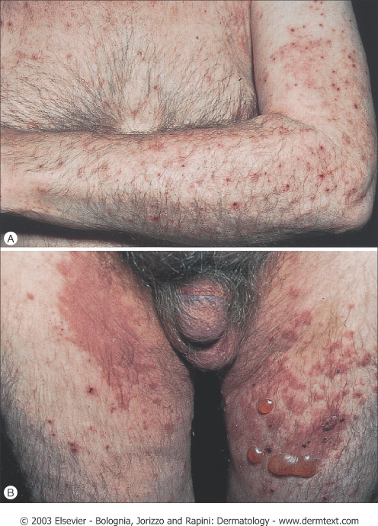
Bullous pemphigoid
Non-bullous phase- nonspecific mild-severe intractable pruritis, excoriated, exanthematous, urticarial like
Bullous phase- normal or erythematous skin, urticarial plaques, tense blisters 1-4cm
Weeks-months
Symmetrical, flexural, limbs, mucous membranes (10-30%)

Slide 14
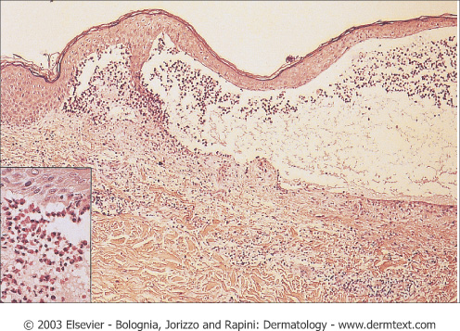
Bullous pemphigoid
Most common autoimmune subepidermal blistering disease
Elderly > 60, 90+
IgG autoAb bind to components of hemi-desmosomes
Associated diseases- nil, age, ca,, neuro
Triggers- trauma, burns, RTX, PUVA, drugs e.g. diuretics, NSAIDs, antibiotics
Ddx Nonbullous phase
drug reaction, eczema, contact dermatitis, prurigo nodularis, scabies

Slide 15
Bullous pemphigoid
Chronic exacerbations/remissions
Morbidity- intractable pruritis, bullae, erosions
Death in first year 10-40%
Treatment
Drain Blister – sterile needle, non-adhesive dressings
Treat any infections
Potent topical steroids (localised/mild or generalised) + wet dressings
PO corticosteroids (first line), immunosuppressives

Slide 16
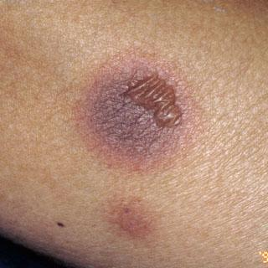
Case 3: Post operative patient day 2
Notes:
Violaceous patch on the abdomen with a surrounding erythematous rim. There is also a flaccid bullae within the lesion.
Ddx: FDE, EM, Erythema migrans, Sweet’s, Contact dermatitis,

Slide 17
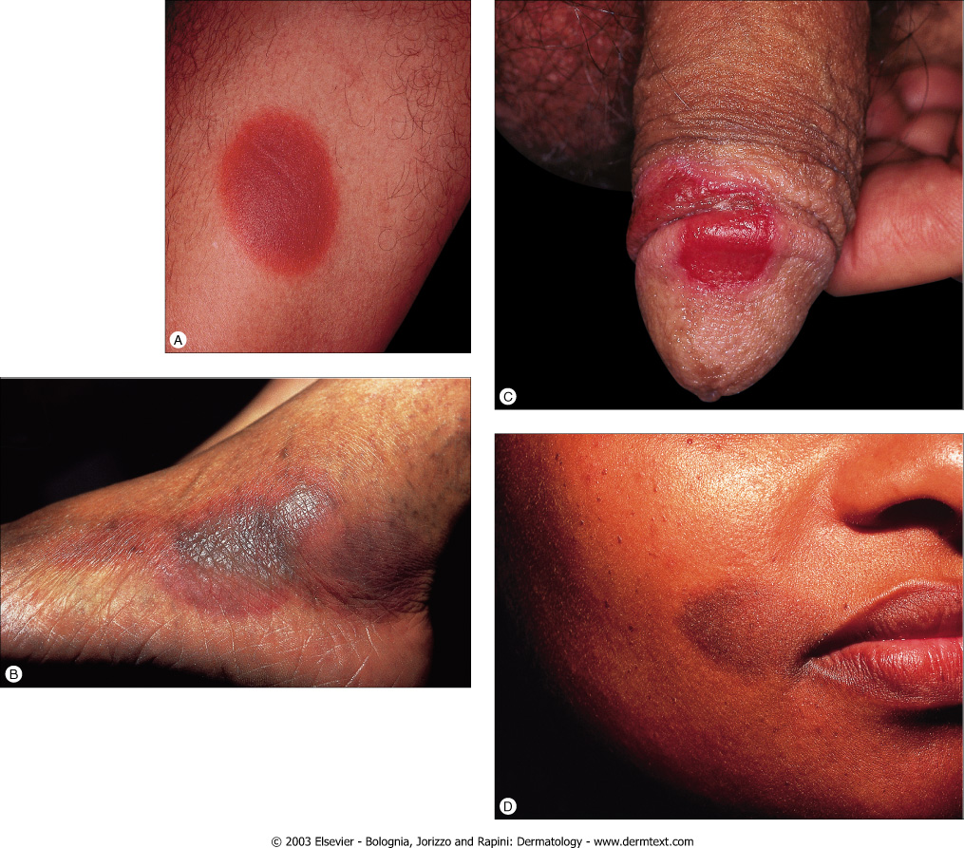
Fixed drug reaction
One to a few, well demarcated
Central blister, erosion
Fade with hyperpigmentation
Recur same sites/others
Lips/face/hands/genitalia

Slide 18
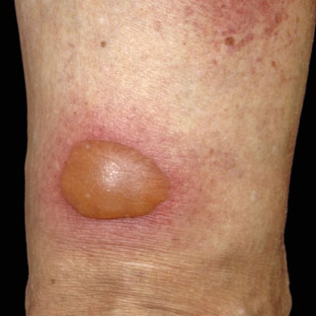
Fixed drug reaction
Aetiology almost always drug
NSAID, sulphonamide, aspirin, tetracyclines, paracetamol
1-2 weeks/<24hrs with recurrences
Ddx: spider bite or bite reaction, EM, bacterial infection
Diagnostic cause may confounded be refractory period, patch testing

Slide 19
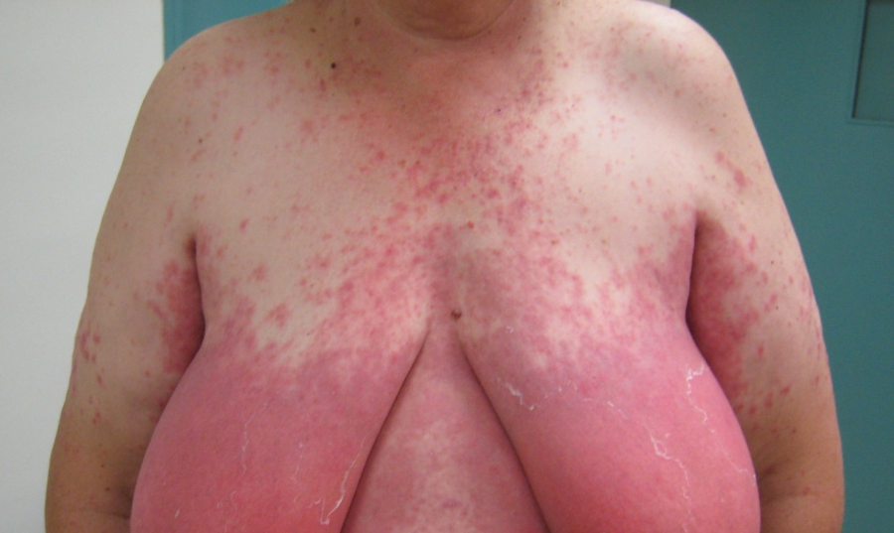
Case 4: 51 year old woman 2 days after commencing cephalexin. Pdx/DDx?

Slide 20
Acute Generalised Exanthematous pustulosis (AGEP)
High fever (with or a few days before onset of AGEP)
Commences face, intertriginous, disseminate over hours with oedema face and hands, vesicles, bullae, EM like
+++ small non-follicular sterile pustules on oedematous erythematous plaque
Onset <2 days after exposure to drug
Duration 1-2 weeks, desquamation

Slide 21
agep
Acute febrile drug eruption
90% drug induced/viral
Beta lactam, cephalosporins, tetracyclines, antifungals, sulphonamides, CCB, HCQ
Bx: Subcorneal pustules filled with neutrophils
Treatment: drug withdrawal, topical steroids, antipyretics
Immunological recall sensitisation short interval after drug exposure
Positive patch test (up to 80%)
Notes:
90% drug induced/HS rn mercury/enteroviral

Slide 22
Patch testing in cutaneous adverse drug reaction
Zinn Z, Gayam S, Chilliah M, Honari G and Teng J. 2018. Patch testing for nonimmediate cutaneous drug reactions. JAAD 78(2): 421-423

Slide 23
Patch testing
Considered of value in the following conditions:
Generalised eczema
Systemic contact dermatitis
Maculopapular rash
AGEP
Lichenoid rash
Fixed drug eruption***
And of less value in:
Urticaria
Stevens-Johnson syndrome
Pruritis
Vasculitis

Slide 24
Patch testing in cutaneous adverse drug reaction
Based on pathogenesis of T-cell involvement and delayed-type hypersensitivity reactions
Generally considered safe but isolated reports of recurrence of eruption have been reported¹
Reaction limited to test site
Mimics the CADR both clinically and histologically at that site
Hospital surveillance not required
Positive results reported in 32-50% of patients
1 Mashiah et al. (2003) A systemic reaction to patch testing for the evaluation of AGEP. Arch Dermatol 139: 1181-3.

Slide 25
Patch testing
Weak positive (+)
Slightly elevated pink
Strong positive (++)
Papulo-vesicles
Extreme reaction (+++)
Blisters or ulcers

Slide 26
CASe 5:
Notes:
Morbiniform eruption affecting the torso and limbs and become confluent over the lower abdomen.

Slide 27
dress
Definition: Severe drug reaction with eosinophilia and systemic symptoms (Type 4 H.S.)
Presentation:
High fever
Lymphadenopathy
Morbilliform eruption, facial swelling, M.M.
Organ involvement
Investigations:
Drug timeline
FBC, EUC, LFT, biopsy
Treatment:
Withdrawal of drug
Supportive care - topical steroids, atihistamines
Consider oral prednisolone

Slide 28
Case 6:

Slide 29
erythroderma
Definition: widespread erythema >90% BSA, also known as exfoliative dermatitis
Cause
Skin disease (psoriasis, atopic dermatitis), drugs, lymphoma
Presentation:
Reaction pattern is different for each cause
Preceded by morbilliform eruption
Erythema, pruritic, oedematous, scaling (~5d)
Investigations: skin swab, biopsy, bloods
Treatment:
Drug history/ withdrawal of drug,
Topical wet wraps, moisturisers, steroids
Treat underlying cause and complications

Slide 30
Case 7:

Slide 31
Erythema multiforme
Definition: Acute often self limiting conditions, often young adults and children
Causes:
Infections (90%): Herpes simplex virus, Mycoplasma pneumoniae
Drugs: NSAIDs, penicillins, sulphonamides, anticonvulsants
Presentation:
Targetoid lesion
Erythematous macule with central blister
Palms and soles common location
Haemorrhagic crusted lips

Slide 32
Erythema multiforme
Investigations:
Clinical diagnosis
Can consider: FBC, HSV swab/mycoplasma pneumoniae, skin biopsy
Treatment:
Symptomatic treatment, self limiting
Ophthlamology input if oral involvement
Can be recurrent
Antivirals for recurrence of HSV

Slide 33
Case 8:

Slide 34
Urticaria, angioedema, anaphylaxis
Definition:
Urticaria: swelling of the superficial dermis, characterized by weals/hives
Angioedema: deeper swelling of the dermis and subcutaneous tissue
Anaphylaxis: characterized by bronchospasm, facial oedema and haemodynamic compromise
Causes: Idiopathic, certain food, drugs, insect bites, infections, autoimmune and hereditary
Pathophysiology: increase in capillary permeability from release of inflammatory mediators and histamine
Treatment:
Supportive care: DRABCs
Remove precipitating agent
1) Antihistamines for urticaria
2) Corticosteroids for severe/refractory urticaria or angioedema
3) Adrenaline and antihistamines for anaphylaxis

Slide 35
Case 9:

Slide 36
Stevens-Johnston and Toxic Epidermolysis
Definition: Severe skin disorder characterised mucosal involvement, extensive skin necrosis and epidermal detachment.
Causes: Drugs (Allopurinol, Antibacterial’s, Anti-epileptics, anti-inflammatory’s) mainly and infrequently Mycoplasma pneumoniae
Presentation:
Drug typically started 1-2 weeks prior
Flu-like symptoms (high fever, sore throat, LN)
Widespread erythema, desquamation, Nikolsky +ve
Mucosal: eyes, GI, respiratory, genitourinary
Investigations: Skin swab, CBE, LFT, EUC, skin biopsy
Treatment:
DRABCs (airway support, IV access, fluids) and withdrawal of drug
Call for help: Dermatology, plastics, burns, ICU, ophthalmology, I.D.
Topical steroids (avoid systemic), daily dressings, Cyclosporine vs. IVIG
Notes:
Classification: SJS: <10% | Overlap 10-30% | TEN >30%

Slide 37
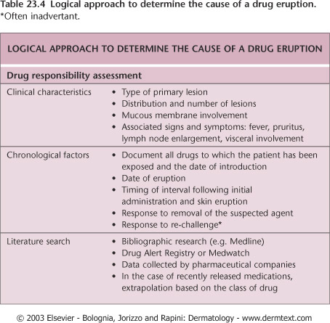
Investigations when calling for ?drug rash consult
FBC, EUC, LFT
Drug timeline

Slide 38
Drug timeline

Slide 39
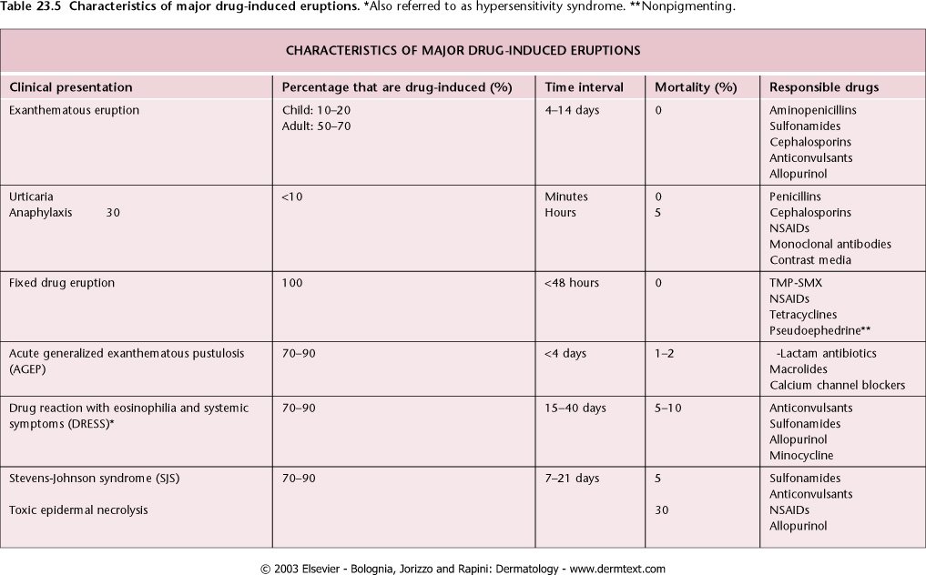
summary

Slide 40
How to do a punch biopsy
Useful and simple test
Biopsy can be done if there's doubt about diagnosis
The most difficult aspect of skin biopsy technique is selecting the biopsy site.
In general, try to:
Select a recent lesion
Select a typical lesion
Avoid areas of ulceration and excoriation
If biopsying an ulcer, take the biopsy through the edge and include normal skin
If biopsying a vesicular rash, attempt to take a whole vesicle
Remember, a skin biopsy leaves a scar: avoid cosmetically sensitive areas if possible

Slide 41
How to do a punch biopsy
Prior to performing the biopsy, consent the patient & set up equipment:
Local anaesthetic (adrenaline may be used in most cases)
Biopsy tools: skin prep, dressing pack with suture, suture material and equipment, punch/scalpel and dressings
Specimen jar
Formalin for H&E
Specimen jar for culture (with normal saline)
Michel’s medium for DIF
If in doubt – no formalin, get to lab ASAP
Instructions for patient

Slide 42
How to do a punch biopsy
Quick and easy to perform
Small, sharp metal cylinder which is an easy to use cutting instrument.
Many sizes from 2-8mm in diameter but 3-4mm is sufficient for most diagnostic purposes.
Small punch biopsies do not require a suture, however 4mm and above should be sutured to reduce healing time.

Slide 43
How to do a punch biopsy
Orienting a punch biopsy. (A) Just before performing the biopsy, the lines of least skin tension are determined. (B) The skin is stretched 90 degrees perpendicular to the lines of least skin tension using the nondominant hand. The punch biopsy is performed. Following relaxation of the distending hand, (C) the wound has an elliptical shape that can be closed with sutures parallel to the lines of least skin tension.
Zuber T. 2002. Punch biopsy of the skin. American Family Physician 15;65(6):1155-1158.

Slide 44
How to do a punch biopsy
Punch biopsy technique. (A) The punch biopsy instrument is held perpendicular to the surface of the lesion. The instrument is pressed down into the lesion while it is rotated clockwise and counterclockwise, cutting down into the subcutaneous fat. The punch biopsy instrument is removed. (B) The biopsy specimen is gently lifted with a needle to avoid crush artifact. Scissors are used to cut the specimen free at a level below the dermis. Small punch biopsy defects do not require suturing, while larger wounds (4 to 5 mm) should be closed to reduce healing time and scarring.
Zuber T. 2002. Punch biopsy of the skin. American Family Physician 15;65(6):1155-1158.

Slide 45
How to do a punch biopsy
Information for the pathologist
When submitting a biopsy to pathology, you must include the following data:
Site of the biopsy
Clinical history
Drug history
Treatment so far conducted
If you have a differential diagnosis in mind, include it!

Slide 46
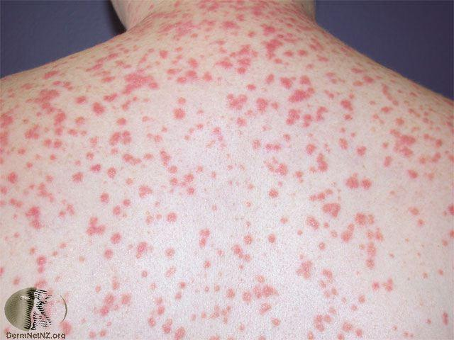
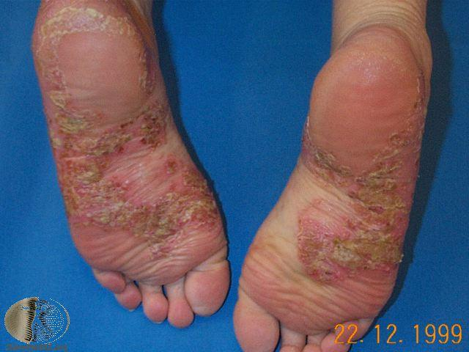
Common cases: 1

Slide 47
Chronic plaque Psoriasis
Definition: Chronic inflammatory disorder with hyperproliferation of keratinocytes
Cause: Genetic, immunological
Triggers: trauma (Koebner), infection, drugs, stress, alcohol
Presentation:
Well demarcated plaques with silvery scale +/- joint
Extensor surfaces, scalp, behind ears
Nail: onycholysis, ridging, pitting, subungal hyperkeratosis
Investigations not needed: usually clinical
Treatment:
Topical: steroids, coal tar, vitamin D analogues
Systemic: MTX, retinoids, cyclosporine, acitretin
Phototherapy: PUVA, NBUVB
Biologic: TNFa, monoclonal, IL12, IL 23, IL 17

Slide 48
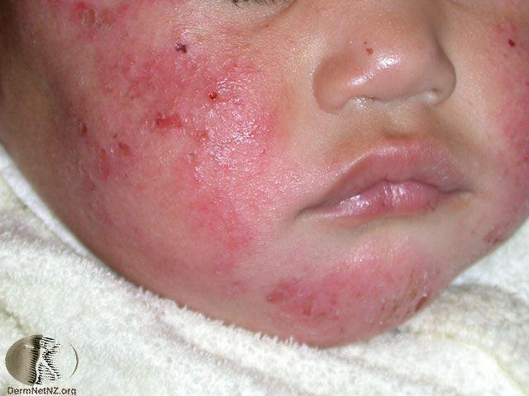
Common case: 2

Slide 49
Common cases: Atopic dermatitis
Definition: Type 1 hypersensitivity
Cause: Genetic defect in skin barrier function (filaggrin)
Triggers: infection, allergens (food, dust, pets), irritants, sweat, heat, stress
Presentation:
Pruritic maculopapular rash +/- vesicles on erythematous base
Face & extensors in infants, flexors in children and adults
2º changes: excoriations & lichenification
Investigations: skin swabs, total IgE, skin biopsy
Treatment:
Conservative: avoid, soap substitutes, bath oil
Topical: steroids and emollients
Systemic: MTX, Azathioprine, Cyclosporine, MMF
Phototherapy: NBUVB
Biologic: Dupilumab (not currently available)

Slide 50
COVid-19
Notes:
Macular confluent eruption with islands of sparing
20.5% developed skin manifestations.
similar to cutaneous involvement occurring during common viral infections

Slide 51
COVID-19
Notes:
livedo reticularis

Slide 52
How to consult
Before 1pm
Take a history
Examine and describe the rash
Think of some differentials and consider investigations
Drug timeline
Baseline blood tests
Consider a biopsy

