Slide 1
The Crashing Asthmatic
Registrar Teaching POWH 2020
Therese Becker

Slide 2
Asthma
Bronchoconstriction
Airway oedema
Excess mucous
Notes:
Leads to Increased WOB; increased airway resistance and decreased pulmonary compliance→ hypercapnic resp failure
V/Q mismatch from airway narrowing and closure-→impaired gas exchanges and increased WOB
Adverse cardioresp interactions→ increased venous return secondary to high intrapleural pressures, and increased afterload-→ pulsus paradoxus
Near fatal asthma- defined as acute asthma associated with respiratory arrest or PCO2 > 50 mmHg with ot without altered consciousness

Slide 3
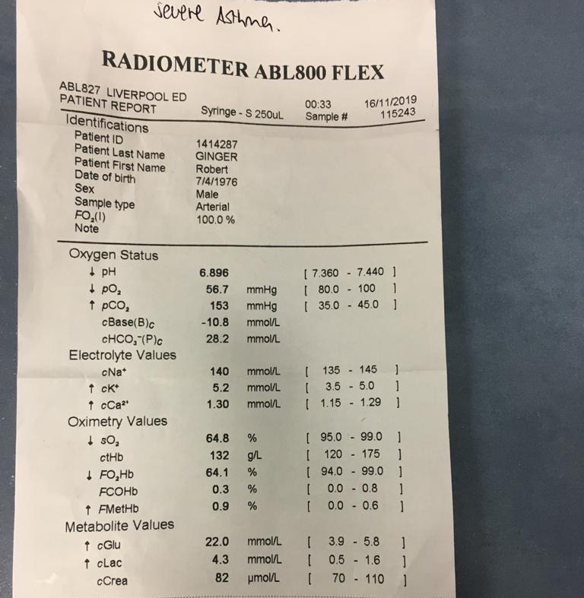
45 M with known severe asthma
170 kg
RR 35, sats 90% 15 L HR 140 BP 100 systolic
GCS 3
Describe this gas

Slide 4
Pathophysiology
V/Q mismatch altering gas exchange
Expiratory flow limitation → hyperinflation
Expiratory muscles now actively involved in expiration
Muscles start at a greater stretch so less efficient and more fatigable
Greater inspiratory effort is needed to commence flow into lung → increased WOB
Notes:
Ie resp muscles start at a greater stretch so less efficient and more fatiguable, and great inspiratory effort is needed to commence flow into lungs- increased WOB

Slide 5
Dynamic Hyperinflation
Dynamic hyperinflation = high intrathoracic pressure at the end of expiration (auto-PEEP)
Decrease expiratory flow → gas trapping
Continues until equilibrium where exhaled volume matches the inspired volume

Slide 6
What are the management priorities?

Slide 7
Position, Oxygen, Monitoring, Access
First minutes…

Slide 8
Oxygen
Hypoxaemia from V/Q mismatch
High flow assumed to be harmless in acute asthma
However may be harmful to have too much- receieving 100% FiO2 can cause increase in pCO2
Treatment should be based on achieving target arterial sats > 92%
Needs to be humidified → dry gas can lead to further bronchocontriction

Slide 9
Short acting B₂ agonists
Rapid onset, well tolerated
Continuous vs intermittent
Nebulised versus with spacer
Role of IV B₂ agonists
Notes:
No increased efficacy shown in systemic review of intermittent versus continuous- however earlier studies showed some increased efficacy but none shown in lung function or admission rates- in severe asthma though for me continuous means don’t need to think about it
Some patients when this obtunded can’t manage a spacer
IV- theory is when so constricted the inhaled B2 agonist is not reaching the B2 receptors- again systemic reviews shown no sig difference between inhaled and IV. IV associated with increased autonomic. Effects. Benefit not known in ventilated patients

Slide 10
Steroids
Reduce airway inflammation, airway reactivity and decrease secretions
Also increase the number and sensitivity of B receptors
Take 4-6 hours to take effect and benefits often not seen for 6-24 hours- start early
Some evidence in severe patients can have earlier effect by reversing B 2 receptor downregulation seen in chronic use

Slide 11
Magnesium
Relaxes smooth muscle and may inhibit contraction
Involved in acetylcholine and histamine release
May also block the Ca –ion influx into smooth muscle
Multicentre trial showed 2 g IV improved lung function in severe asthma (increase FEV1 43.5% versus 48.2% )
Evidence the sicker you are the more likely to have effect

Slide 12
Inhaled anticholinergics
Block muscarinic receptors in airway smooth muscle and inhibit vagal tone → bronchodilation
Mild additional effect when added to B₂ agonist- different mechanisms of action- synergist
3 initial doses (500 mcg neb) 20 minutely then q6 hrly

Slide 13
Adrenaline
Can give nebulized (5 mg), IM (0.5 mg), IV (1-20 mcg/min)
Bronchodilation form B2 effects
Decreased oedema from alpha effects
Infusion- rescue therapy when hypotensive (not related to dynamic hyperinflation

Slide 14
Non invasive ventilation
Little evidence- acts a bridge
Helps overcome auto-PEEP from gas trapping reducing WOB
Augments inspiration decreasing WOB, increasing TV
Reduces V/Q mismatch
Hypercapnic- BIPAP 10/5
CPAP- 5 mm H20 and titrate

Slide 15
Indications for Intubation
Arrest
Severe hypoxia
Altered mental state
Severe fatigue
Failure to respond to treatment

Slide 16
High Risk
Often die / arrest during intubation
Needs planning/ preparation
Most experienced operator

Slide 17
Preparation
Keep sitting upright until the intubation itself
Preoxygenate with NIV/ nasal canula and have apnoeic oxygenation
Load with IVF 20-40 ml/kg- insensible losses are high and have a decreased pre load
Have inotropes ready
Large ETT

Slide 18
Induction
Ketamine 1-2 mg /kg IV (bronchodilator)
Rocuronium 1.2-1.5 mg/kg for extended paralysis
Forced exhalation
Very slow BVM to allow time for expiration
Avoid intrinsic PEEP→ circulatory collapse

Slide 19
Ventilator Settings- Rule of 6’s
RR 6
TV 6 ml/kg (IBW)
FiO2 60%
Low I: E ratio 1: 4
PEEP 5 cmH20 (less than 6)
Permissive Hypercapnia – well tolerated
Goal plateau pressures < 30 cm H20

Slide 22
Conclusion
The crashing asthmatic is terrifying
Aggressive management and planning for the next stage
Don’t intubate lightly
Involve seniors early
Plan the intubation and anticipate complications
Rule of 6’s- modified ventilation strategy

