Slide 1
SH*T
you see if you’re a shit magnet like me.

Slide 2
CASe 1: blind drunk
57 YO M
Triaged 0200 as PFO, smelled of EtOH
Nurses did routine bloods (without a VBG)
Left in ambulance bay due to access block

Slide 3
Patient picked up at 0630
Interpretation?
What would you do next?

Slide 4
He now complains of blindness
Interpret the venous gas
What other information do you want?
What is the diagnosis?
Notes:
Cl 102 Urea 3.5 – glucose 20.9 - Blood alcohol < 2.2 mosm/L – osmolality 494
Anion gap = 147-102-6 = 39
Delta ratio = 27/18 >1 = pure HAGMA
Osmolality = 2x147 + 21.3 +3.5 =318.8
Pure high osmolar gap HAGMA

Slide 5
OSMOLAR GAP Acidosis
Alcohols
Methanol
Ethylene Glycol
Polyethylene glycol (IV lorazepam)
Proplylene glycol (IV phenytoin
Other sugars
Mannitol
Sorbitol
Maltose (IVIG)
Ketones

Slide 7

MEthanol POISONING
From home brews in Australia mainly

Slide 8
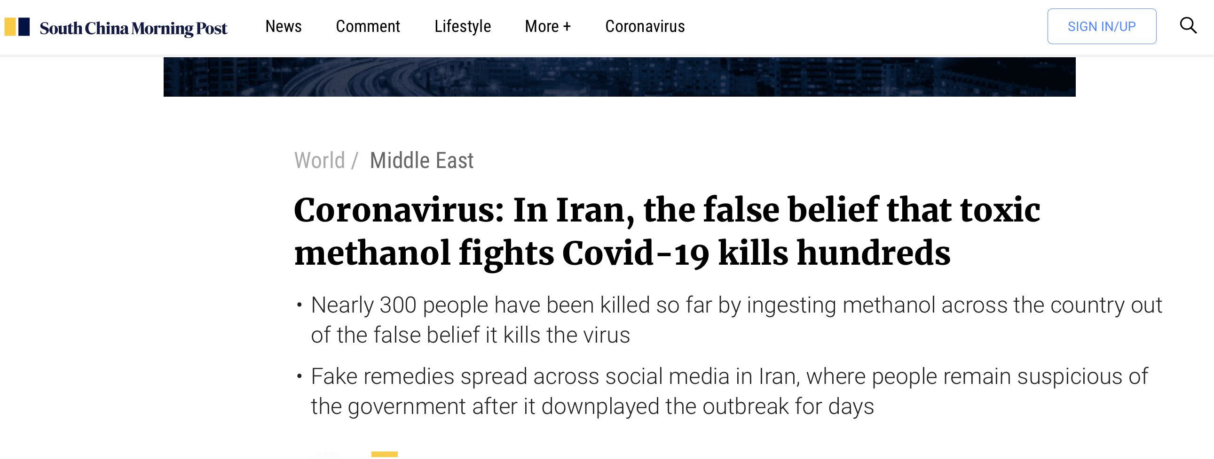

Slide 9
Case II: ?Unwarranted troponin
72 YO M
BG: Stage 5 CKD – on IHD M/W/F – due for dialysis later in the day
T2DM/HTN/Hypercholesterolaemia
SIB GP by ?automated SMS that his troponin was elevated
No other information by GP
Pt reports seeing GP for mild abdominal discomfort
Nil chest pain/SOB/palpitations.

Slide 10
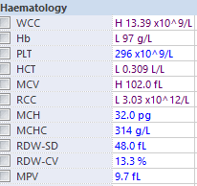
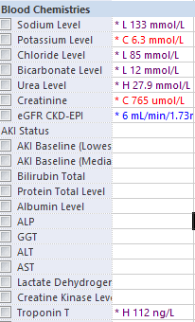
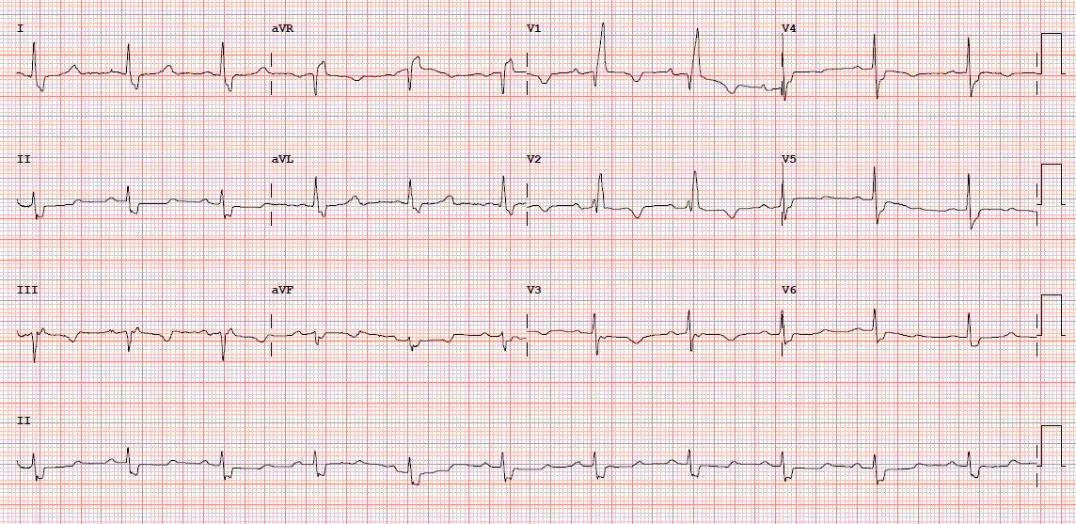
Ix
Repeat Trop is 109
ECG remains unchanged from previous
What would you do?

Slide 11
He represents from dialysis… …
Became hypotensive and desaturating at dialysis
Sent back in for reassessment.
Further history at this stage: (from son)
Unwell for 3-4 days
With ?pre-syncope while in bed
Delirious as of today at dialysis
OBSERVATIONS on arrival
BP 100/60 (baseline 180) RR 36 SpO2 99% 6L HM HR 68

Slide 12
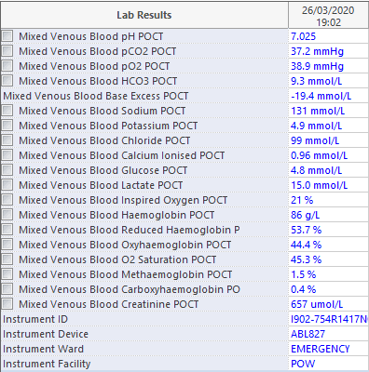
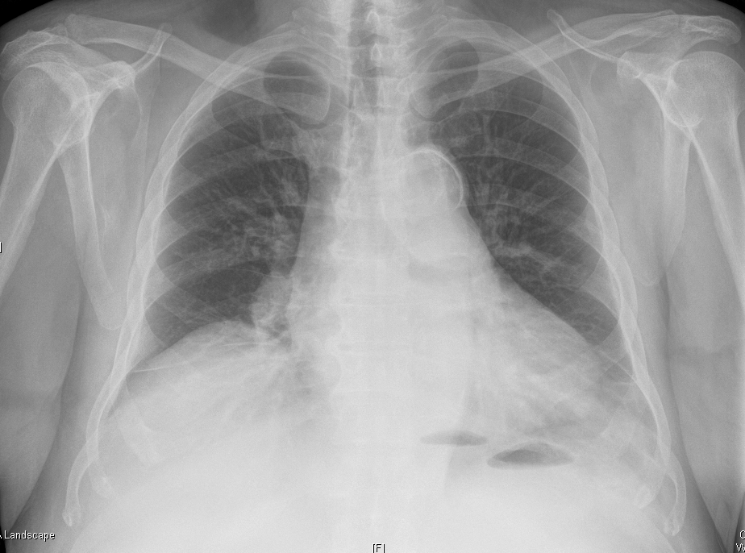
Bloods now

Slide 13
Lactic Acidosis
Type A: Inadequate O2 delivery
Anaerobic muscle activity (sprinting, seizures)
Tissue hypoperfusion (shock, cardiac arrest, regional hypoperfusion -> mesenteric ischaemia)
Reduced tissue O2 delivery (hypoxaemia) or delivery (CO poisoning)
Type B: No evidence of inadequate O2 delivery
B1: underlying diseases
LUKE
TIPS
FAILURES
B2: Drugs & toxins
B3: inborn errors of metabolism
Notes:
LUKE: leukaemia, lymphoma.
TIPS: thiamine deficiency, infection, pancreatitis, short bowel syndromw
DRUGS:
Metformin
Salicylates, paracetamol
Salbutamol, adrenaline
Isoniazid
Frutose, sorbital, biguanides, CN

Slide 14
Progress
Intubated for worsening MA, tiring from resp perspective
Swabbed for COVID19
CT chest + mesenteric angiogram looking for sepsis/mesenteric ischaemia.
Up to ICU on noradrenaline.
Clinically improving, treated as likely sepsis.

Slide 15
Case III: ?simple dehydrational AKI
1st day at POWH
48 YO F
Seen through FT:
5/7 abdo discomfort with BNO, followed by diarrhoea
Decreased PO intake, decreased urine output
BIBA due to ongoing pain, unmanaged at home.
BG: HTN, DISH
Obs: RR 26 SpO2 97% BP 150/80 HR 100
What are the differentials at this stage?

Slide 16
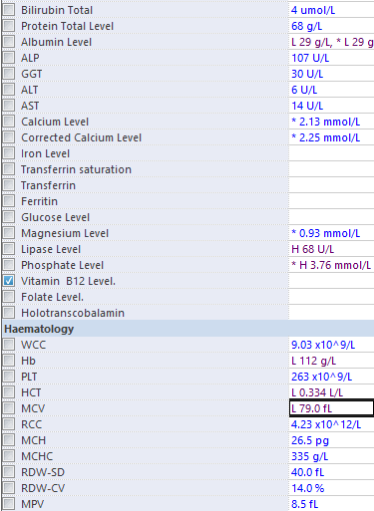
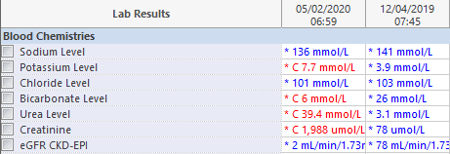
Her bloods come back…

Slide 17
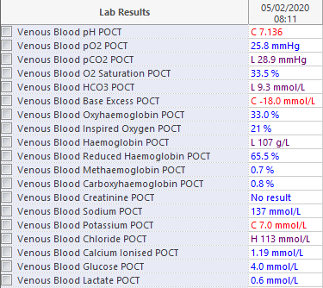
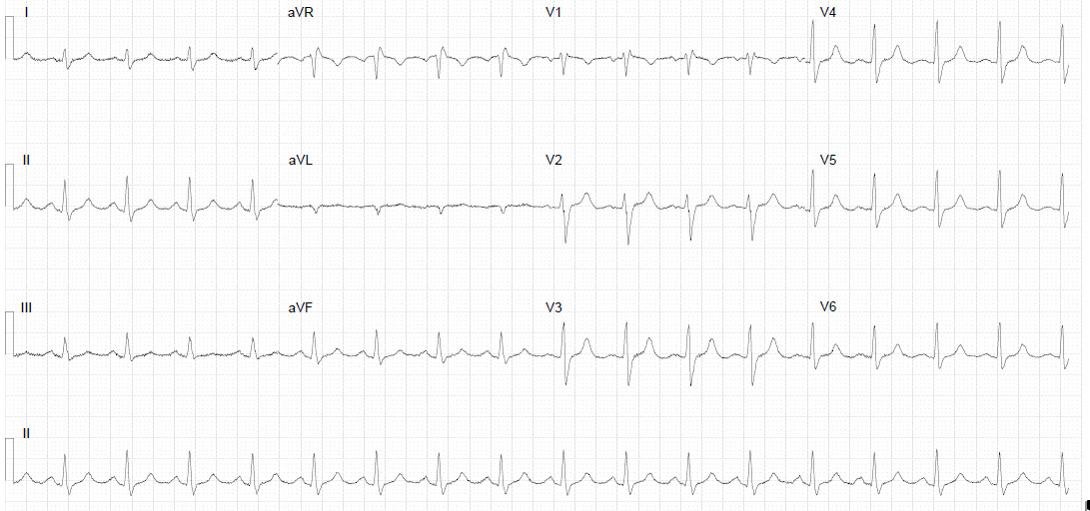
Handed over at this stage

Slide 18
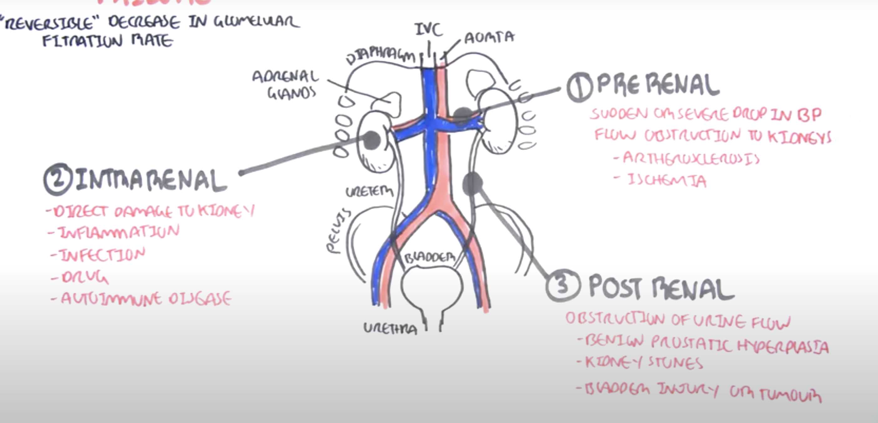
Causes of AKI

Slide 19
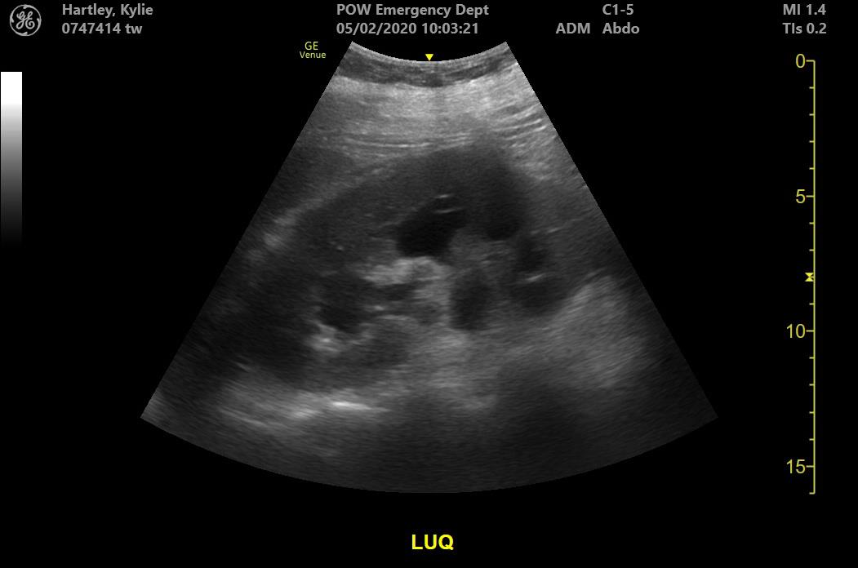
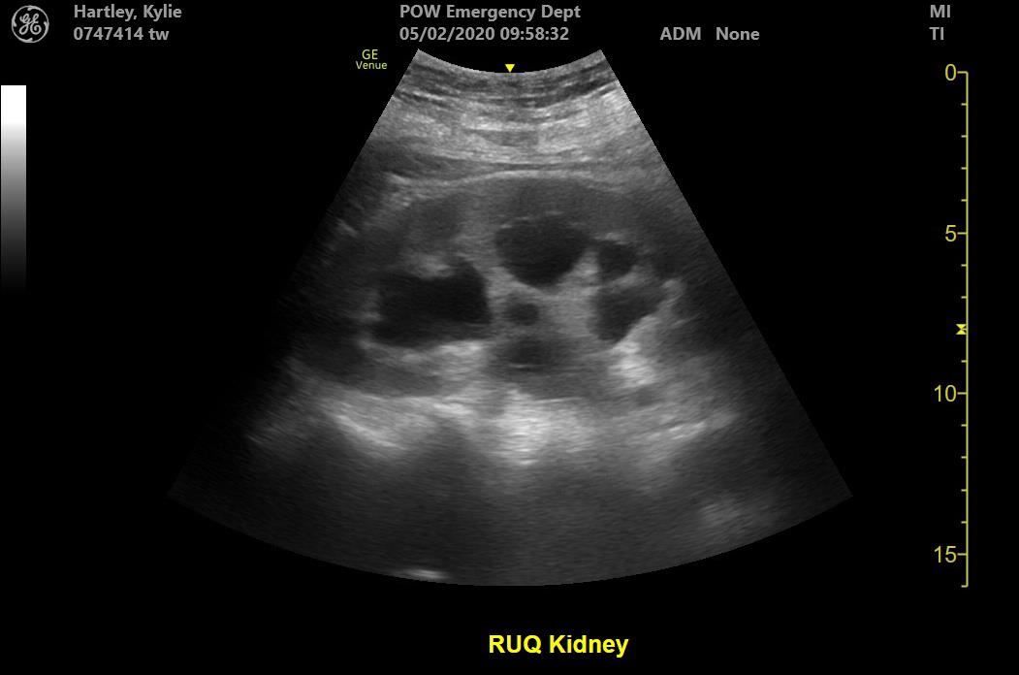
Treated for hyperkalaemia, bedside US

Slide 20
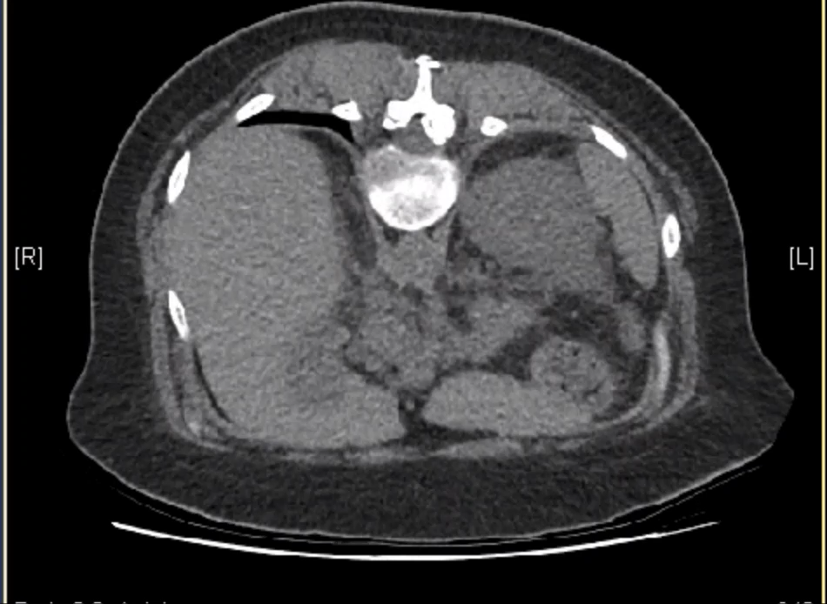

Slide 21
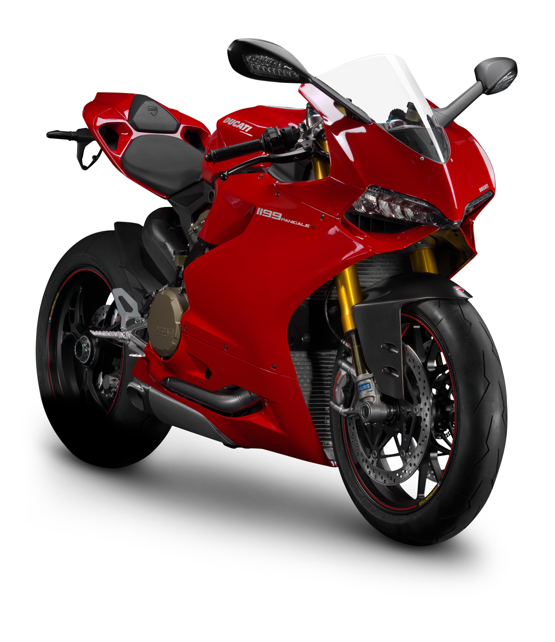
Take home points
If you see an abnormal bicarb, do a gas!
Don’t assume that patients have the pathology they’ve presented for
Don’t be a shit magnet

