Slide 1

Histones
The dark side of Immunity

Slide 2

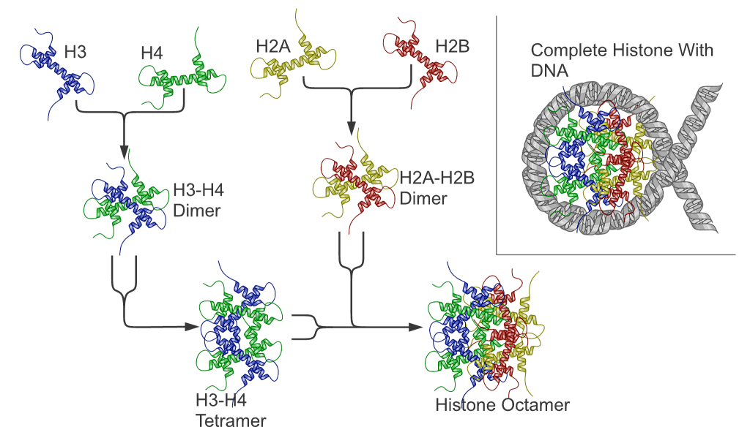
What are Histones?
‘Highly conserved cationic (positively charged) proteins which package DNA’

Slide 3
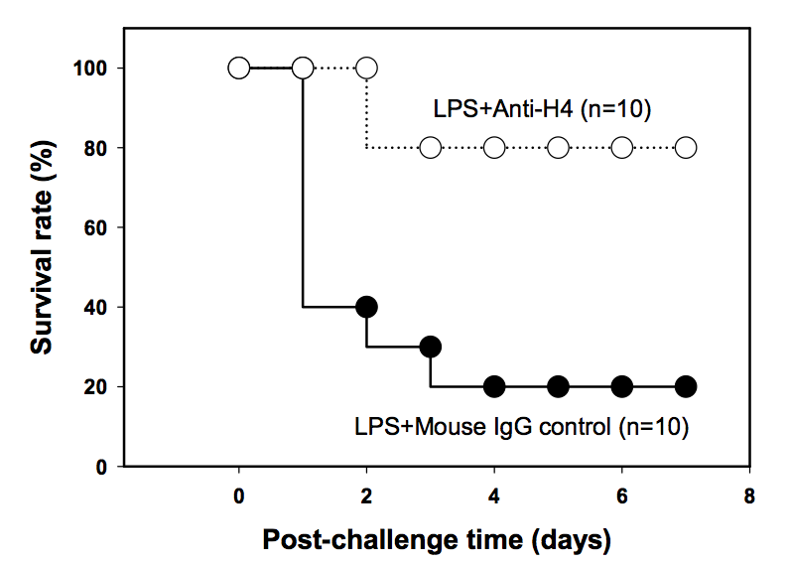
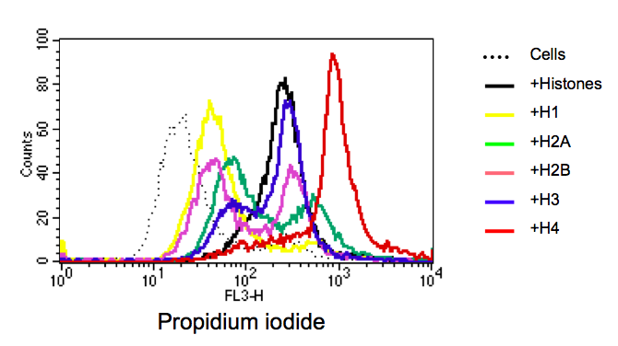
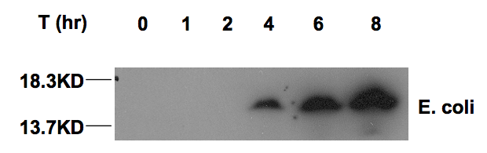
Seminal Finding
‘Extracellular Histones are Major Mediators of Death in Sepsis, Xu et al, Nat Med. (2009); 15(11): 1318-1321
H3 concentration increases in baboon sepsis
Histones are cytotoxic for HUVECs
H4 inhibition improves survival in murine LPS model

Slide 4
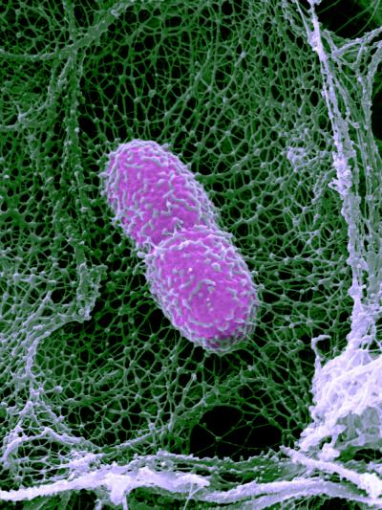
Where do they come from?
Issue: injured tissues (apoptotic/necrotic cells) = insufficient histones
Neutrophil extracellular traps (NETs)
‘a spider web of DNA (chromatin) and neutrophil elastase covered with Histones’
Brinkmann et al, Science (2004)

Slide 5
Pathology associated with Histones/NETs
Sepsis Ischemic AKI Pulmonary Fibrosis DVT/VTE ARDS Juvenile Arthritis TRALI cIRI Endothelial injury Cystic Fibrosis (CLI) | Xu et al, Nature Med (2009); 15(11): 1318-1321 Nakazawa al J Am of Nephrol (2017); 28(6): 1753-1768 Zhang et al, J Occup Enviro Med (2019); 61(2): 89-95 Brill et al, J Thromb Haemostat (2012); 10(1): 136-144 Lv et al, Respiratory Research (2012); 18(1): 165 Xiao et al, Ital J Pediatr (2019); 45(1): 14 Caudrillier et al, (2012); 122(7): 2661-2671 Shah et al, Cardiovasc Drugs Ther (2020); 34(1): 123-131 Saffarzadeh et al, PLoS One (2012); e32366 Gray et al, Antibiotics (2015); 4(1): 62-75

Slide 6
The power of attraction

Slide 7
Endothelial Cell Injury
Calcein-AM (Alive)
PI (Dead)
Untreated
Histone 400ug/ml
HIS 400 + PAC1

Slide 8
Endothelial Cell Injury

Slide 9
Erythrocytes

Slide 10
Erythrocytes
Increasing Histone concentration and flow velocity increases erythrocyte lysis

Slide 11
Erythrocyltes

Slide 12
Platelet Activation

Slide 13
SPAs vs Current Anticoagulants

Slide 14
In-vivo Models

Slide 15
Sepsis
Rodent Caecal Ligation & Puncture model of Sepsis
No Antibiotics
Control or Treatment (5hr/intervals)

Slide 16
Cardiac Ischemia Reperfusion Injury
Circulating H4 correlates to infarct size

Slide 17
Deep Vein Thrombosis

Slide 18
Local Flap Ischemia Reperfusion Injury

Slide 19
Human ex-vivo model: Sepsis

Slide 20
Human ex-vivo model: Cardiac Ischemia Reperfusion Injury

Slide 21
Summary
Histones/NETs place an integral role in the innate immune system
Unfortunately, they can also compromise vascular haemostasis
SPAs may represent an effective therapy for inhibiting the detrimental aspects of Histones/NETs

Slide 22

Fini… for now..
Neutralising the Pathological Effects of Extracellular Histones with Small Polyanions
C. O’Meara, L. Coupland, F. Kordbacheh, B. Quah, D. Simon-Davis, A. Bezos, A. Browne, C. Freeman, A. Dulhunty, L. Arnolda, I. Mitchell, L. Khachigian, R. Stephans, M. Von Itzstein, CR. Parish. Nature Comm (2020); 11(1):6408
Extracellular Histones Induce Erythrocyte Fragility and Anaemia
F. Kordbacheh*, C. O’Meara*, LA. Coupland, PM. Lelliott, CR. Parish. Blood (2017); 130(26): 2884-2888
* First authors

