Slide 1
Effect of enhanced interactive text messages and phone instruction on the quality of bowel preparation for colonoscopy: a randomised controlled trial
Dr Minh Pham, Dr John Kandiah

Slide 2
Introduction
Patient understanding of bowel preparation (BP) instruction and compliance is crucial in obtaining good bowel preparation, which impacts the safety and accuracy of colonoscopy.
A method of achieving this is by reinforcing this instruction with timed interactive SMS and phone calls in the 48 hours before colonoscopy, through an automated computer program which requires little clinical input.
This study aims to evaluate the efficacy of said enhanced instruction by using a validated bowel preparation assessment, the Boston Bowel Preparation Scale (BBPS).

Slide 3
Background
Quality of bowel preparation is key to achieving an adequate colonoscopy. Inadequate bowel preparation may lead to^{1,2}:
Cancellation on day of procedure
Increase the risk of perforation, bleeding or abdominal pain
Lengthen procedural time
Lower caecal intubation and adenoma detection rates
Inadequate BP has been reported in up to 25% of all colonoscopies.^{3,4}
Multiple RCTs have demonstrated that enhanced BP instruction improved the quality of BP. ⁵

Slide 4
Authors | Year | Country | Method
Spiegel et al ⁶ | 2011 | USA | Educational booklet with pictures and FAQs at sixth grade language level
Calderwood et.al ⁷ | 2011 | USA | Card with photographs and explanation of good and poor BP
Liu et al ⁸ | 2012 | China | Patients called 9-11am day prior reinforcing instruction
Lee et al ⁹ | 2015 | Korea | Patients either called or SMS 2 days prior - SMS found to be optimal modality
Kang et al ¹⁰ | 2015 | China | Social media (WeChat) used as platform for both delivering instruction and having Q&A with researcher prior to procedure
Janahiraman et al ¹¹ | 2020 | Malaysia | Additional 20 minute education session on day of booking colonoscopy
Walter et al ¹² | 2021 | Germany | Installed smartphone app which provided instructions and time adjusted push notifications for timing of diet and preparation mixture
Enhanced BP Instruction Studies

Slide 5
Reason for SMS and Phone Calls
Previous studies had used a range of methods in order to enhance bowel preparation instructions. In each study, there had been limitations found with each method - either too labour intensive (ie 20 minute education sessions or phone calls) or were too technological for all patients to participate (ie social media platforms or smartphone apps).
It was thought that a combination of SMS and phone calls, done by automated software was the best combination of the two methods of enhanced instruction, by having all patients being able to access the enhanced instruction, while at the same time not being labour intensive for investigators.

Slide 6
Objectives
Primary objective is to study the effect of enhanced instruction on bowel preparation quality, cancellation rate, complication rate, caecal intubation rate and polyp detection rate.
Secondary objective is to assess the patient’s understanding of and compliance with the routine bowel preparation instruction.

Slide 7
Study Design
All patients booked for a colonoscopy at Griffith Base Hospital are invited to participate in the trial. After full informed consent, these patients are added to a computer program written specifically for this study - Enhanced Interactive SMS and Phone Instruction for Bowel Preparation (EiSIP). This consent is attached to the patient’s RFA.
Once patients are consented, they are added to the booking list on EMR for colonoscopy. This list is automatically uploaded to the program, which takes the name and mobilse phone number of the patients on the waitlist. Patients who refused the study are removed by the bookings clerk.
This program automatically and silently randomises all patients included in the study to either receive or not receive the enhanced interactive instructions via SMS and phone calls.

Slide 8
Study Design
Once randomised, those who are randomised to receive enhanced instructions receive a series of 5 text messages.
No | Time | Reason
1 | 8am 2 days prior | Reminder about procedure, link to website, bookings phone number
2 | Immediately after 1 | Remind patient to commence low fibre diet
3 | 6pm 2 days prior | Start clear fluid diet from midnight
4 | 8am day prior | Reinforce clear fluid diet
5 | 12pm day prior | Reminder for moviprep timing and volume of additional clear fluid

Slide 9
Study Design
Patient is asked to reply OK to each message. If no reply after 3 hrs, pre-recorded phone call sent to patient with same message, asking patient to press 1 if they understand. If no response to phone call, investigators notified about potential problem with compliance.
Response only included for first and last message, which also contains website for further information about bowel preparation.

Slide 10
Study Design
All patients included in study are also asked to complete a questionnaire when arriving at Day Surgery for their procedure. Questionnaire used to assess understanding and compliance with bowel preparation. Questionnaire is not seen by the proceduralist prior to performing the colonoscopy.
Proceduralist then completes a Boston Bowel Preparation Score sheet to assess the bowel preparation at the time of colonoscopy.

Slide 11
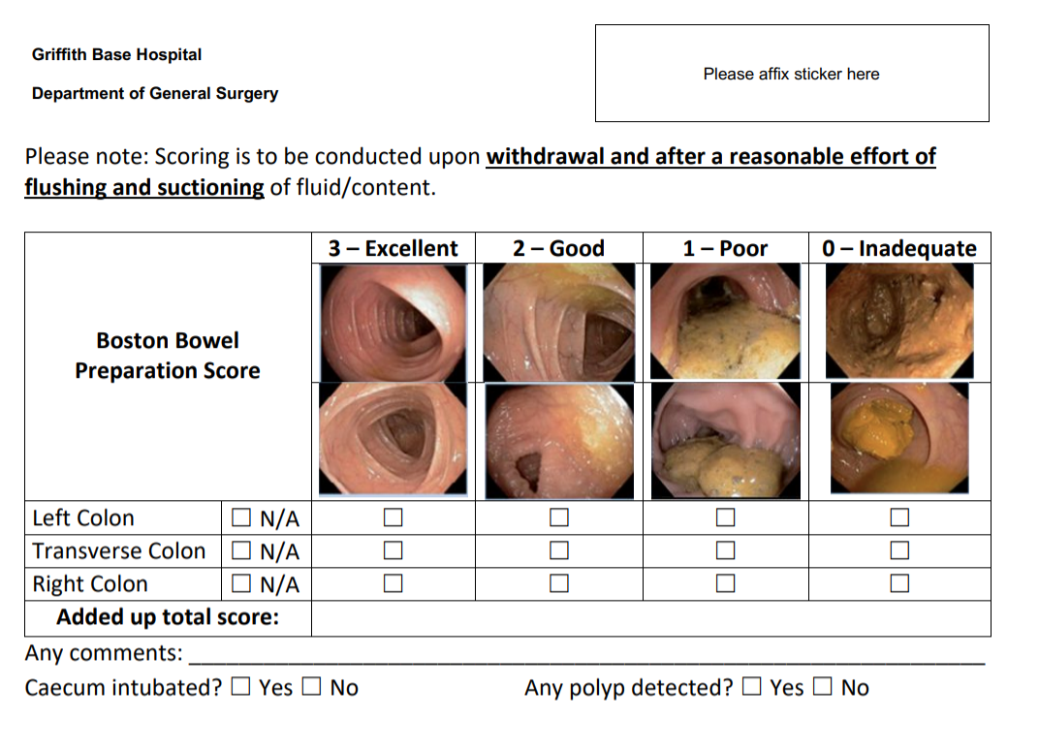
Boston Bowel Preparation Score Sheet

Slide 12
Study Design
Inclusion/Exclusion Criteria
All patients booked for elective colonoscopy
Full informed consent given
It is hoped that 500 participants will be recruited for both arms of the study.
Further information in language has been provided in the two largest non-english speaking populations at Griffith, Italian and Punjabi - all consent information, as well as messages, phone calls and questionnaires have been translated.

Slide 13
Outcome Measures
Primary Endpoints
Evidence of statistically significant improvement in BBPS scores
Secondary Endpoints
Evidence of statistically significant reduction in complication and cancellation rate
Evidence of statistically significant improvement in caecal intubation and polyp detection rates
Evidence of statistically significant improvement in patient’s understanding of and compliance with BP instruction

Slide 14
Thank you
Further information - griffith.bowelprep.info

Slide 15
References
Rex DK, Imperiale TF, Latinovich DR, Bratcher LL. (2002). Impact of bowel preparation on efficiency and cost of colonoscopy. Am J Gastroenterol. 2002 Jul;97(7):1696-700. doi: 10.1111/j.1572-0241.2002.05827.x. PMID: 12135020.
Chokshi RV, Hovis CE, Hollander T, Early DS, Wang JS. (2012). Prevalence of missed adenomas in patients with inadequate bowel preparation on screening colonoscopy. Gastrointest Endosc. 2012 Jun;75(6):1197-203. doi: 10.1016/j.gie.2012.01.005. Epub 2012 Feb 28. PMID: 22381531.
Froehlich F, Wietlisbach V, Gonivers JJ, Burnand B, Vader JP. (2005). Impact of colonic cleansing on quality and diagnostic yield of colonoscopy: the European Panel of Appropriateness of Gastrointestinal Endoscopy European multicenter study. Gastrointest Endosc. 2005 Mar;61(3):378-84. doi: 10.1016/s0016-5107(04)02776-2. PMID: 15758907.
Harewood GC, Sharma VK, de Garmo P. (2003). Impact of colonoscopy preparation quality on detection of suspected colonic neoplasia. Gastrointest Endosc. 2003 Jul;58(1):76-9. doi: 10.1067/mge.2003.294. PMID: 12838225.

Slide 16
Refences
Guo X, Yang Z, Zhao L, Leung F, Luo H, Kang X, Li X, Jia H, Yang S, Tao Q, Pan Y, Guo X. (2017). Enhanced instructions improve the quality of bowel preparation for colonoscopy: a meta-analysis of randomized controlled trials. Gastrointest Endosc. 2017 Jan;85(1):90-97.e6. doi: 10.1016/j.gie.2016.05.012. Epub 2016 May 14. PMID: 27189659.
Spiegel, B. M., Talley, J., Shekelle, P., Agarwal, N., Snyder, B., Bolus, R., Kurzbard, N., Chan, M., Ho, A., Kaneshiro, M., Cordasco, K., & Cohen, H. (2011). Development and validation of a novel patient educational booklet to enhance colonoscopy preparation. The American journal of gastroenterology, 106(5), 875–883. https://doi.org/10.1038/ajg.2011.75
Calderwood, A. H., Lai, E. J., Fix, O. K., & Jacobson, B. C. (2011). An endoscopistblinded, randomized, controlled trial of a simple visual aid to improve bowel preparation for screening colonoscopy. Gastrointestinal endoscopy, 73(2), 307–314. https://doi.org/10.1016/j.gie.2010.10.013

Slide 17
References
Liu, X., Luo, H., Zhang, L., Leung, F. W., Liu, Z., Wang, X., Huang, R., Hui, N., Wu, K., Fan, D., Pan, Y., & Guo, X. (2014). Telephone-based re-education on the day before colonoscopy improves the quality of bowel preparation and the polyp detection rate: a prospective, colonoscopist-blinded, randomised, controlled study. Gut, 63(1), 125–130. https://doi.org/10.1136/gutjnl-2012-304292
Lee, Y. J., Kim, E. S., Choi, J. H., Lee, K. I., Park, K. S., Cho, K. B., Jang, B. K., Chung, W. J., & Hwang, J. S. (2015). Impact of reinforced education by telephone and short message service on the quality of bowel preparation: a randomized controlled study. Endoscopy, 47(11), 1018–1027. https://doi.org/10.1055/s-0034-1392406
Kang, X., Zhao, L., Leung, F., Luo, H., Wang, L., Wu, J., Guo, X., Wang, X., Zhang, L., Hui, N., Tao, Q., Jia, H., Liu, Z., Chen, Z., Liu, J., Wu, K., Fan, D., Pan, Y., & Guo, X. (2016). Delivery of Instructions via Mobile Social Media App Increases Quality of Bowel Preparation. Clinical gastroenterology and hepatology : the official clinical practice journal of the American Gastroenterological Association, 14(3), 429–435.e3. https://doi.org/10.1016/j.cgh.2015.09.038

Slide 18
References
Janahiraman, S., Tay, C. Y., Lee, J. M., Lim, W. L., Khiew, C. H., Ishak, I., Onn, Z. Y., Ibrahim, M. R., & Chew, C. K. (2020). Effect of an intensive patient educational programme on the quality of bowel preparation for colonoscopy: a single-blind randomised controlled trial. BMJ open gastroenterology, 7(1), e000376. https://doi.org/10.1136/bmjgast-2020-000376
Walter, B., Frank, R., Ludwig, L., Dikopoulos, N., Mayr, M., Neu, B., Mayer, B., Hann, A., Meier, B., Caca, K., Seufferlein, T., & Meining, A. (2021). Smartphone Application to Reinforce Education Increases High-Quality Preparation for Colorectal Cancer Screening Colonoscopies in a Randomized Trial. Clinical gastroenterology and hepatology : the official clinical practice journal of the American Gastroenterological Association, 19(2), 331–338.e5. https://doi.org/10.1016/j.cgh.2020.03.051

