Slide 1


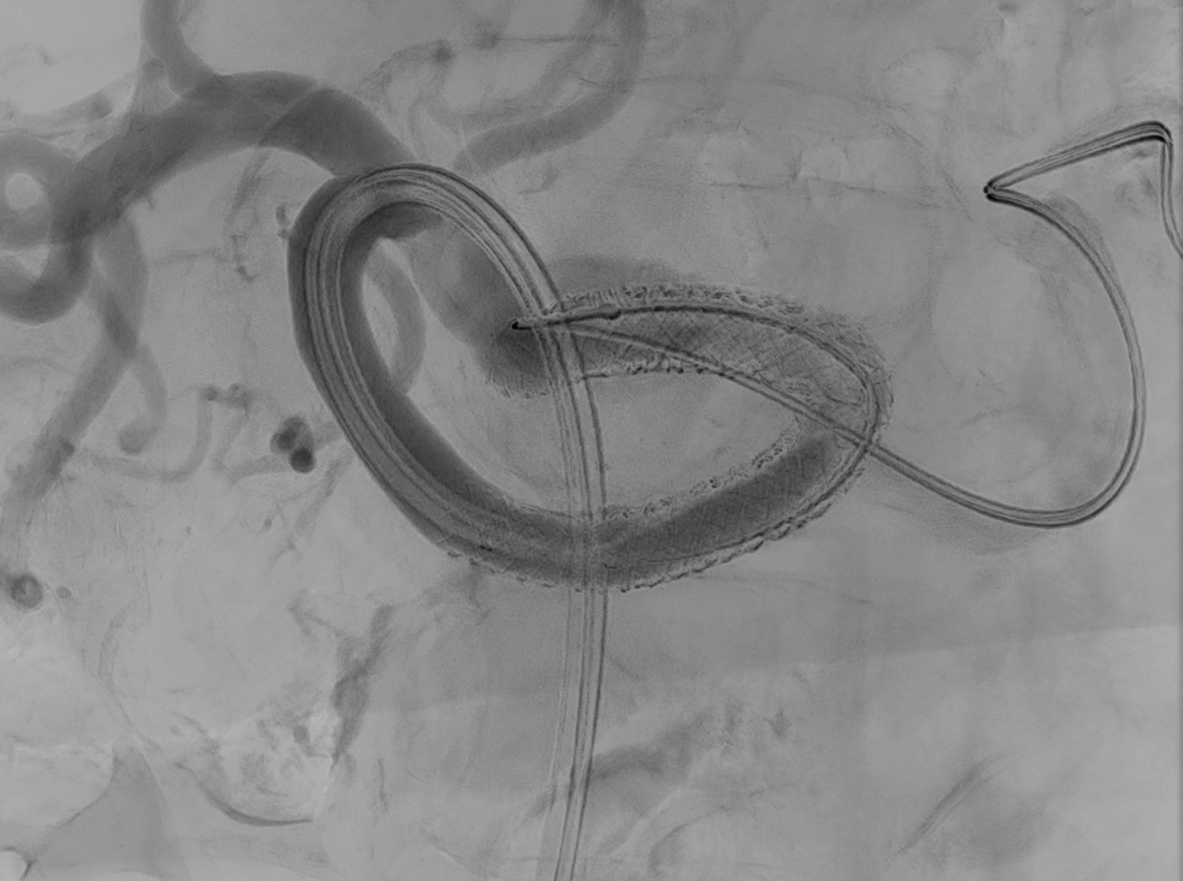
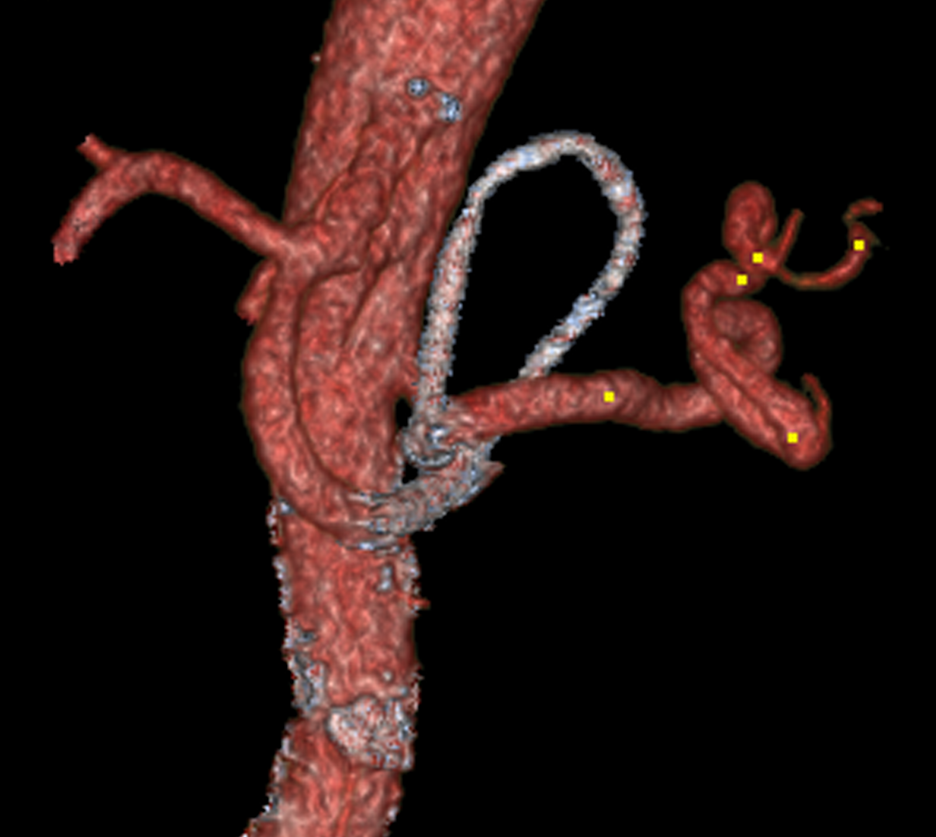
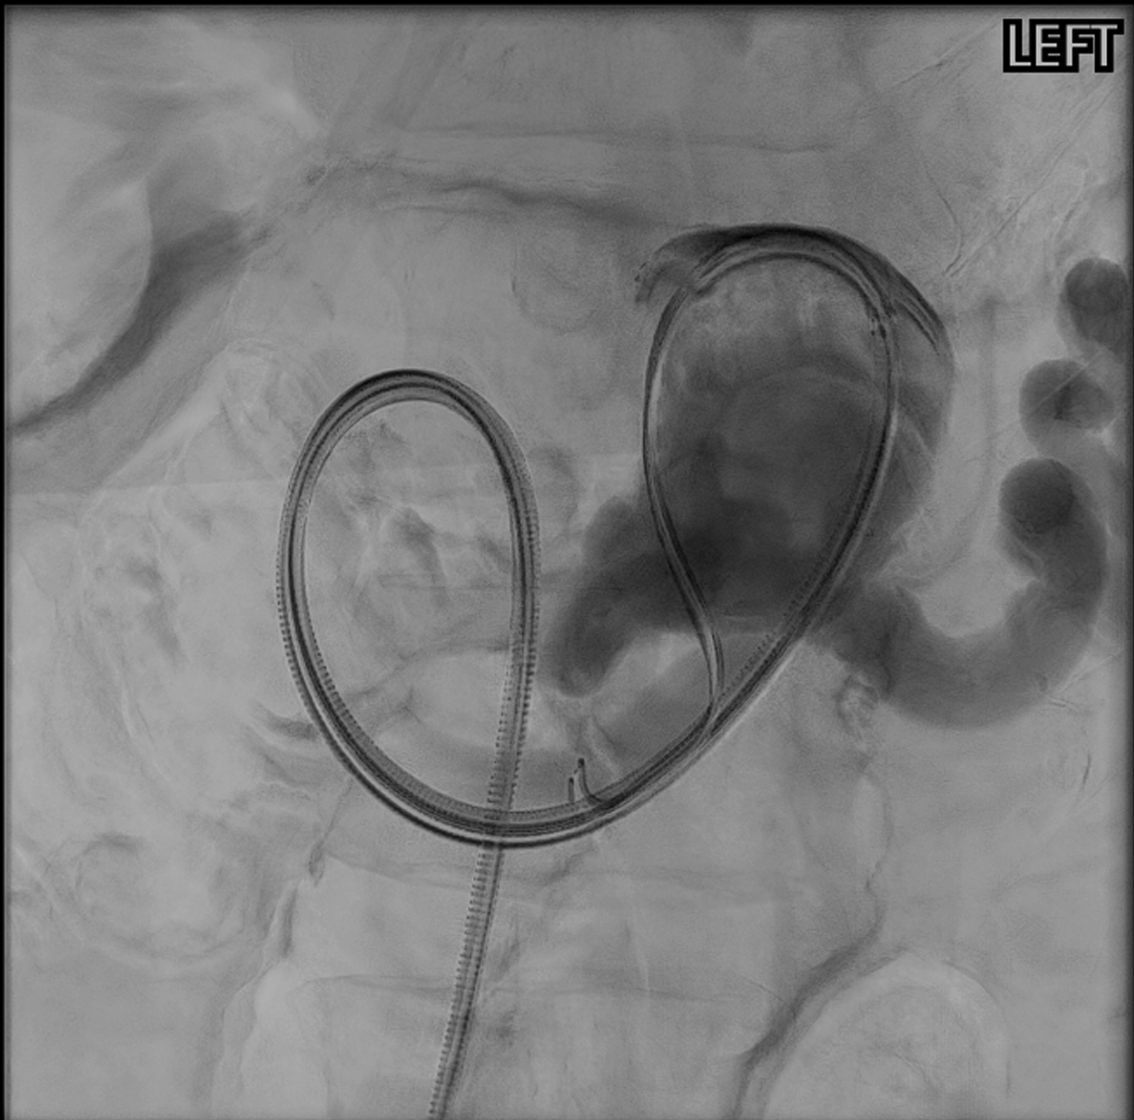
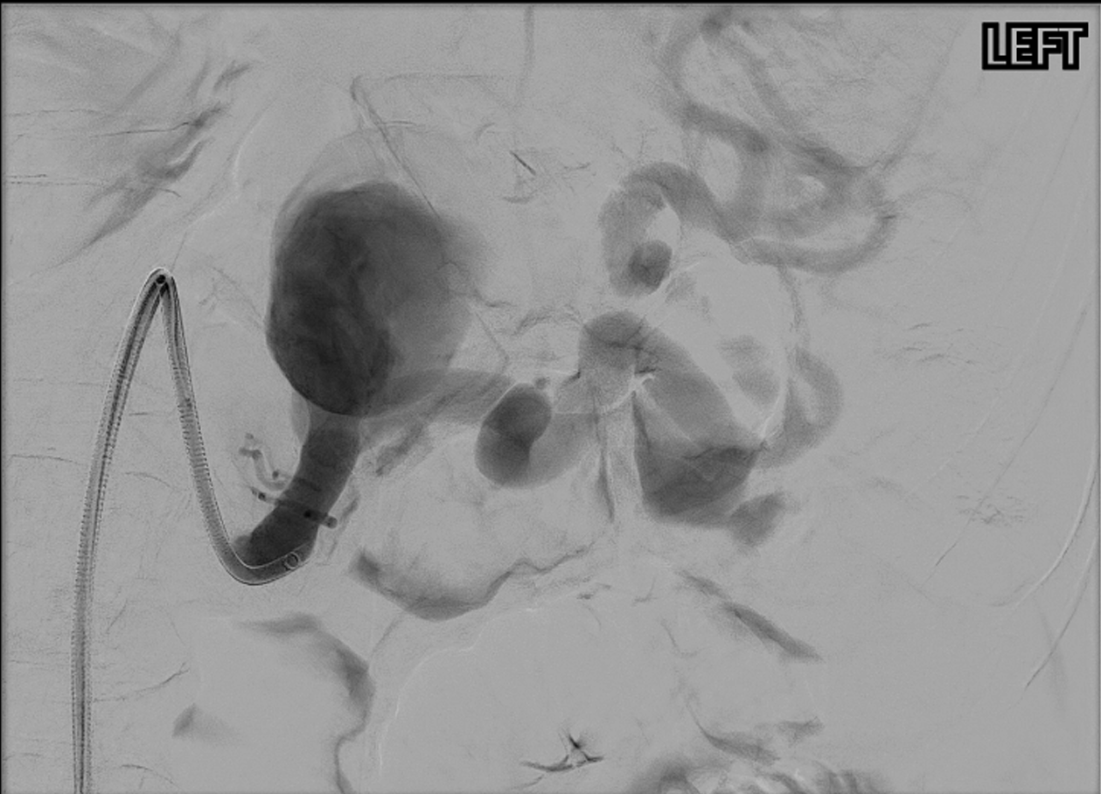
Large splenic artery aneurysm: An effective approach to highly tortuous vessels
BTK McManus, T Warburton, D Evans
Department of Vascular Surgery, St Vincent’s Hospital, Sydney
Introduction
General anaesthesia was administered and bilateral common femoral access was obtained. Celiac angiogram demonstrated a large mid-splenic artery aneurysm with significant tortuosity throughout the entirety of the vessel. Right groin access was upsized to an 8.5Fr Agilis NxT steerable sheath to provide stability. Given the inability to create a straight platform, the decision was made to deploy 7mm Gore Viabahn VBX balloon-mounted covered stents to allow for trackability whilst minimising the sheath size required. The acute angulation of the inflow and outflow vessels necessitated prolapse of the stents into the aneurysmal segment. The stented portion was then reinforced with Medtronic Everflex self-expanding stents to contour the repair and prevent stent kinking.
Completion angiogram showed patent inflow and outflow vessel and a sealed splenic artery aneurysm with no evidence of endoleak.
A follow up CT angiogram six weeks postoperatively showed patent stents with a sealed splenic artery aneurysm.
In order to mitigate the need for such a large sheath, and thus reduce its relative risks, we utilised balloon-expandable covered stents to successfully seal the aneurysm.
Whilst some case series have investigated the utility of balloon-mounted stent for aneurysm repair, few have looked at how to effectively negotiate a highly tortuous splenic artery whilst minimising sheath diameter. The ability to mitigate and minimize access-related complications such as haemorrhage or ischaemia by utilising a smaller sheath size is invaluable.
Splenic artery aneurysms (SAA) are the most common occurring visceral artery aneurysm. They are estimated to be present in 1% of the population, are more common in women and incidence increases with age.^{1,2} Despite often being asymptomatic, their presence is increasingly being identified with the use of CT and MRI imaging. Operative repair has been improved over the years with the emergence and advent of endovascular techniques, but pose a separate set of specific risks and challenges.^{3,4}
The chief outcome of clinical significance in SAAs is rupture, with a mortality rate of 25-40%.⁵
Conclusion
Case report
A 72 year old gentleman was referred to the vascular surgical service with a recent history of colorectal malignancy necessitating resection, with a staging CT chest, abdomen and pelvis that demonstrated a concurrent 55mm mid splenic artery aneurysm. Other past medical history was significant for hypertension and a previous smoking history.
On assessment of the splenic artery, significant tortuosity and sharp angulation of the inflow and outflow vessels precluded confident deployment of a self-expanding covered endograft commonly utilised in such pathology.⁶ Given the risk of open intervention in the setting of recent abdominal surgery, and the imminent initiation of chemotherapy, endovascular management was still considered the most appropriate treatment approach.⁷
We present here a novel approach and method to confidently navigate highly tortuous vessels utilising balloon-mounted covered stents via a low-profile sheath to safely navigate fragile vessels and permit accurate deployment and successfully treat a large splenic artery aneurysm.
References
Kaya M, Baran Ş, Güya C, Kaplan MA. Prevalence and predictive factors for development of splenic artery aneurysms in cirrhosis. Indian J Gastroenterol. 2016 May;35(3):201-6. doi: 10.1007/s12664-016-0670-z. Epub 2016 Jun 3. PMID: 27256433.
Abbas MA, Stone WM, Fowl RJ, Gloviczki P, Oldenburg WA, Pairolero PC, Hallett JW, Bower TC, Panneton JM, Cherry KJ. Splenic artery aneurysms: two decades experience at Mayo clinic. Ann Vasc Surg. 2002 Jul;16(4):442-9. doi: 10.1007/s10016-001-0207-4. Epub 2002 Jul 1. PMID: 12089631
Hogendoorn W, Lavida A, Hunink MG, Moll FL, Geroulakos G, Muhs BE, Sumpio BE. Open repair, endovascular repair, and conservative management of true splenic artery aneurysms. J Vasc Surg. 2014 Dec;60(6):1667-76.e1. doi: 10.1016/j.jvs.2014.08.067. Epub 2014 Sep 26. PMID: 25264364.
Zhu C, Zhao J, Yuan D, Huang B, Yang Y, Ma Y, Xiong F. Endovascular and Surgical Management of Intact Splenic Artery Aneurysm. Ann Vasc Surg. 2019 May;57:75-82. doi: 10.1016/j.avsg.2018.08.088. Epub 2018 Nov 26. PMID: 30496903.
Chaer RA, Abularrage CJ, Coleman DM, Eslami MH, Kashyap VS, Rockman C, Murad MH. The Society for Vascular Surgery clinical practice guidelines on the management of visceral aneurysms. J Vasc Surg. 2020 Jul;72(1S):3S-39S. doi: 10.1016/j.jvs.2020.01.039. Epub 2020 Mar 20. PMID: 32201007.
Venturini M, Marra P, Colombo M, Panzeri M, Gusmini S, Sallemi C, Salvioni M, Lanza C, Agostini G, Balzano G, Tshomba Y, Melissano G, Falconi M, Chiesa R, De Cobelli F, Del Maschio A. Endovascular Repair of 40 Visceral Artery Aneurysms and Pseudoaneurysms with the Viabahn Stent-Graft: Technical Aspects, Clinical Outcome and Mid-Term Patency. Cardiovasc Intervent Radiol. 2018 Mar;41(3):385-397. doi: 10.1007/s00270-017-1844-5. Epub 2017 Nov 21. PMID: 29164308.
Reed NR, Oderich GS, Manunga J, Duncan A, Misra S, de Souza LR, Fleming M, de Martino R. Feasibility of endovascular repair of splenic artery aneurysms using stent grafts. J Vasc Surg. 2015 Dec;62(6):1504-10. doi: 10.1016/j.jvs.2015.07.073. Epub 2015 Sep 10. PMID: 26365664.
Figure 3: Completion angiogram demonstrating sealed aneurysm
Figure 4: Post-operative CT angiogram demonstrating patent, sealed aneurysm
Discussion
The significant tortuosity of the splenic artery poses a significant challenge for endovascular management. The classical nature of splenic arteries are tortuous, and the evolution of aneurysms further exacerbate this. Mr DF’s anatomy prevented our ability to track an appropriate sheath to confidently and effectively deploy a self-expanding covered stent. To counter this, a larger sheath, often as large as 12 Fr, would have been required to provide a more stable platform to telescope a sheath in order to facilitate accurate and precise stent deployment.
Figure 1: Diagnostic angiogram of large splenic artery aneurysm
Figure 2: Angiogram demonstrating significant vessel tortuosity both proximal and distal to aneurysm

