Slide 1
April 2021
Meeting
EASTERN & GREATER SOUTHERN SURGICAL SKILLS TRAINING NETWORK

Slide 2
OUTLINE
Welcome
Education Session: How to Write a Case Report
SRS Education Update
SRS Research Update
Feedback and Discussion

Slide 3
Education Session - Dr Ritesh Patel

Slide 4
How to right a case report
Ritesh Patel
GI Fellow
Yashutosh Joshi
Cardiothoracic Registrar & PhD Candidate

Slide 5
Key Considerations
What is the purpose - points on C.V
Genuine interest in the situation
Rare event and want others to know about it

Slide 6
How to choose the topic
Usually senior colleague recognises it is a rare event or unusual presentation
Unusual presentation of common conditions
Usually just ask a senior

Slide 7
PERSIST!!
Find a way or MAKE a way
No one else is going to do it for you

Slide 8
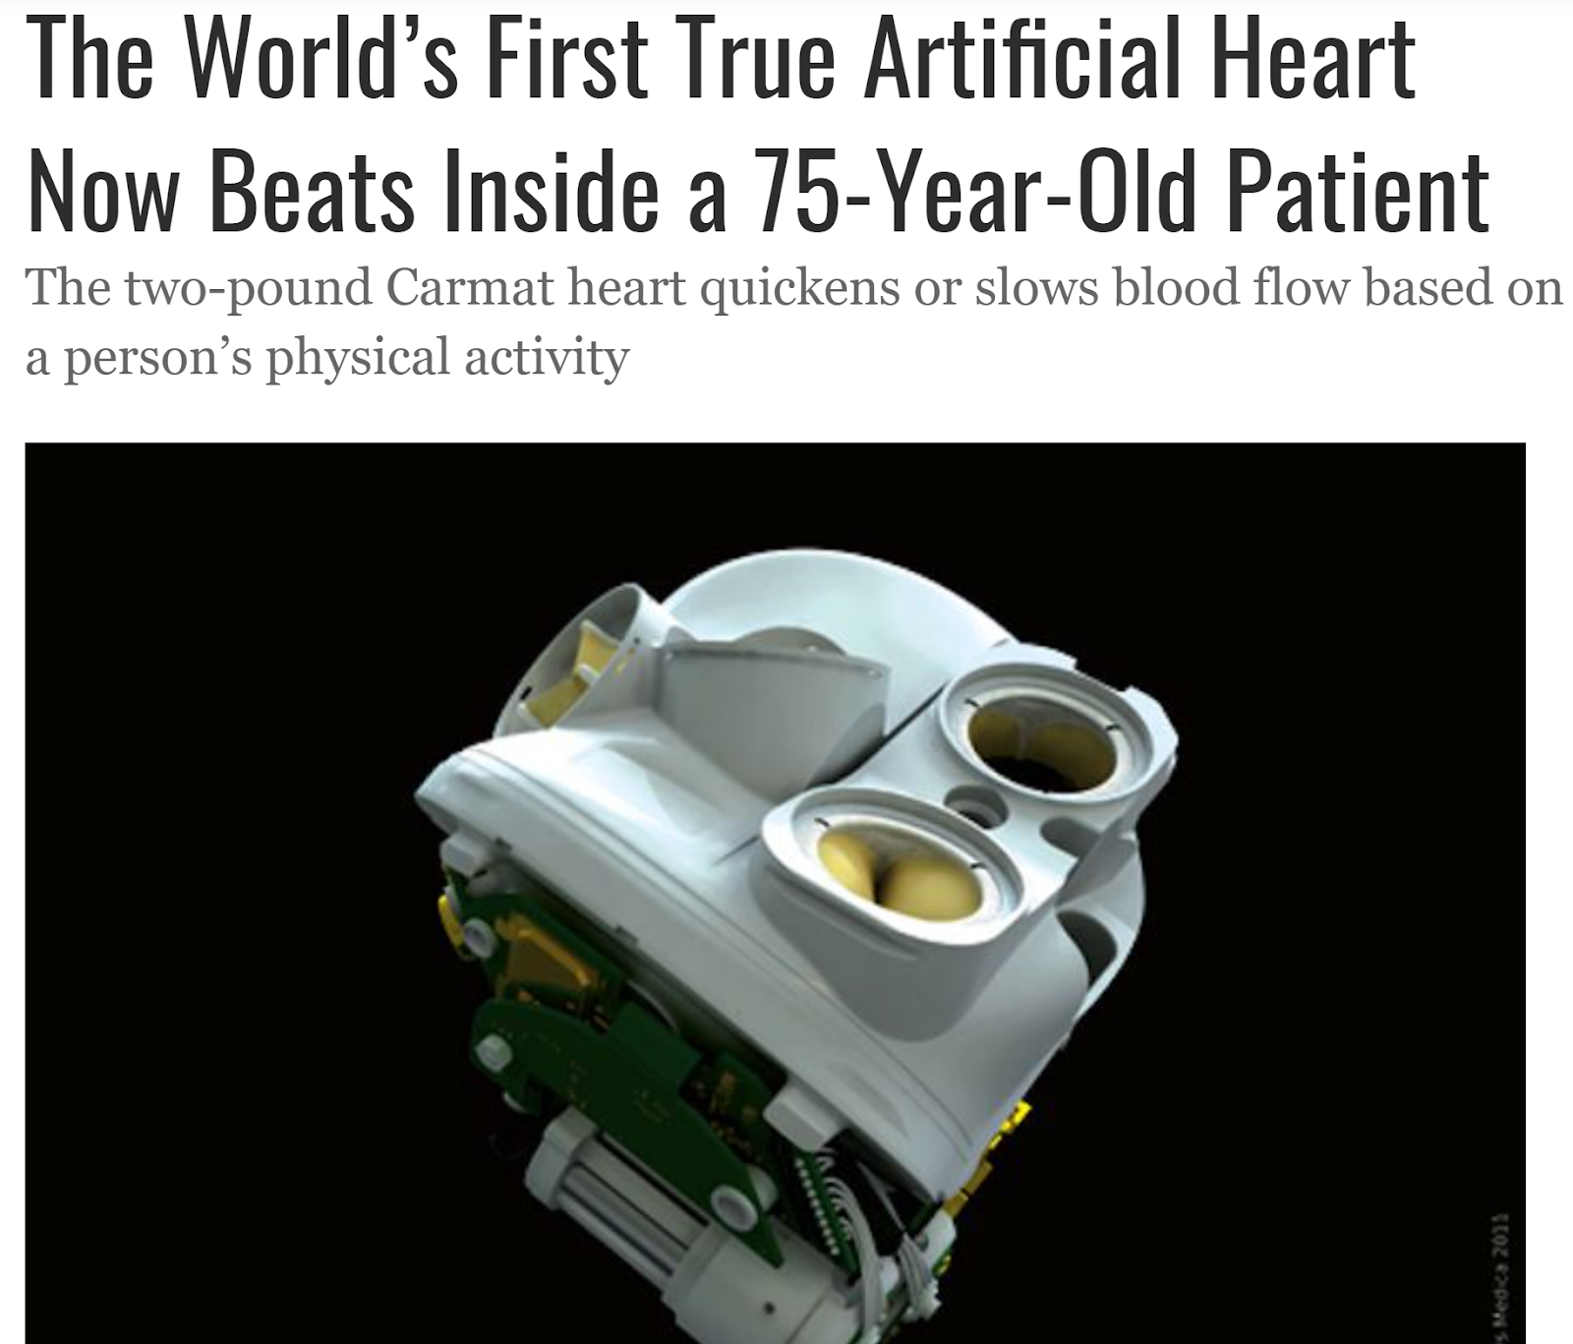
Inspiration can come from the strangest places….even France!

Slide 9
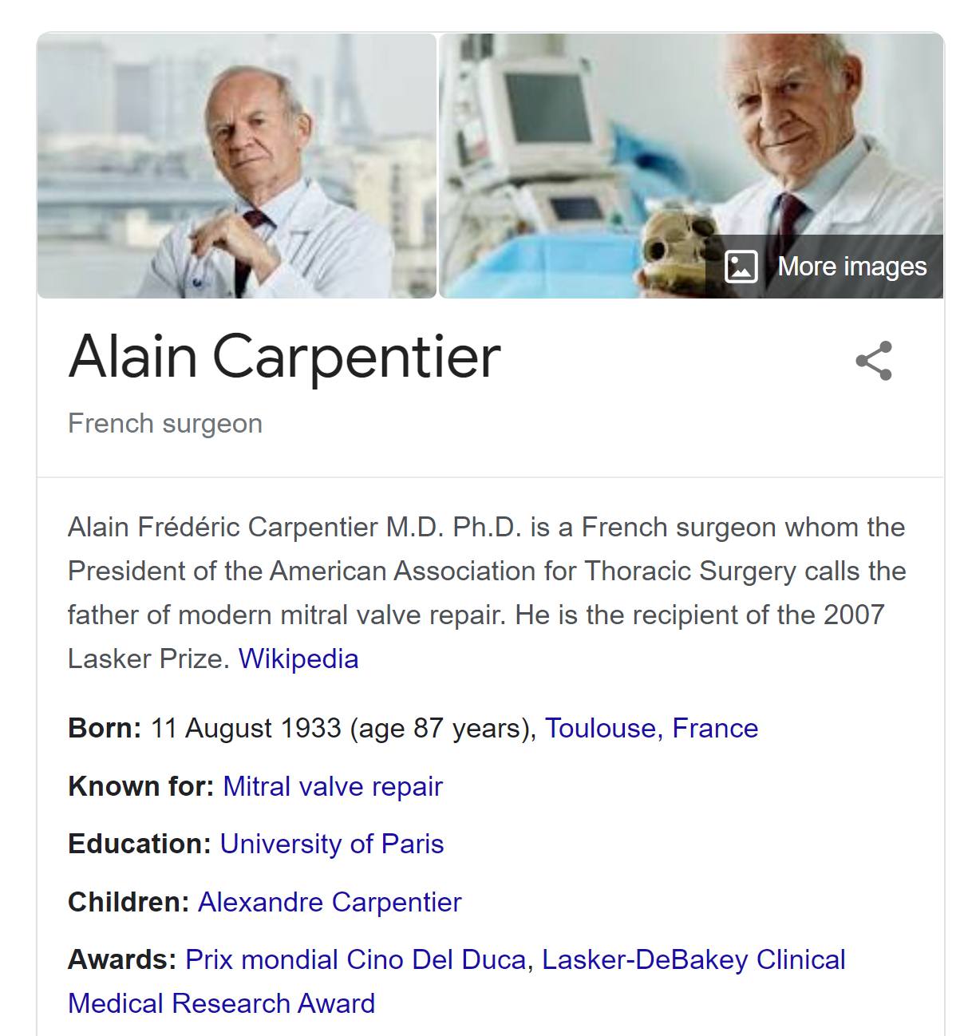

Slide 12
Things to remember
Lot of work and low rewards
Introduction to writing papers

Slide 13
Other types of papers to consider
Retrospective Reviews
Systematic reviews (Cochrane database for example)

Slide 14
Before writing
Use multiple sources
Pubmed, Medline, Uptodate etc
Read them carefully to see how case contributes to that literature
How it is same and how it is different

Slide 15
How to do it
Pick the journal you wish to write to
Thoroughly read their requirements on a case report
Format, pictures, references, word limit etc
Do this carefully before you start writing

Slide 16
Would also add
Try, if you can, to have sources that the journal has already published
Pictures and media make a big difference!
Prepare yourself for the peer review comments

Slide 17
Some cautions
“Only 26 report cases worldwide” - not the same as only 26 pts ever had this pathology
It is a lot of work!!

Slide 19
SRS Education Update

Slide 20
SRS Research Update

Slide 21
Feedback and Discussion

Slide 22
Current Project Updates
SVH Updates

Slide 23
Thank you for coming!
EASTERN AND GREATER SOUTHERN SYDNEY

