Slide 1


Slide 2
Welcome
Dr Mark Muhlmann - opening and judges introduction
Sponsors - MIGA and MIPS
SRS overview
Presentations
Posters
Awards

Slide 3
Dr Mark Muhlmann - Network Director

Slide 4
Judges
Professor Philip Crowe
Head of Prince of Wales Clinical School
Dr Christina Norris
Geriatrician (Care of Older People in Surgery service)
Dr David Evans
St Vincent's Hospital Site Director of Surgical Training
Dr Mark Muhlmann
Network Director of Surgical Training

Slide 5
Sponsors

Slide 6
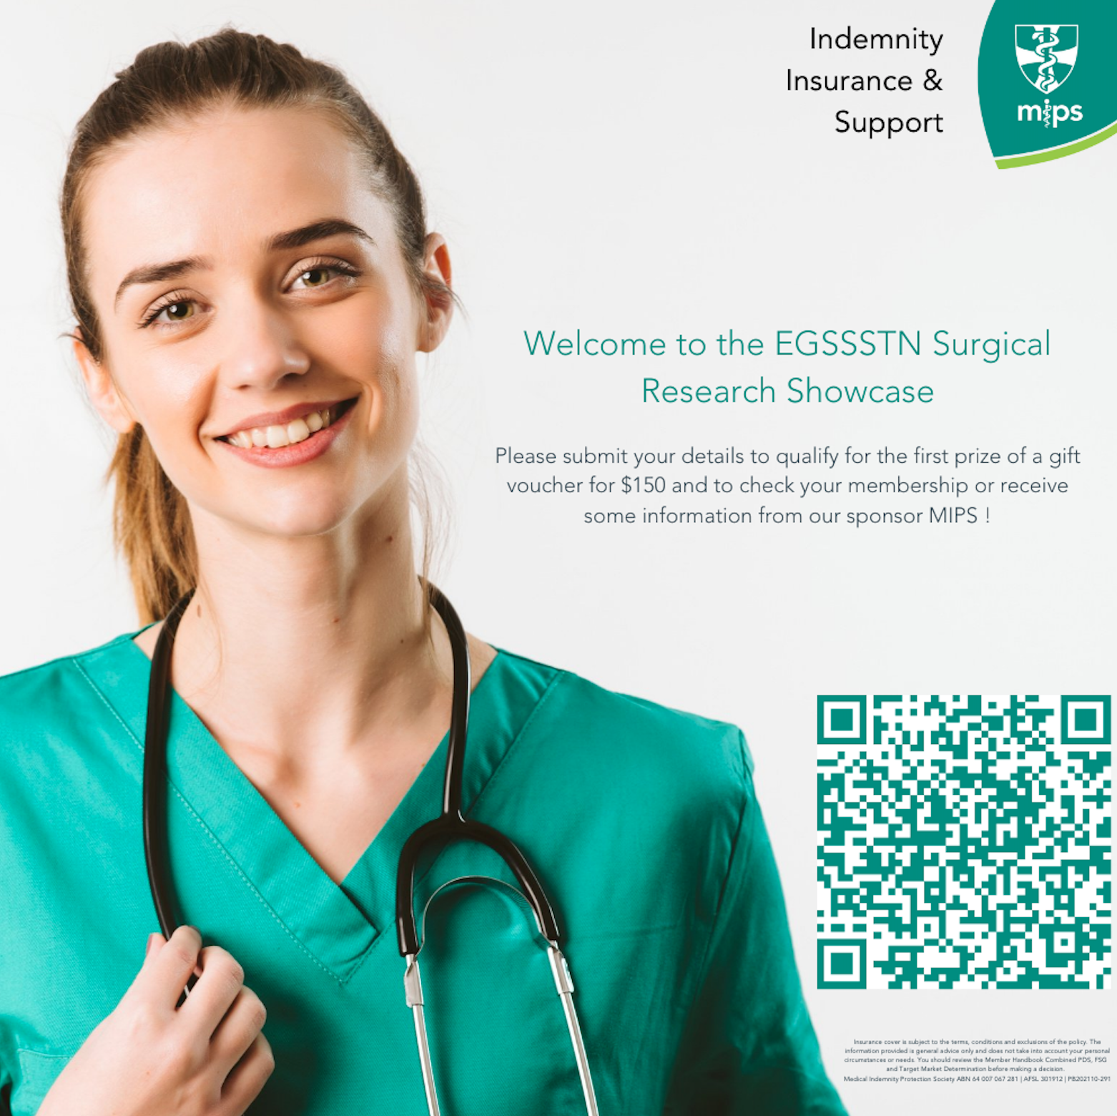

Slide 7
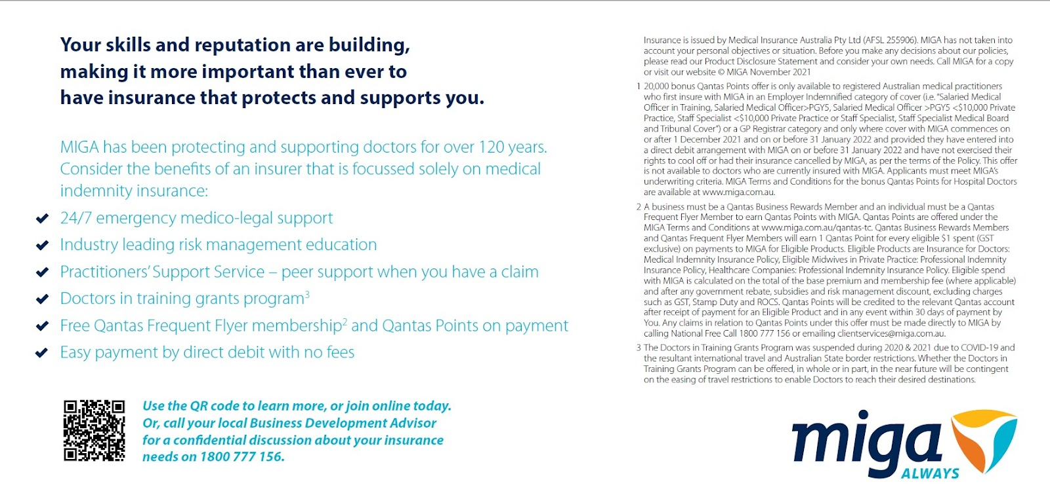

Slide 8


Slide 9
SRS overview

Slide 10
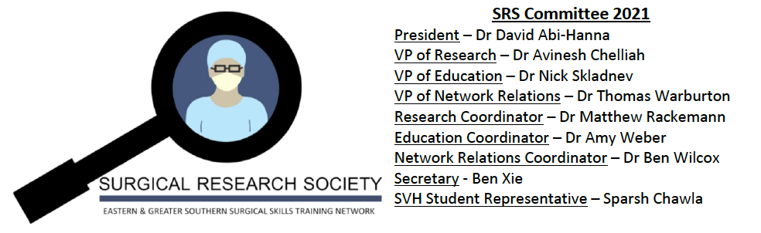
Committee

Slide 11
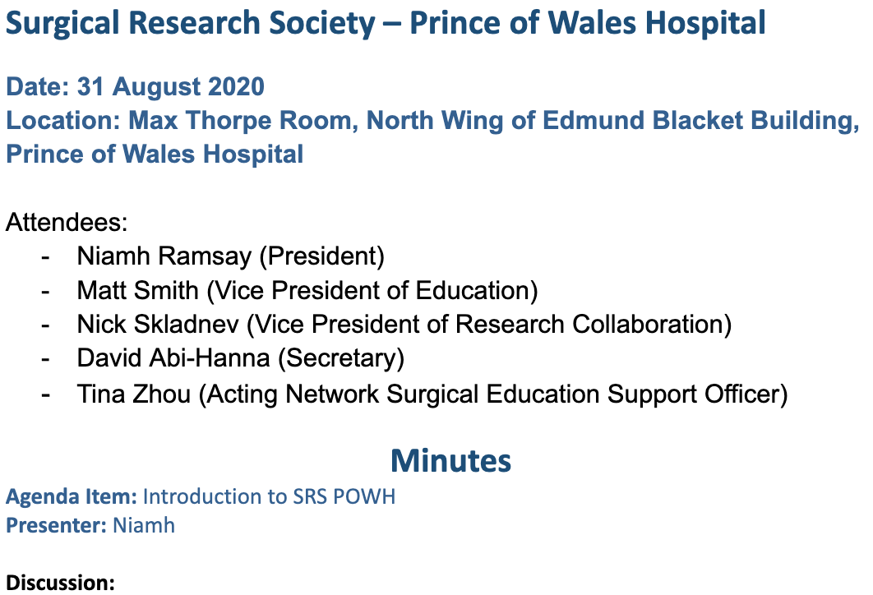
History

Slide 12
Problem
Everyone needs/wants to do research
Lack of centralised system
Challenges accessing supervisors and research projects
Difficulties creating partnerships between junior and senior medical staff
Poor experience / education in research methods

Slide 13
Solution
Networking platform for individuals with similar research topic interests
Exposure and experience in quality improvement and research activity
Professional development in the context of research-targeted education
Database of current and upcoming research projects
Opportunity for feedback on current projects

Slide 14
Structure
Portfolios - Education, Research, Network relations
~50 members - medical students, JMOs, RMOs, SRMOs, registrars
Monthly meetings (last Thursday night of each month)
  Education - improve understanding of quality improvement and research processes
  Discussion - progress of current projects
  Feedback - forum to present work
  Mini-journal club - develop critical appraisal skills and increase exposure to medical literature
Showcase + AGM

Slide 15
Research
Supported JMOs with ongoing projects in
  Surgical oncology
  Vascular surgery
  Plastic and reconstructive surgery
  ENT surgery
  Orthopaedic surgery
  Urology
Facilitated workshops
  Ethics approval
  Data analysis
Improved accessibility of statistical support via UNSW
Showcase - 6 oral presentations, 6 poster presentations

Slide 16
Education

Slide 17
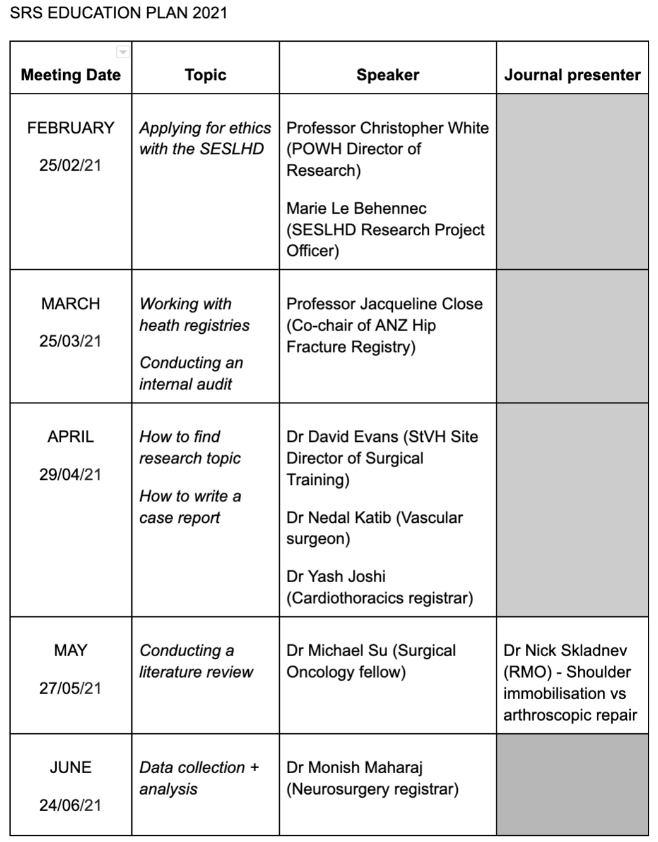
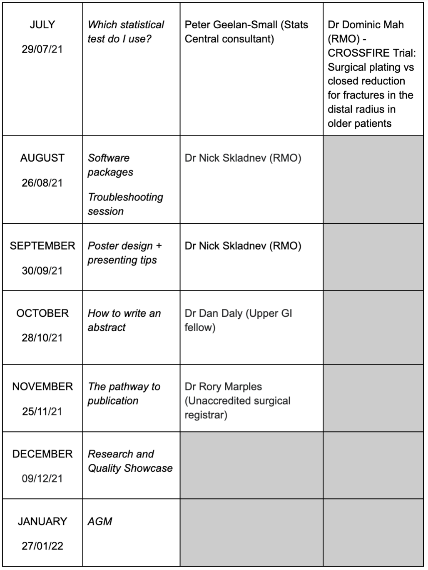

Slide 18
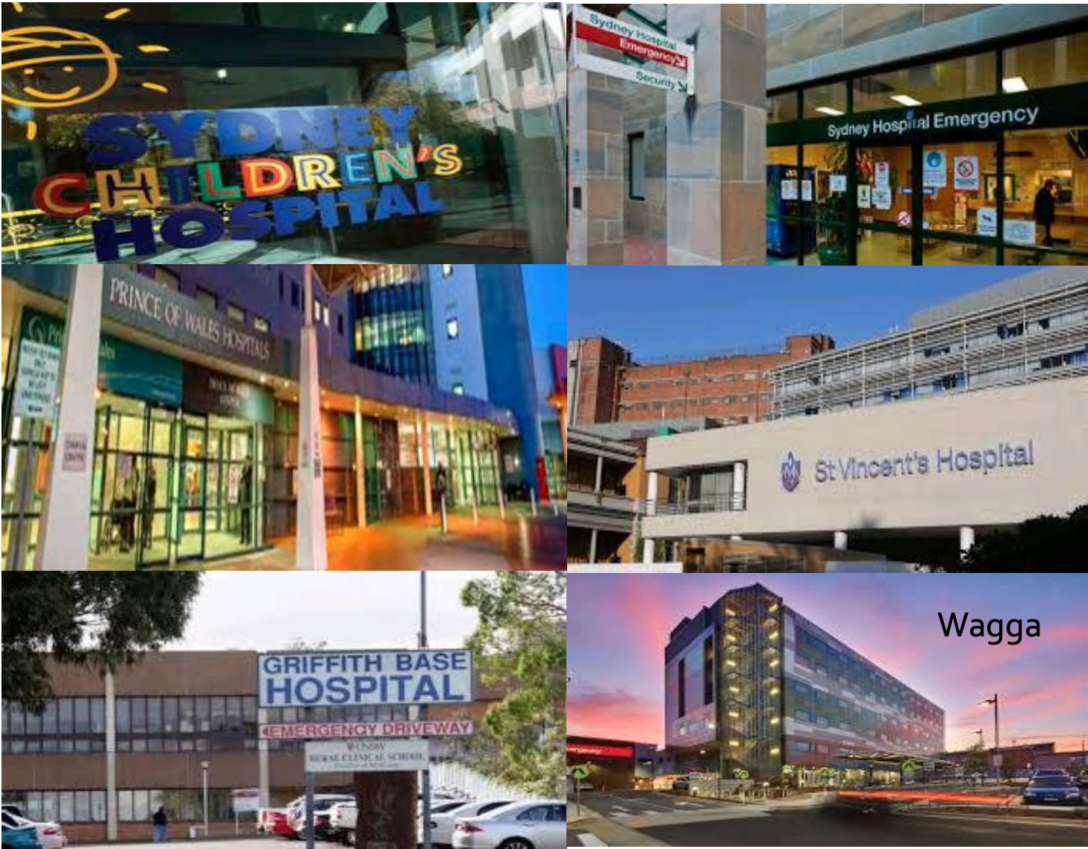
Network

Slide 19
Vision
Foster an environment which encourages mentorship and support
Improve surgical research skills and teamwork
Mental health and stress reduction
Pioneer at POWH and expand into EGSS network
Model for and collaboration with other surgical networks (also POWH MRS)
Outcomes - membership + involvement → conferences + publications

Slide 20

Thanks
Tina Zhou
Dr Mark Muhlmann
Dr David Evans
Dr Nedal Katib
Founding members
Current committee members
Presenters tonight
Sponsors
AGM
Thursday 27th January 2022
EOI for committee positions

Slide 21

Showcase

Slide 22
Posters
Amy Weber
Femoral Neck System vs. Dynamic Hip Screw fixation for undisplaced intracapsular NOF#
Benjamin Tassie
Are there postoperative benefits of fascia Iliaca blocks performed in ED for patients with a NOF#?
Bryan McManus
Large splenic artery aneurysm - an effective approach to highly tortuous vessels
Hayden Ly
The Australia and New Zealand Diabetic and Ischaemic Foot Outcomes Study
Rory Marples
Rectal Foreign Bodies: A Single-Centre 20-year Retrospective Review
Thomas Warburton
Setting up a Chest Injury Protocol in a Rural Hospital

Slide 23
Presentations
Avinesh Chelliah
A surgical skills logbook for junior doctors
Connor O’Meara
Histones - the dark of immunity
John Kandiah
Effect of enhanced interactive text messages and phone instruction on the quality of bowel preparation for colonoscopy: a randomised controlled trial
Melissa Wright
Percutaneous SpyGlass cholangioscopy for treatment of intrahepatic bile duct calculi
Nick Skladnev
Efficacy and safety of intraoperative tranexamic acid in extracapsular hip fractures
Thomas Warburton
Impact of homelessness on surgical outcomes

Slide 24
Presentations
Judges to breakout room

Slide 25
Posters
https://www.seslhd.health.nsw.gov.au/prince-of-wales-hospital/services-clinics/directory/powh-surgical-training/surgical-research-society-showcase
Username: POWMedEd
Password: #POWMedEd

Slide 26
Awards

Slide 27


“Eastern and Greater Southern
Surgical Research Society”
surgicalresearchsociety@gmail.com

