Slide 1

SRS September Meeting
29 September 2020
Edmund Blacket Building
Prince of Wales Hospital

Slide 2
MEETING OUTLINE
Refresh: SRS POWH Objectives & Membership
New 2020 committee
September Recap
Current research opportunities
Presentation – Creating a research poster

Slide 3
OBJECTIVES
Encourage and facilitate opportunities for exposure and experience in quality improvement and research activity at Prince of Wales Hospital
Provide a networking platform for individuals with similar interests in research topics
Provide opportunity for feedback on current projects
Encourage education and teaching on relevant research topics
Collate a database of current and upcoming research project opportunities

Slide 4
MEMBERSHIP
Open to those interested in surgical research including:
Junior medical officers
Resident medical officers
Senior resident medical officers
Medical students
To become a member of the surgical research society:
Register interest – sign up!
Attend six meeting per 12 month-period

Slide 5
NEW 2020 COMMITTEE
Matthew Smith – Vice President of Education
Nicholas Skladnev – Vice President of Research Collaboration
David Abi-Hanna– Secretary

Slide 6
SEPTEMBER RECAP
Orthopaedics Children’s Meeting
Mock AOA Trainee Interview night
September General Surgery M+M meeting
GSSE
St Vincent’s Hospital
Surgical Research Society Eastern and Greater Southern Sydney

Slide 7
CURRENT RESEARCH OPPORTUNITIES
Vascular: Validating the Wound Ischaemia and Foot Infection (WIfI) grading system for all diabetic foot presentation to Prince of Wales Hospital
Transplants: Details not available
General Surgery: UGI, Details not available

Slide 8
RESEARCH POSTERS

Slide 9

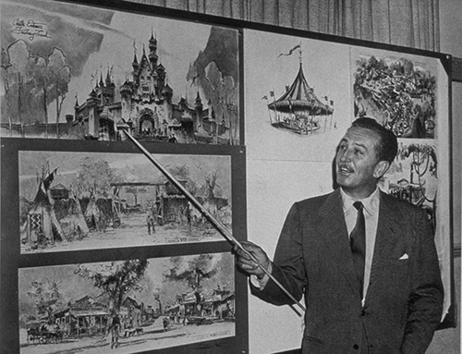
Design Tips
“Elevator pitch”
The lure
Bait & reel
Hook
Line & sinker
Notes:
30 seconds
Play audience. Visuals to attract. Some meat to keep them interested. Readability.
A ‘story’

Slide 10
Development steps
> Conceptualise
Audience
Guidelines
Materials
> Development
Sizing
Outline of content
Design
Layout & flow
> Review
Outside perspective & feedback
Notes:
https://dukeahead.duke.edu/sites/dukeahead.duke.edu/files/u94/Poster%20Creation%20Presentation.pdf

Slide 11


Slide 12
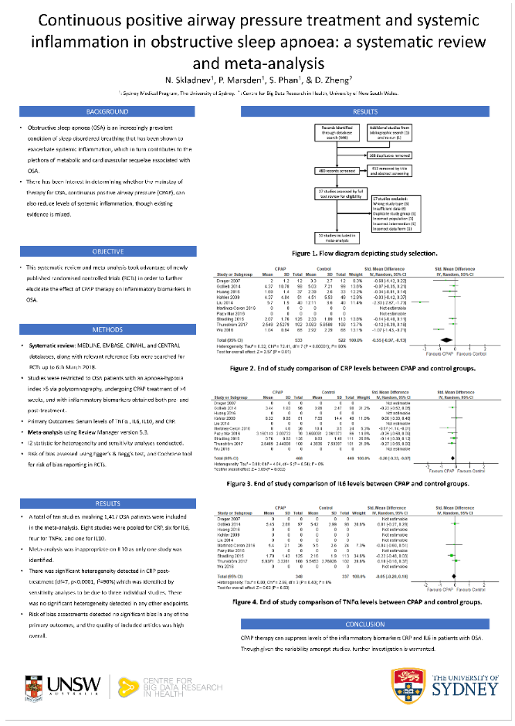


Slide 13
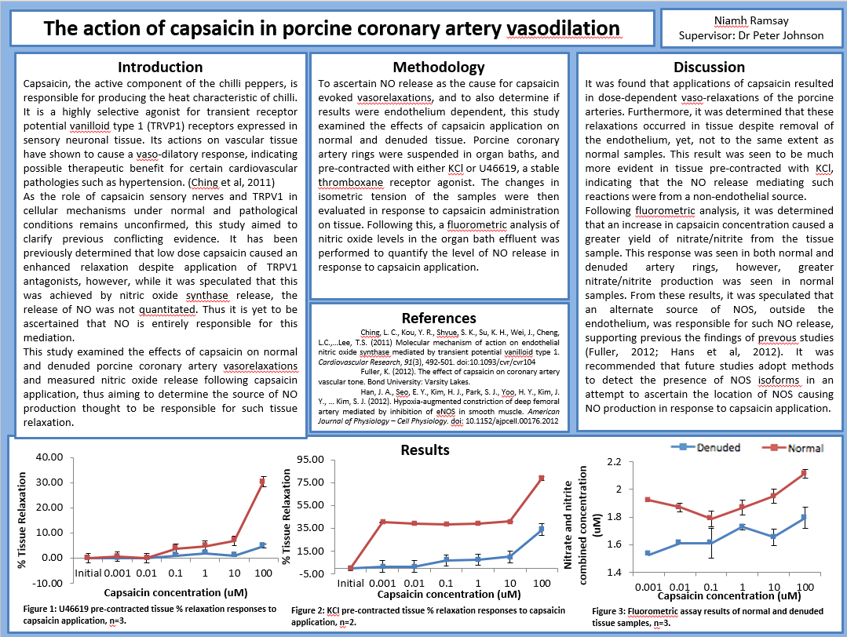

Slide 14
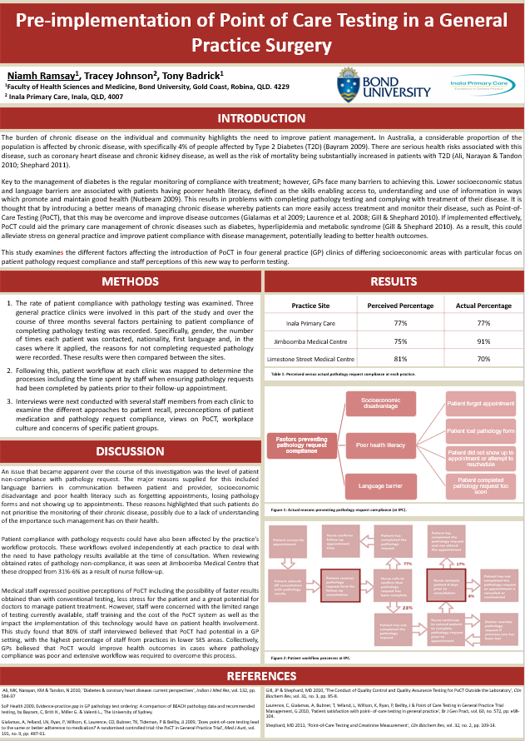

Slide 15
