Slide 1
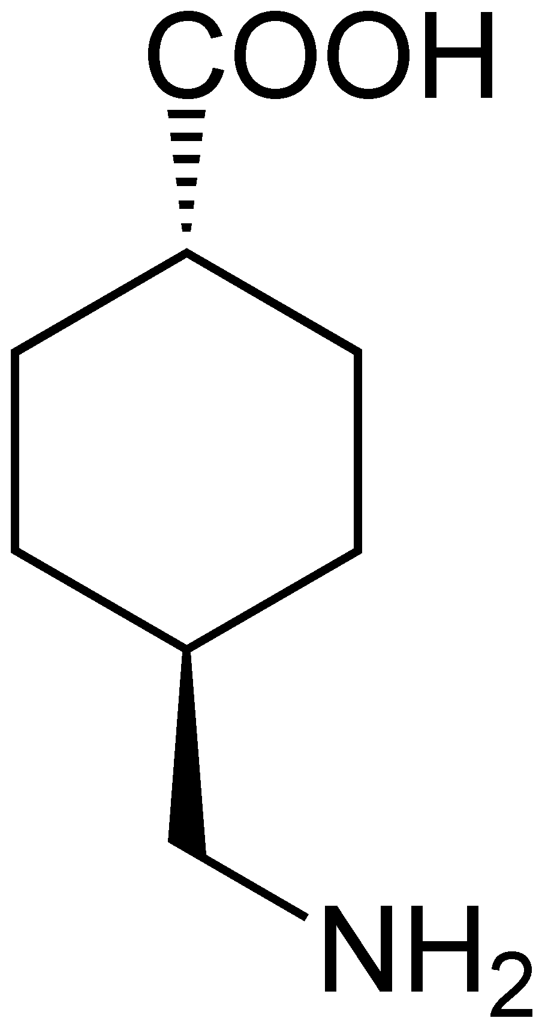
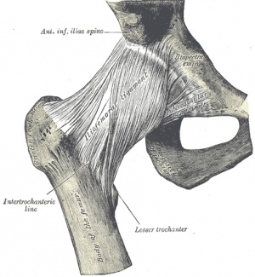
The efficacy and safety of intraoperative tranexamic acid in extracapsular hip fractures.
Nicholas Skladnev
RMO
Prince of Wales Hospital

Slide 2
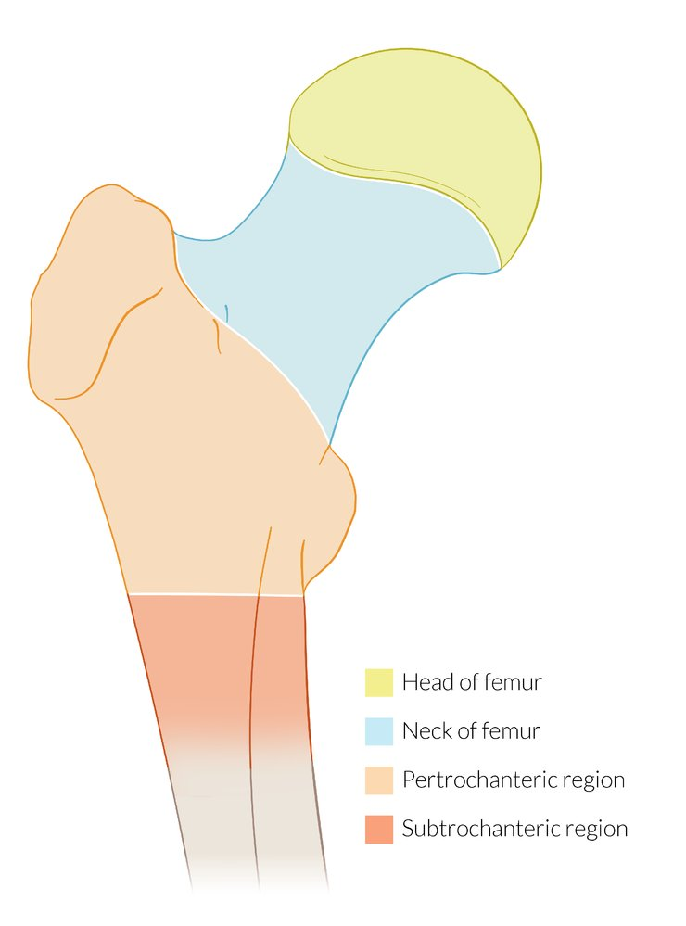
TXA and its use in femoral neck fractures
Anti-fibrinolytic
Well established in severe bleeding/trauma ^{(1,2)}
Good evidence in elective hip arthroplasty ^{(3,4)}
Emerging use in acute hemiarthroplasty ⁽⁵⁾
Can it be used in acute extracapsular fractures?
1. Al-Jeabory et al., J. Clin. Med. (2021)
2. Vasichko et al., Obstet. Gyn. (2018)
3. Fillingham et al., J. Arthroplasty (2018)
4. Zhu et al., Medicine (2017)
5. Xie et al., BMC Musc. Dis. (2019)

Slide 3
Evidence in extracapsular hip fractures?
Controversial
Recent RCT’s show no difference in postop Hb, but less hidden blood loss ⁽⁶⁾
No difference in transfusion rates⁽⁷⁾
Meta-analyses support use in reducing bleeding, transfusion rates, and length of stay ^{(8,9)}
Benefit from early administration of TXA⁽¹⁰⁾
6. Lei et al., JOSR (2017)
7. Zhou et al., Orthop. Surg. (2019)
8. Xing et al., OTSR (2020)
9. Yu et al., J. Thromb (2020)
10. Ma et al., JOSR (2021)

Slide 5
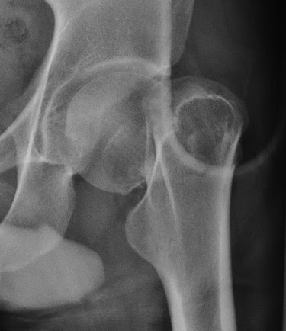
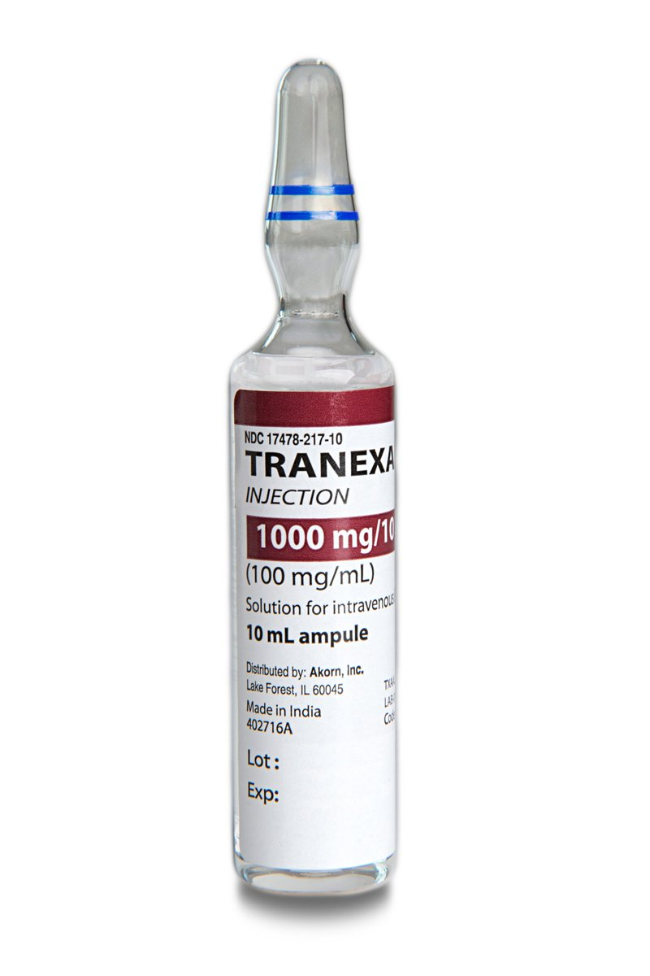
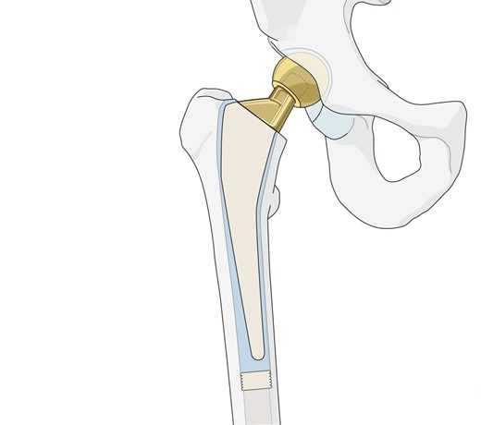
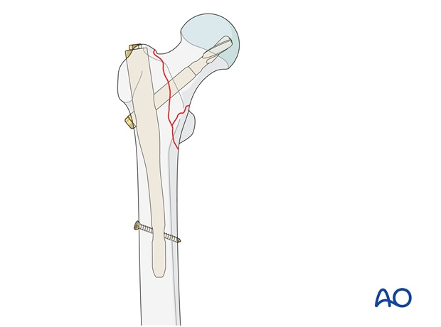
Aim: Examine the efficacy and safety of TXA use in in extracapsular hip fracture patients undergoing surgical intervention

Slide 6
Methods
Single centre study
Retrospective cohort (2019 – 2020)
Incl: All extracapsular hip fractures treated with either IMN or DHS
Excl: Preoperative + Intraoperative transfusions
ANZHFR, Anaesthetic charts, eMR
OUTCOMES
1’: Preoperative to postoperative haemoglobin decline (ΔHb) in g/L
2’: Post op transfusion, LOS, 120 survival, Postop VTE

Slide 7
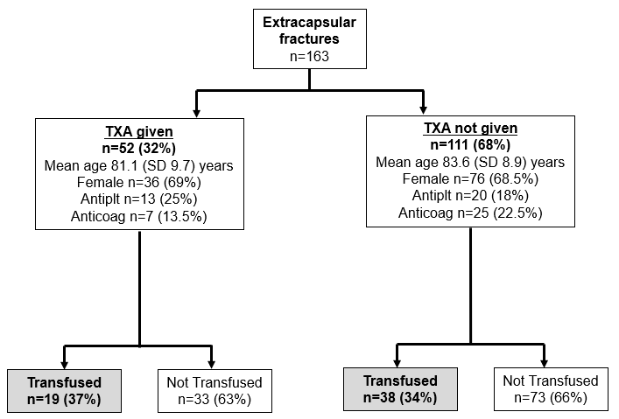
Results – patient flow

Slide 8
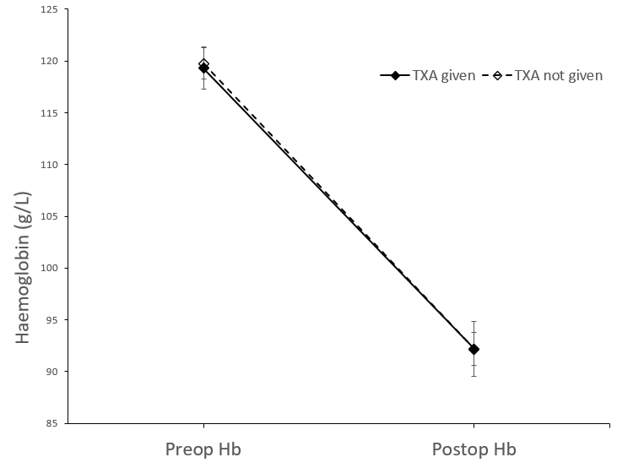
Results – no difference in primary outcome
ΔHb
TXA 27.1 g/L
No TXA 27.6 g/L
p=0.851

Slide 9
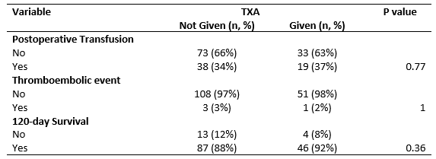
No difference in LOS, transfusion, thromboembolism, or survival

Slide 10
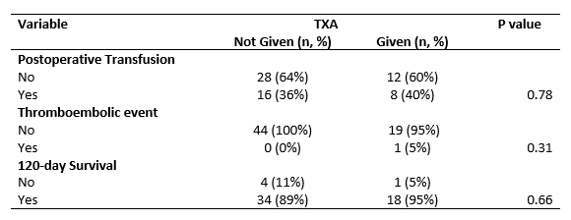
Subgroup Analysis
Antiplatelet or Anticoagulant at admission

Slide 11
Negative Binomial Regression
Outcome: Postoperative Transfusion Units

Slide 12
Conclusions
No evidence to support use of TXA in extracapsular hip fractures to reduce blood loss or blood product use
No effect on length of stay, 120 day mortality, or thromboembolic events

Slide 13
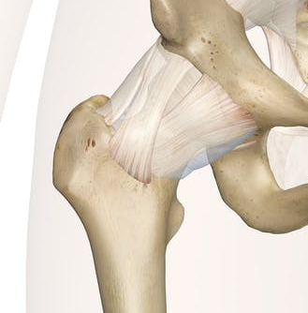
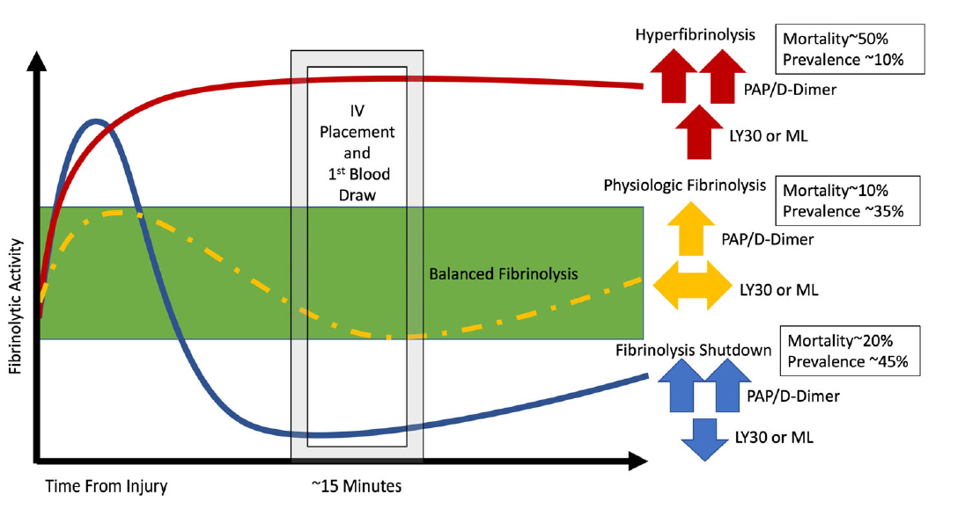
Discussion
Morphology (intracapsular vs extracapsular)
TXA Earlier? ⁽¹⁰⁾
Hyperfibrinolytic versus Hypercoagulable ⁽¹¹⁾
Role of viscoelastic testing ⁽¹²⁾
Precision care vs blanket policies
10. Ma et al., JOSR (2021)
11. Moore et al., JTACS (2014)
12. You et al., CJS (2021)

Slide 14
References
Al-Jeabory M, Szarpak L, Attila K, Simpson M, Smereka A, Gasecka A, Wieczorek W, Pruc M, Koselak M, Gawel W, Checinski I. Efficacy and Safety of Tranexamic Acid in Emergency Trauma: A Systematic Review and Meta-Analysis. Journal of clinical medicine. 2021 Jan;10(5):1030.
Vasichko PE, Ireland KE, Boyd AR, Acosta OM, Ramsey PS. Use of Tranexamic Acid to Prevent Postpartum Hemorrhage in Women Undergoing Cesarean Delivery: A Meta-Analysis [14H]. Obstetrics & Gynecology. 2018 May 1;131:90S.
Fillingham YA, Ramkumar DB, Jevsevar DS, Yates AJ, Shores P, Mullen K, Bini SA, Clarke HD, Schemitsch E, Johnson RL, Memtsoudis SG. The efficacy of tranexamic acid in total hip arthroplasty: a network meta-analysis. The Journal of arthroplasty. 2018 Oct 1;33(10):3083-9.
Zhu J, Zhu Y, Lei P, Zeng M, Su W, Hu Y. Efficacy and safety of tranexamic acid in total hip replacement: a PRISMA-compliant meta-analysis of 25 randomized controlled trials. Medicine. 2017 Dec;96(52).
Xie J, Hu Q, Huang Q, Chen G, Zhou Z, Pei F. Efficacy and safety of tranexamic acid in geriatric hip fracture with hemiarthroplasty: a retrospective cohort study. BMC musculoskeletal disorders. 2019 Dec;20(1):1-9.
Lei J, Zhang B, Cong Y, Zhuang Y, Wei X, Fu Y, Wei W, Wang P, Wen S, Huang H, Wang H. Tranexamic acid reduces hidden blood loss in the treatment of intertrochanteric fractures with PFNA: a single-center randomized controlled trial. Journal of orthopaedic surgery and research. 2017 Dec;12(1):1-6.

Slide 15
References
Zhou XD, Zhang Y, Jiang LF, Zhang JJ, Zhou D, Wu LD, Huang Y, Xu NW. Efficacy and Safety of Tranexamic Acid in Intertrochanteric Fractures: A Single‐Blind Randomized Controlled Trial. Orthopaedic surgery. 2019 Aug;11(4):635-42.
Xing F, Chen W, Long C, Huang F, Wang G, Xiang Z. Postoperative outcomes of tranexamic acid use in geriatric trauma patients treated with proximal femoral intramedullary nails: a systematic review and meta-analysis. Orthopaedics & Traumatology: Surgery & Research. 2020 Feb 1;106(1):117-26.
Yu X, Wang J, Wang X, Xie L, Chen C, Zheng W. The efficacy and safety of tranexamic acid in the treatment of intertrochanteric fracture: an updated meta-analysis of 11 randomized controlled trials. Journal of thrombosis and thrombolysis. 2020 Aug;50(2):243-57.
Ma H, Wang H, Long X, Xu Z, Chen X, Li M, He T, Wang W, Liu L, Liu X. Early intravenous tranexamic acid intervention reduces post-traumatic hidden blood loss in elderly patients with intertrochanteric fracture: a randomized controlled trial. Journal of Orthopaedic Surgery and Research. 2021 Dec;16(1):1-7.
Moore HB, Moore EE, Gonzalez E, Chapman MP, Chin TL, Silliman CC, Banerjee A, Sauaia A. Hyperfibrinolysis, physiologic fibrinolysis, and fibrinolysis shutdown: the spectrum of postinjury fibrinolysis and relevance to antifibrinolytic therapy. The journal of trauma and acute care surgery. 2014 Dec;77(6):811.
You D, Skeith L, Korley R, Cantle P, Lee A, McBeth P, McDonald B, Buckley R, Duffy P, Martin CR, Soo A. Identification of hypercoagulability with thrombelastography in patients with hip fracture receiving thromboprophylaxis. Canadian Journal of Surgery. 2021 Jun;64(3):E324.
..

Slide 16
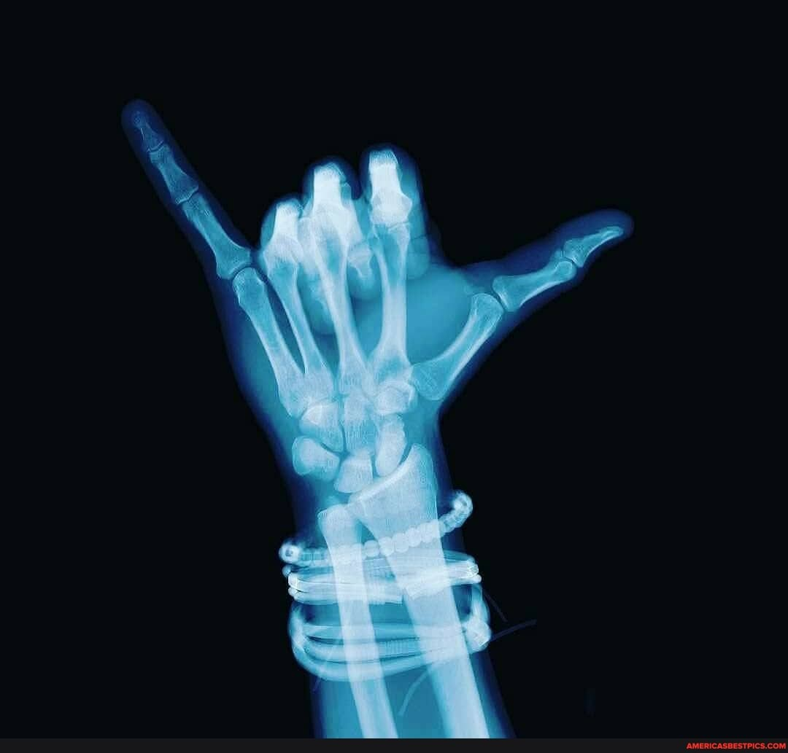
THANK YOU

