Slide 1
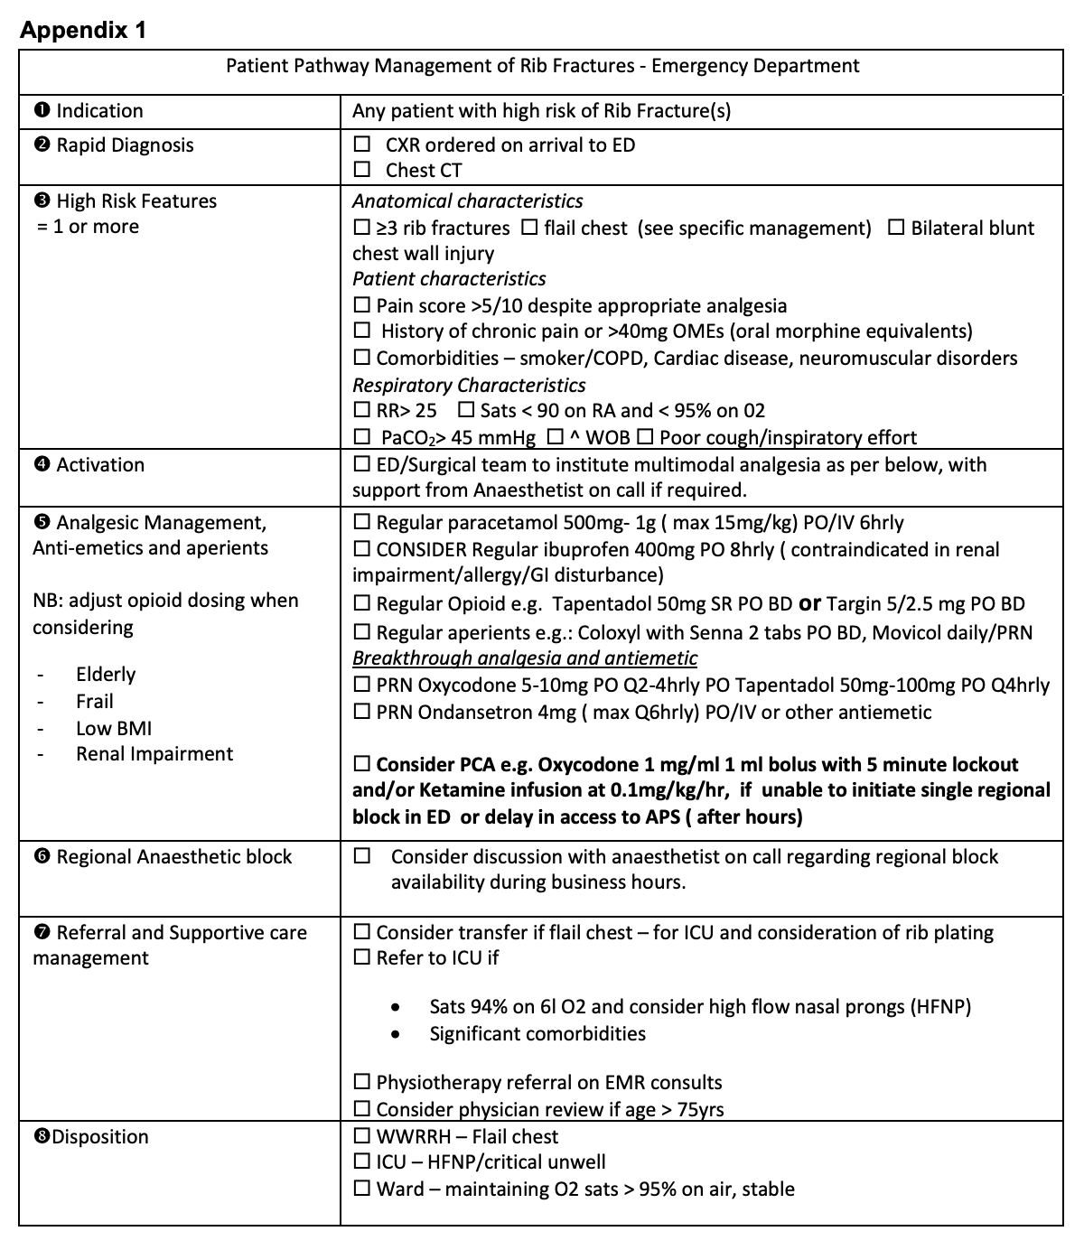

Setting up a Chest Injury Protocol in a Regional Hospital
Chest injury Audit and Protocol
Griffith Base Hospital Chest Injury Protocol
GRIFFITH BASE HOSPITAL CHEST INJURY AUDIT 2020-2021
Review of emergency representations over 12 months following rib fracture diagnosis:
12 patients found to represent
Average age 62.75
75% male
Average no. rib fractures: 2.66
4 patients had background of lung disease
ALL patients represented with chest pain as chief complaint
0 patients received adequate rib fracture pain management
2 patients represented with pneumonia
Pain Management of the 12 patients upon initial presentation:
Regular Paracetamol: 10
Regular NSAID: 3
Regular Opioid 6
Breakthrough Analgesia: 6
Aperients: 3
Physiotherapy: 2 (out of 3 admitted patients)
PRESENTER:
Thomas Warburton
BACKGROUND:
Rib Fractures are:
Common: found in 21% of blunt chest injury patients
From low-level trauma in the elderly
Dangerous: 13% of rib fracture patients suffer pulmonary complications (pneumonia, ARDS, PE, pneumothorax, etc.)
High mortality in severe chest trauma, but also in elderly or comorbid patients
Analgesia and ventilatory support reduce complications and mortality
Chest Injury Protocols (ChIPs) introduced in Australia have been found to reduce the incidence of pneumonia and death
Griffith Base Hospital
119 Bed regional hospital
Emergency department
General surgical department
1 regular specialist anaesthetist, multiple GP anaesthetists
Limited regional anaesthesia capacity
Small ICU staffed by general physicians
Challenges
Limited capacity for regional anaesthesia
Small ICU with limited 24-hour care
No orthopaedic surgery care available
Thomas M Warburton
Eastern and Greater Southern Surgical Skills Training Network
Senior Resident Medical Officer
Notes:
Notes:
In Powerpoint, click View > Guides
Keep text within gutter guides.
Author list: Don’t split names onto two lines (e.g., “Jimmy [break] Smith”). If that happens, use a new line, unless you need the space. Bold the first names of anybody who’s presenting in person.
Intro/methods/result: Do not drop below font size 28, but if you have extra space, jack up the font size until the space is full.
Do not use color in the sidebars except in graphs/figures. It’ll pull attention from the center and slow interpretation for passersby.

