Slide 1

Role of the Medical Referee in the approval of cremations
Prof Mark Ferson & Ms Reannon Johnson
Medical Referee Team
Public Health Unit,
South Eastern Sydney LHD
Feb.2026

Slide 2
Who is a NSW Medical Referee?
In accordance with the Public Health Regulation 2022, a medical referee is a medical practitioner, with appropriate AHPRA registration, specifically appointed by the Secretary of the NSW Ministry of Health to issue Cremation Permits.
In addition, medical practitioners in these specific roles may issue a Cremation Permit:
  a public health officer (in charge of a public health unit)
  a medical superintendent (or director of medical/clinical services) of a public hospital

Slide 3
What is the role of a Medical Referee?
The key task is to issue (or decline to issue) a Medical Referee’s Cremation Permit
First review the
  Application for Permission for Cremation, AND
  Medical Certificate of Cause of Death
Ensure information provided is consistent
Consider if there is a need to make an external examination of the body

Slide 4
Before signing a cremation permit
Be certain of the identity of the deceased
Be certain that the deceased died of natural causes
Be satisfied that the deceased left no written objection to cremation
In the case of an application for a stillborn baby, verify that the deceased was stillborn,
i.e. it did not die after being born

Slide 5
Medical Referee must be independent
If you
  completed the death certificate or cremation risk advice in respect of the deceased, OR
  are a close relative of the deceased person, OR
  provided medical treatment or care to the deceased in the previous 6 months, OR
  have a pecuniary interest in the death of the deceased
you MUST decline and ask the funeral director to allocate another medical referee

Slide 6
Other reasons for declining
Reason for declining | Remedy
The identity of the body is unclear or incorrect | Decline until the deceased’s identity is verified and documents corrected
Incorrect or incomplete application for permission for cremation, including that the applicant’s identity is unclear | Inform the funeral director that the forms must be correctly completed before you can issue the Cremation Permit
A medical certificate of cause of death is missing, incomplete, illegible or incorrect | Request the funeral director to obtain a correctly completed medical certificate of cause of death from the issuing doctor
The deceased has left a written note that their body is NOT to be cremated | Decline. The cremation MUST NOT take place
Death was due to violent or unnatural causes | Decline. Refer the matter to the coroner
There are suspicious circumstances surrounding the death | Decline. Refer the matter to the coroner

Slide 7
Your step-by-step guide to completing the Cremation Permit (Other than Stillborn Children)

Slide 8
Step ❶: review the Application for Cremation and the Certificate of Cause of Death
Ensure the identity of the body is correct, the cause of death is clear and that Coronial review is not required
If you are uncertain about any of these points, DO NOT sign the Cremation Permit and inform the funeral director
Carefully check that Q2(a) on the Application says YES or NO
  If YES, then 2(b) MUST state that the deceased wished to be cremated
If the deceased left written direction that he/she NOT be cremated, then by law, you must NOT sign the cremation permit
If you feel you are being asked to sign the permit contrary to the deceased’s written direction, please contact the Medical Referee Team at the South Eastern Sydney Public Health Unit for advice:
  e: SESLHD-PHU-MedicalRefereeTeam@health.nsw.gov.au
  t: 02 9382 8333 option 5

Slide 9
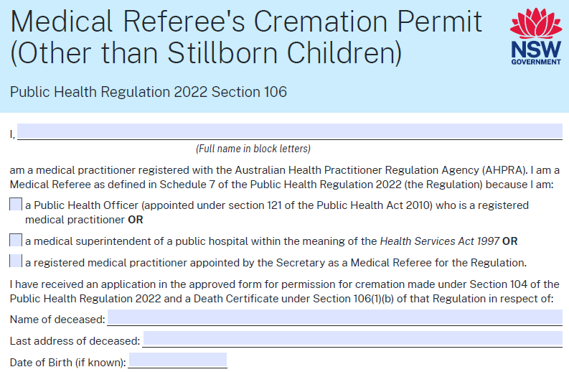
Step ❷: your and the deceased’s details
In the first half of the Cremation Permit, complete:
  your own details, including whether you are a NSW Medical Referee by appointment OR by virtue of your public office
  the name, last known address and date of birth of the deceased

Slide 10
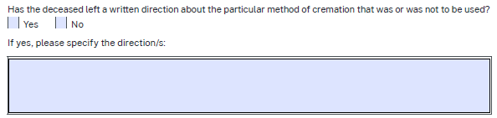
Step ❸: the deceased’s direction regarding the method of cremation
Check with the funeral director if
  the deceased left a written direction stating he/she did not wish to be cremated. If so, by law, you MUST NOT sign the permit
  The deceased left a written direction about a particular method of cremation. Complete this section accordingly:

Slide 11
Step ❹: do you need to examine the body?
Do not accept the funeral director’s request to sign the Permit unless you are able to examine the body if, after reviewing the documents, you feel that it is necessary
NOTE: this examination cannot be carried out by another person on your behalf
If indicated, you should make an external examination
of the body before you sign the Cremation Permit
If your examination of the body raises concerns, DO NOT sign, but seek advice first
If you intend to sign the Cremation Permit, circle the appropriate words in the statement on the Permit
‘I have/have not made an external examination …’

Slide 12
Step ❺: your certification
By signing the Cremation Permit you are giving your professional opinion that
  You are independent of the deceased, and
  You are satisfied that the Application for Permission for Cremation and Medical Certificate of Cause of Death are correct, and
  You see no reason why the deceased should not be cremated.

Slide 13
For how long am I appointed?
The term of appointment has no limit as long as FULL medical registration is current
PLEASE inform us of any change in practice location or in your contact details
And BE AWARE that having conditions placed on
your registration by the NSW Medical Council will prompt a review of the appointment, especially if:
  the Council has concerns about poor record keeping
  there is a requirement for close supervision
If you are uncertain, please contact us

Slide 14
For further information
The Medical Referees website
www.seslhd.health.nsw.gov.au/services-clinics/directory/public-health/medical-referees
Final arrangements of the deceased (NSW Health)
https://www.health.nsw.gov.au/environment/dotd/Pages/default.aspx
Our contact details
  t: (02) 9382 8333 option 5 (business hours only)
  e: SESLHD-PHU-MedicalRefereeTeam@health.nsw.gov.au

Slide 15
Feedback or Questions
If you have any suggestions about this
presentation or questions about the process
of issuing a Cremation Permit, please don’t
hesitate to contact the Medical Referee Team
e: SESLHD-PHU-MedicalRefereeTeam@health.nsw.gov.au
or
t: (02) 9382 8333 (option 5)
during business hours

